Slide 1
Professional Growth and Effectiveness System (PGES) Rubric
The What, The Why, & The How
March 2014
ISLN

Slide 2
Today’s Targets
Deepen our understanding of PGES Implementation Rubric
Practice using the rubric to support district implementation

Slide 3
What is the PGES Implementation Rubric?
A resource designed for district leaders to help districts create a robust PGES by-
guiding self-assessment about PPGES and the TPGES implementation across the district
providing definitions and evidence of strong and weak implementation
informing and guiding plans for next steps
Notes:
This resource was developed by the U.S. Education Delivery Institute team support KY in implementation of the PGES. It was developed as a direct response to feedback from districts asking what infrastructure to put in place.
It will impact rollout and the sustainability of your implementation of the PGES is your district, as well as the defensibility of your system.

Slide 4
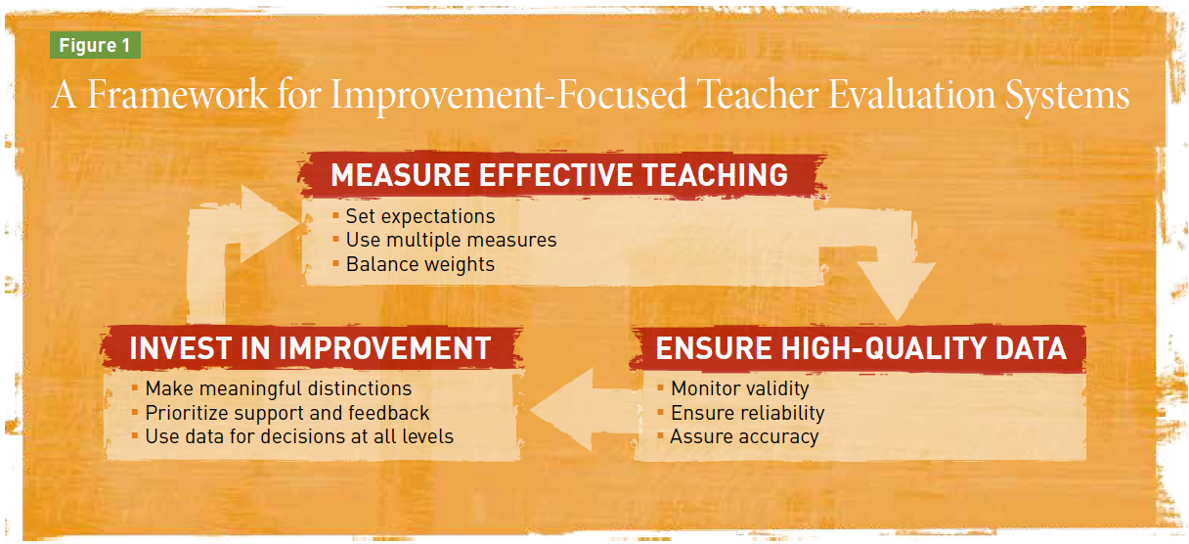
Incorporates -
the Measures of Effective Teaching (MET) principles
Integrates -
KDE’s Capacity Framework
human organizational
material structural
Notes:
This resource is based on the 9 principles from the Measure of Effective Teaching study by the Gates Foundation, and embeds the 4 capacities in KDE’s Capacity Framework throughout the rubric.
MET developed the nine guiding principles to help states & districts implement improvement-focused evaluation systems.

Slide 5
Human Capacity:
Will and Skill
Structural Capacity:
Procedures and Policies
Organizational Capacity:
Collaboration, Communication and Interaction
Material Capacity:
Fiscal and Physical
KDE Capacity Framework
Notes:
This is just a reminder about the what’s included in each of the capacities we used in Feb. to reflect on student growth implementation in your districts.
These capacities in the PGES rubric push us to think about “what”, “how” and “how well.”
The “Questions to Consider” in the Rubric also are aligned with the four capacities.

Slide 6
* to provide consistency of implementation across the state * to communicate priorities to stakeholders * to help districts go beyond technical implementation to the system structure that must be in place for effective PGES implementation * to take the conversation to the needed system shifts – (building on what’s in place or what can be refined)
Notes:
The PGES Implementation Rubric:
Is a tool designed to provide consistency of implementation across the state.
Is a guidance document to communicate priorities to stakeholders.
Supports a facilitated process (using the tool) that will help districts go beyond technical implementation (essentially what you have in CEP) to the system structure that must be in place for effective implementation.
Takes the conversation to the system shifts that have to take place – considering what structures and systems are already in place and what is still needed (building on what’s in place or what can be refined).
Is based on the expectation that all districts must get to strong implementation.

Slide 7
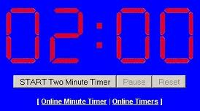
Take 2 minutes…
What do you notice about the format/organization of the Implementation Rubric?
Notes:
Let’s take a couple of minutes to look at the format and organization of the rubric. Be prepared to share what you notice.

Slide 8
Rubric Format
Includes an overall guiding question for each section of the rubric/tool
Includes icons connected to the 4 capacities with the guiding questions
Identifies criteria for weak and strong implementation
Includes evidence that indicates strong implementation
Notes:
Includes an overall guiding question for each section of the rubric/tool:
MEASURE EFFECTIVE TEACHING,
ENSURE HIGH QUALITY DATA,
INVEST IN IMPROVEMENT
Includes guiding questions (with icons connected to the 4 capacities)
Identifies criteria for weak and strong implementation (Strong is the ultimate implementation standard for all districts)
Includes evidence that indicates strong implementation

Slide 9
Feedback from Fayette Co.
Notes:
5 min.
Before you get started trying out the PGES Implementation Rubric, let’s hear from a member of the Fayette Co. leadership team. In late Nov./early Dec. Jefferson and Fayette counties piloted this rubric, facilitated by the EDI team. Fayette had their most recent work session yesterday. They’ve graciously agreed to share with you their perception of the impact of using this tool and process.

Slide 10
Notes:
Now, it’s your time to take a closer look at one category the tool and think/talk about where you see your district right now.

Slide 11
Read and Reflect
Review #6 - Assure Accuracy
Independently, read and reflect on the questions, the weak & strong criteria and the evidence of success
Decide where your district is currently on a scale of 1-4 and record it on a common, shared form.
Notes:
5 min.
Under the “Ensure High Quality Data” category, let’s look at Assure Accuracy - To what extent does your evaluation process accurately measure effective teaching?
Individually, review the rubric for number 6 (page 13) and come to a judgment on a scale of 1 to 4/weak to strong as to the district’s current status in that area.

Slide 12
Discuss your decisions, recording your district’s individual evidence on 1 form.
Discuss the evidence and come to consensus.
Use the evidence to identify any specific areas of strength and weakness and implications for next steps.
Notes:
5-7 min.
Record the rationale (the evidence) for your individual choices on the handout, then discuss the evidence and come to consensus about your district’s current status for # 6.
Use the evidence to identify specific strong or weak areas and the implications for next steps.
What next? Contact your PGES consultant, Mike Cassady, or your effectiveness coach, Becky Woosley to facilitate this process with your district leadership team.

Slide 13
PGES
Notes:
There are several PGES support resources available to you on the KDE web site. There two we want tell you about this morning.
The first is the new Student Growth site, where you can now find all the most current Student Growth resource links on one page.

Slide 14
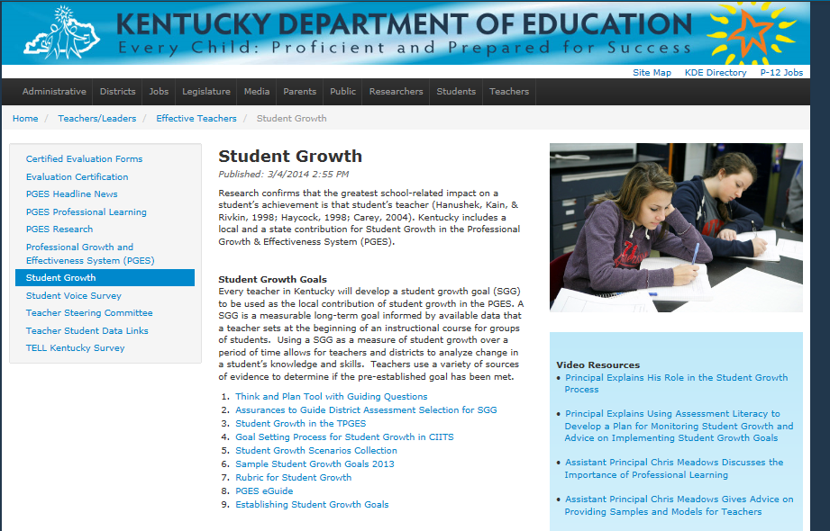
http://education.ky.gov/teachers/HiEffTeach/Pages/Student-Growth.aspx
Notes:
Share with participants KDE’s new page devoted to Student Growth. Walk participants through the page and emphasize important resources.

Slide 15
Enduring Skills Resources:
PowerPoint of process with notes and facilitator’s guide
Sample lists of enduring skills for many content areas
Archived Enduring Skills Process Lync session
Available on Student Growth web page
Notes:
When we looked at the Student Growth goal-setting process back in the fall, you will recall that the critical foundation for quality student growth goals is the enduring skill. Some of you have already begun this process in your PLCs.
A process for leading teachers so they can accurately and collaboratively identify enduring skills is being posted on the Student Growth web page, along with sample initial lists from several content areas. The lists are not finished products, but are intended to give teachers District leaders can use this process, or use it to build the capacity of some of your teacher leaders, so content teams can identify lists of enduring skills that can be shared across content and across schools in your district.

Slide 16
Support Resources
How can you use the SGG resources to support your districts?
Notes:
Time for conversations about how staff will use these in network meetings and in working with districts.

Slide 17
Observation Window 4
CLOSES APRIL 30
MARCH 1- APRIL 30
Window
Notes:
Principals can add 2 observations in one window – making up for the loss of time due to adverse weather. It is important that all observations are entered because KDE needs to capture the observation data.

Slide 18
If you have questions as you take your next PGES implementation steps, contact your PGES consultant, Mike Cassady or Becky Woosley, effectiveness coach.
Notes:
You tried out a mini-version of the process, but if your district leadership would like to have KDE support facilitating the process as your team thinks through the implementation rubric, contact your PGES consultant, Mike Cassady, or Becky Woosley, effectiveness coach.

