Slide 1


CKEC Instructional Support Leadership Network
February 20th, 2014
Today’s materials can be accessed at:
http://www.debbiewaggoner.com/
feb-2014-isln.html

Slide 2
CKEC ISLN Facilitation Team
Debbie Waggoner, KDE/CKEC Instructional Specialist – Math & Social Studies Emphasis
Mike Cassady, PGES Consultant CKEC/KDE
Terry Rhodes, KDE/CKEC Instructional Specialist – Science Emphasis
Kelly Philbeck, KDE Literacy/LDC
Rebecca Woosley, Effectiveness Coach, KDE

Slide 3






















Learning
Teaching
Enhancing
Supporting
Sharing
Burgin Independent School
Over 100 years of Excellence

Slide 4

Norms
Be an ambassador of “lifelong learning.” Show your enthusiasm for the work, support the learning of others, be willing to take risks, participate fully.
Come to meetings prepared. Be on time, any preparations/ readings completed, with necessary materials.
Be focused during meetings. Stick to network goals/ targets, use technology to enhance work at hand, limit sidebar conversations.
Work collaboratively. All members’ contributions are valued and honored, seek first to understand, then be understood.

Slide 5
ISLN Meeting
IMPORTANT NOTES
PINK Sheet
What do I want to remember? | How will I use this information, and how will I share it with others in my district?
Also don’t forget your
YELLOW Evaluation sheet
We Need your FEEDBACK!
Notes:
As always, we have your reflection sheet for you to record your thoughts and ideas throughout the meeting.
(Read Reflection questions)

Slide 6
Today’s Agenda
CKEC ISLN February 20th, 2014 Agenda
Introduction –Learning Forward Modules
Concurrent Sessions:
  --Balanced Assessment in Science – Terry Rhodes
  --Social Studies Network Preview – Debbie Waggoner
  --District Planning for Student Growth – Rebecca Woosley & Mike Cassidy
Closure – Planning for Full Scale Implementation – Where is your district in implementation of CHETL? IC Map
Inside Cover

Slide 7

Pillars again
Highly Effective Teaching and learning
Pillars of Network Meetings
Network Foundations….
Kentucky’s Core Academic Standards
Assessment Literacy
Leadership
TPGES –Teacher Professional Growth and Effectiveness System

Slide 8
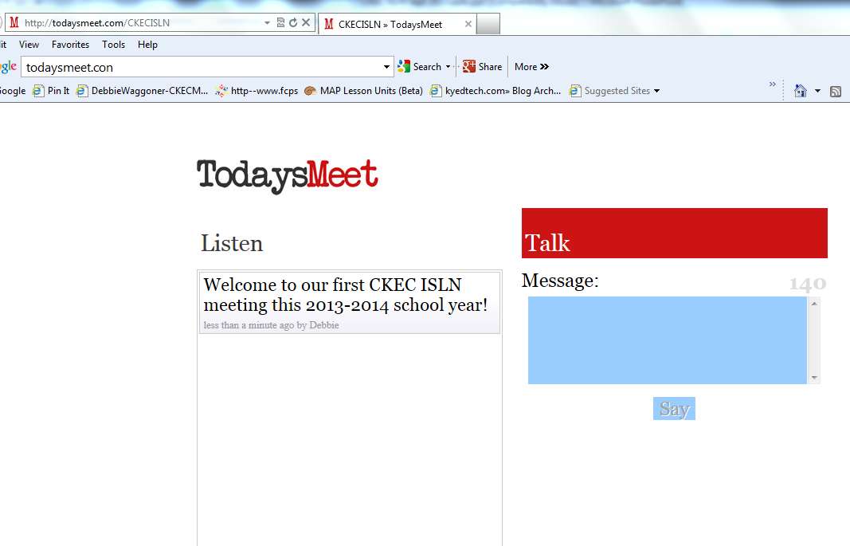
www.todaysmeet.com/CKECISLN

Slide 9
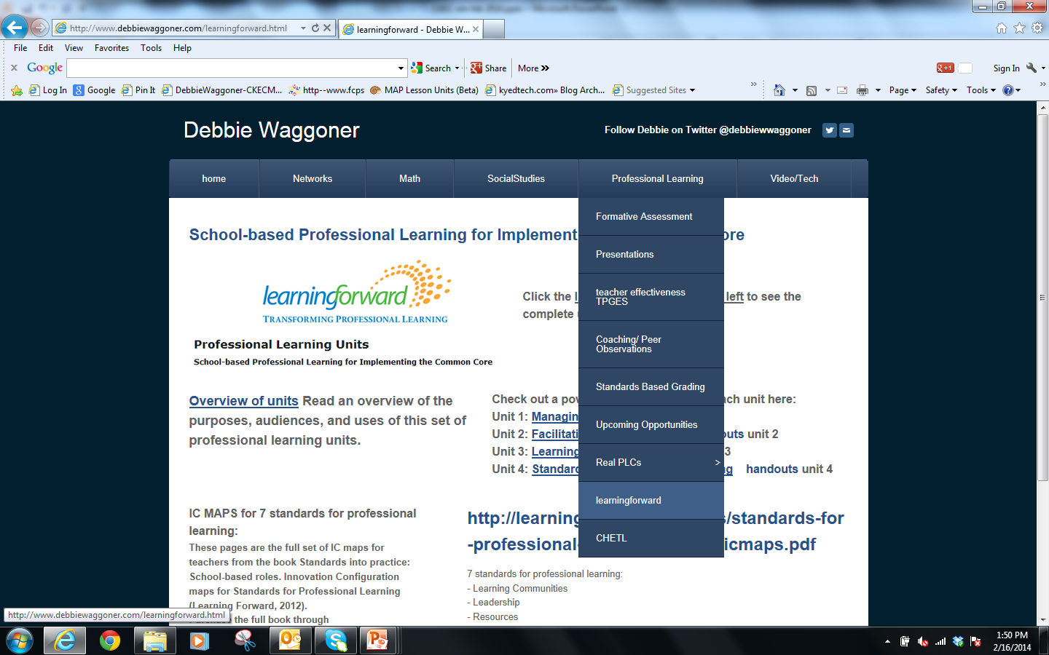

Slide 10
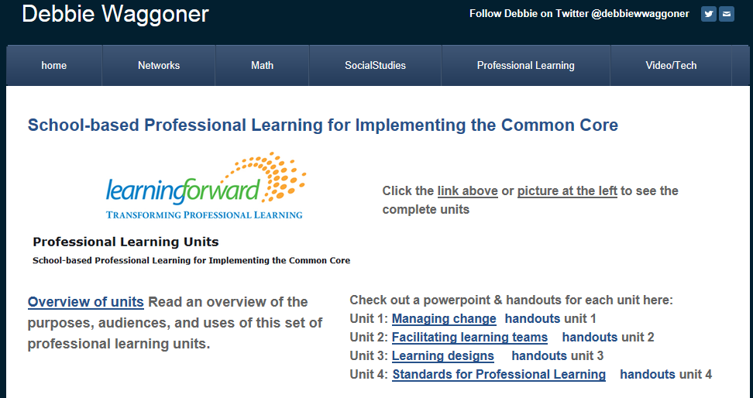
http://learningforward.org/publications/implementing-common-core/professional-learning-units

Slide 11

Packet page 2

Slide 12
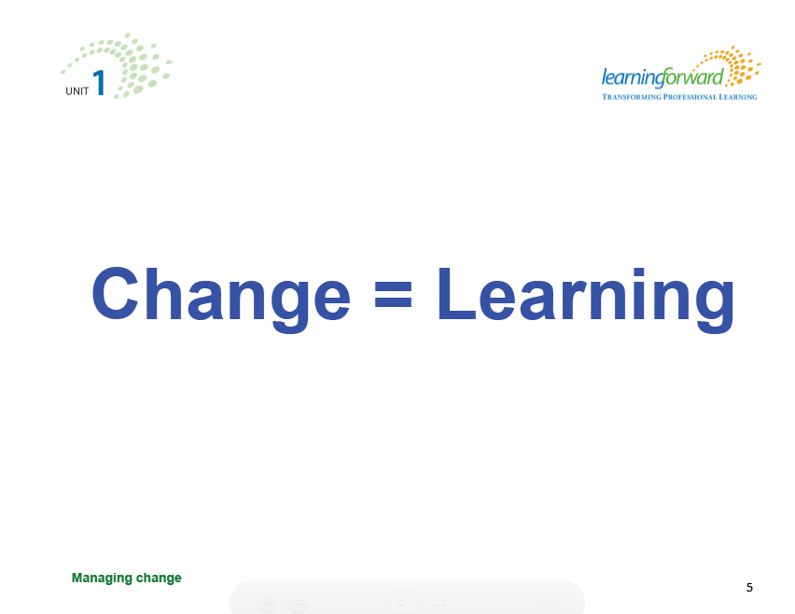
The only thing Permanent in LIFE
is Change… ~Heraclitus

Slide 13
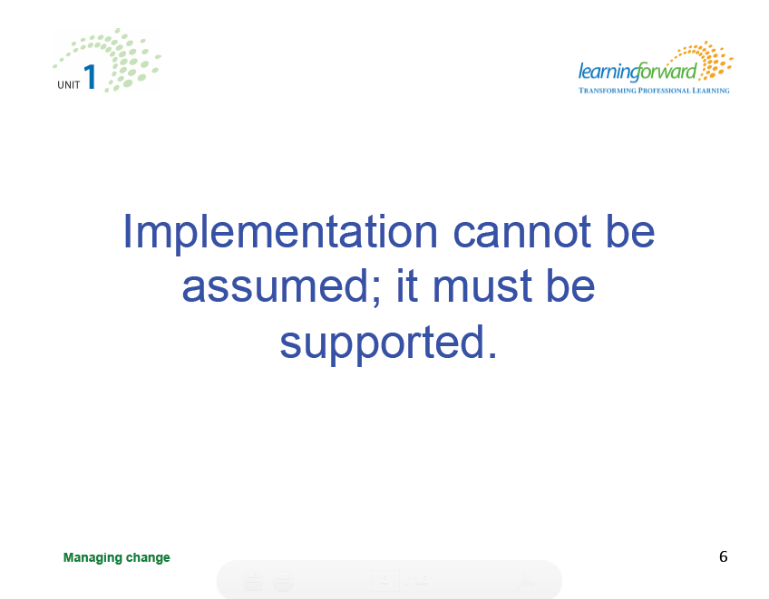

Slide 14
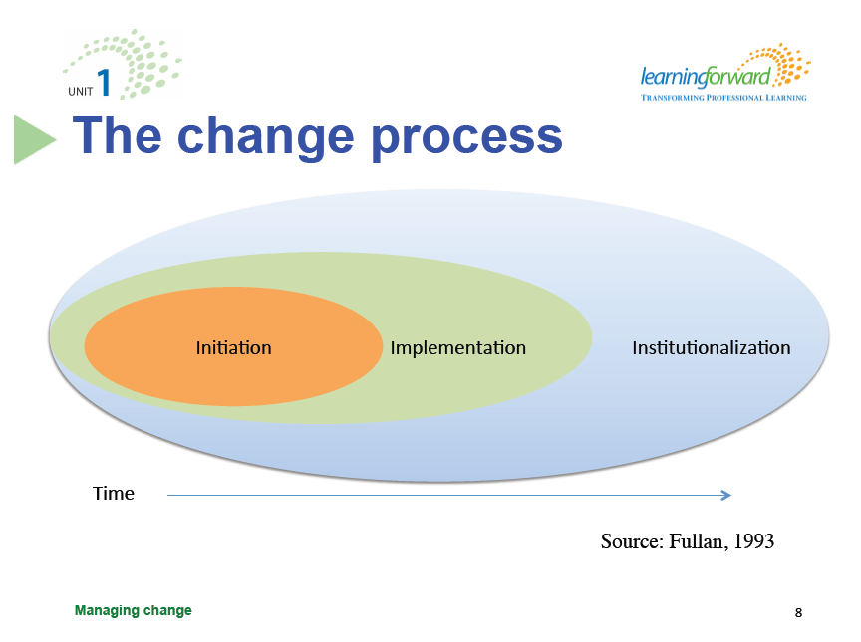
How many “programs” have you initiated without
full implementation much less institutionalization?

Slide 15
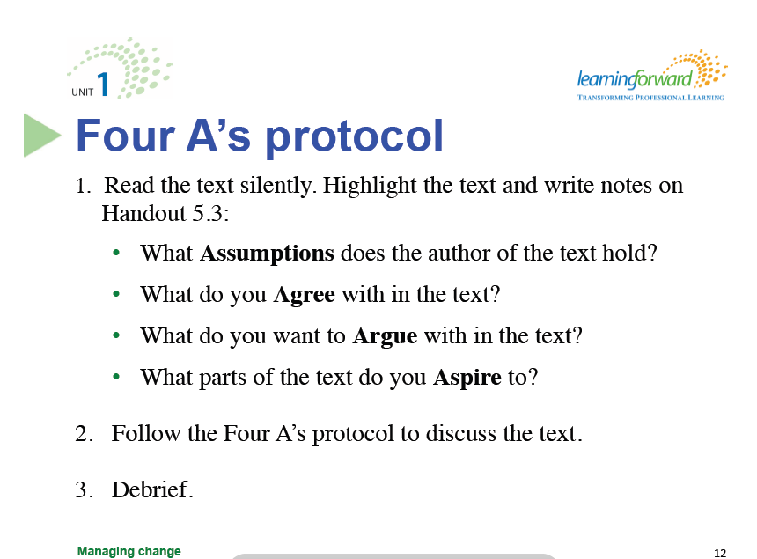
Four A’s protocol note taking form on page 7
Have each person share one thing you either agree with or want to argue with, and one thing you aspire to….
Packet pages 3-7

Slide 16
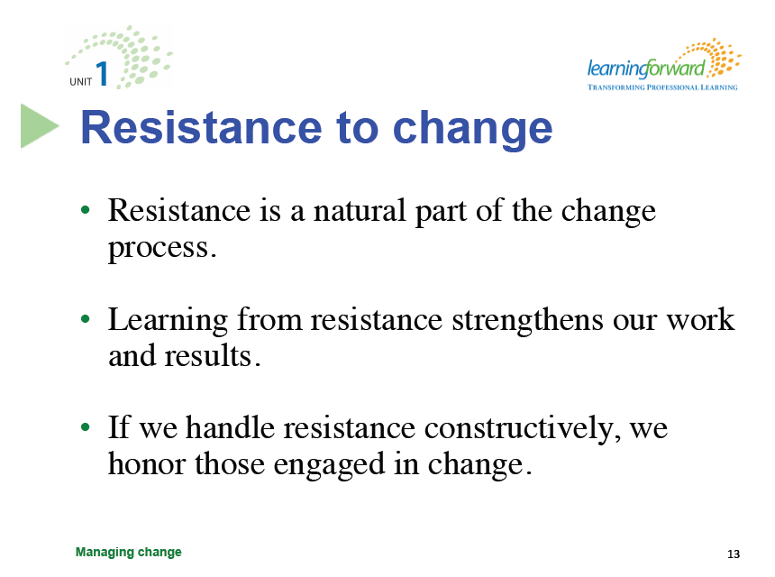
Packet page 8

Slide 17
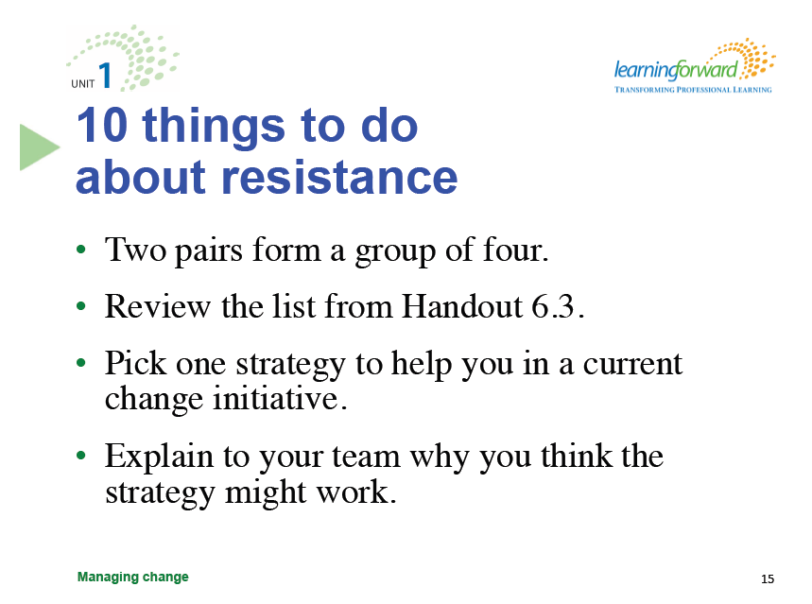

Packet page 8

Slide 18

Packet page 9

Slide 19
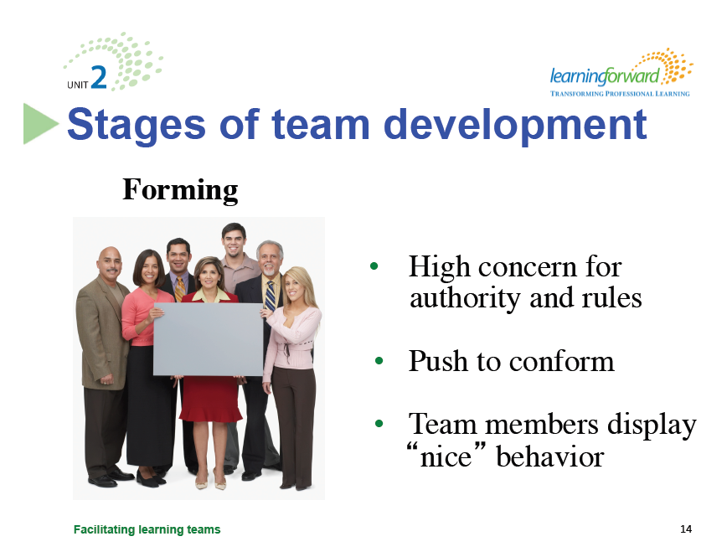
Packet page 10

Slide 20
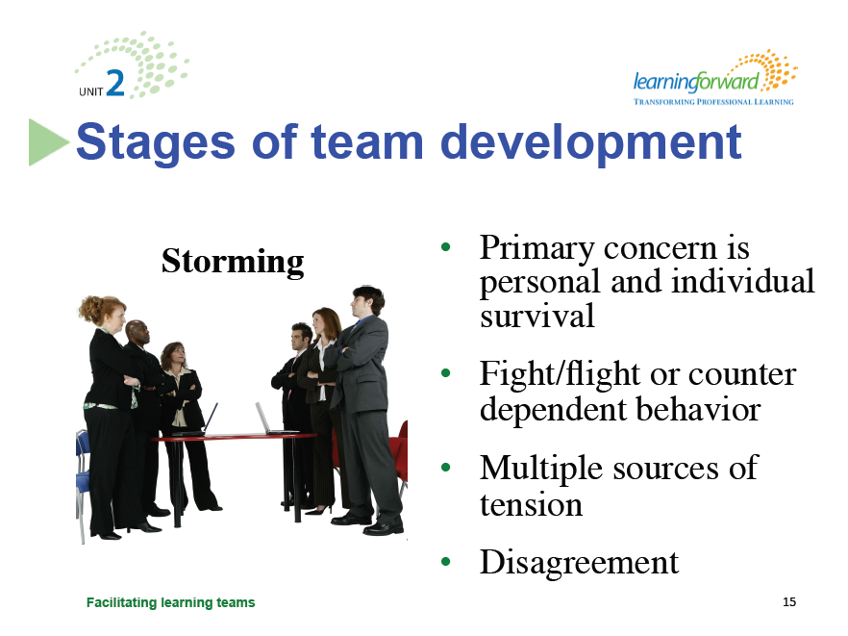
Packet page 10

Slide 21
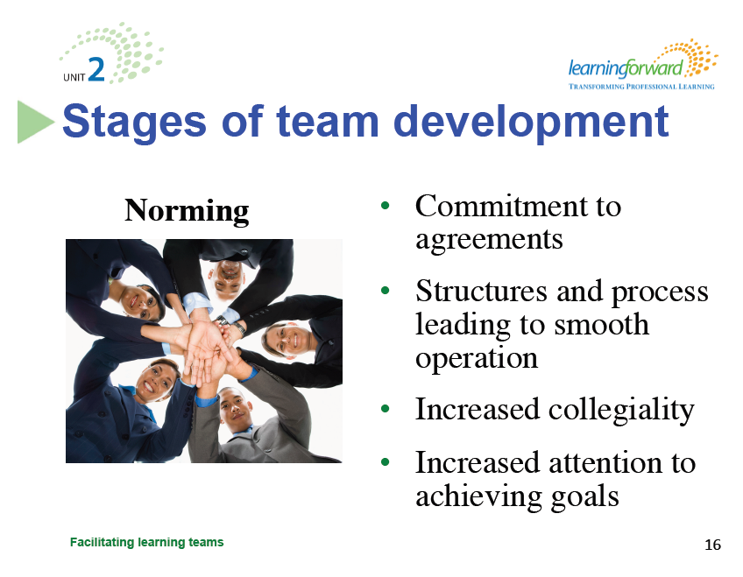
Packet page 10

Slide 22
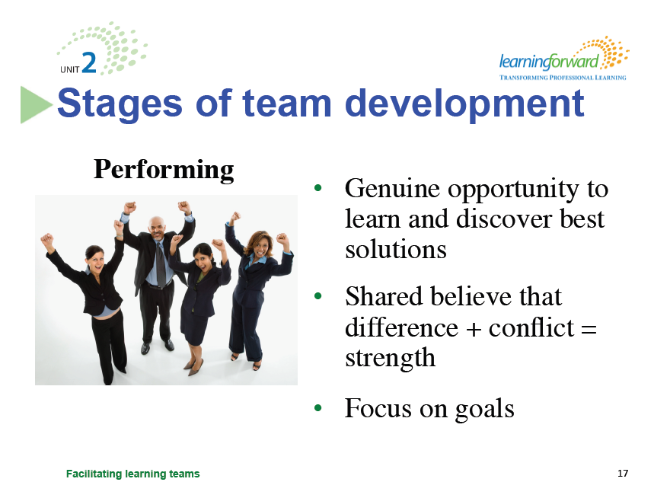
Packet page 10

Slide 23
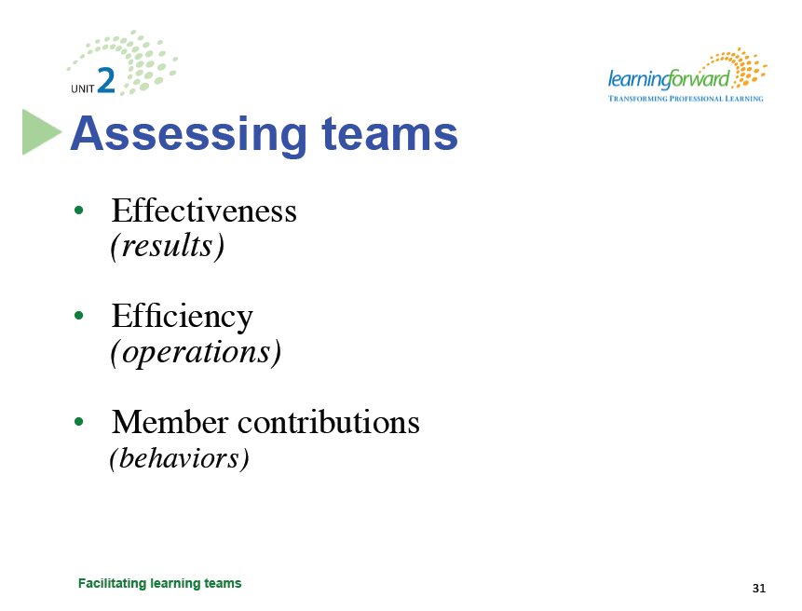
Tools to Explore:
-Teamwork Questionnaire pgs11-13
-Team Meetings Survey Tool pg14
-Rate Yourself as a Team Player pg15
-Protocol to Discuss Survey results pg16
-Learning Teams Survey pgs17-18

Slide 24
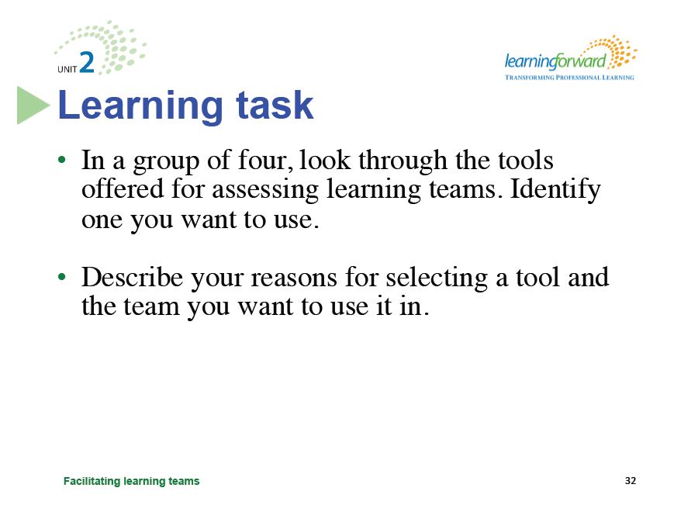
Packet pages 11-18

Slide 25

Packet page 19

Slide 26
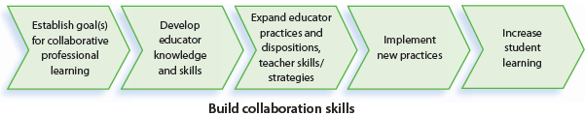
Directions: Use all five pieces,
put them in order of implementation.
“Answers” on Packet page 30

Slide 27
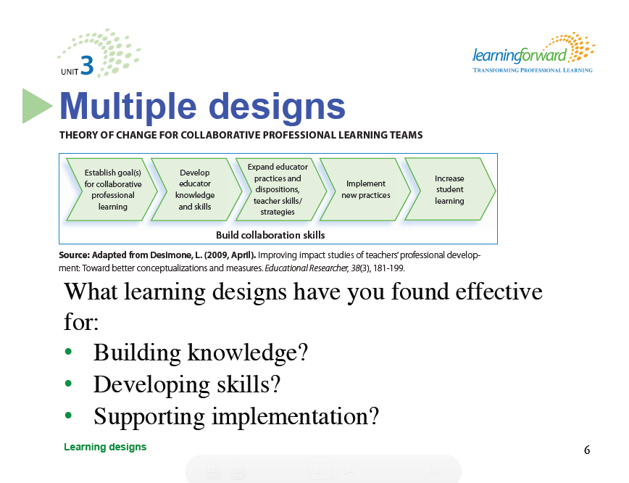
Packet pages 30-31

Slide 28
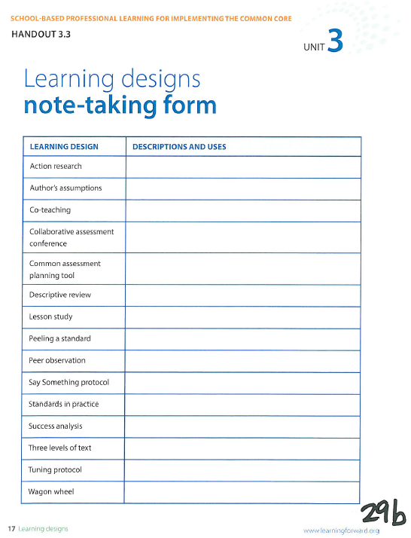
Packet page 29b
1
2
3
4
5
6
7
8
9
10
11
12
13
14
15
Number the
Learning
Designs from
1 to 15
Record one way
you might use each
learning design as
your group shares
each design
on the list.

Slide 29
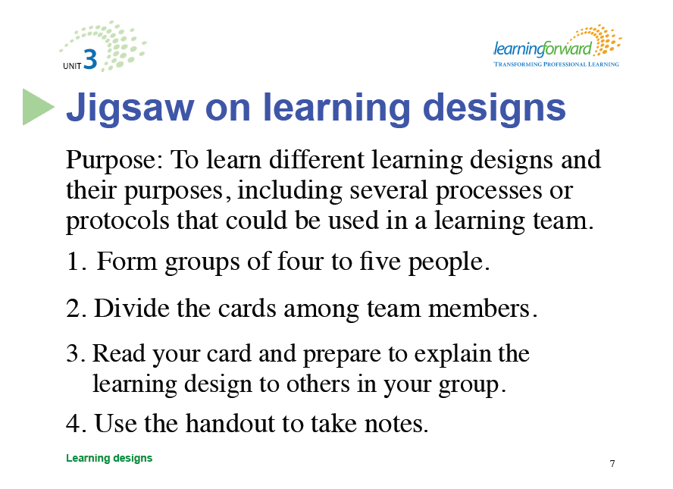
Packet pages 20-29

Slide 30

Packet page 32

Slide 31
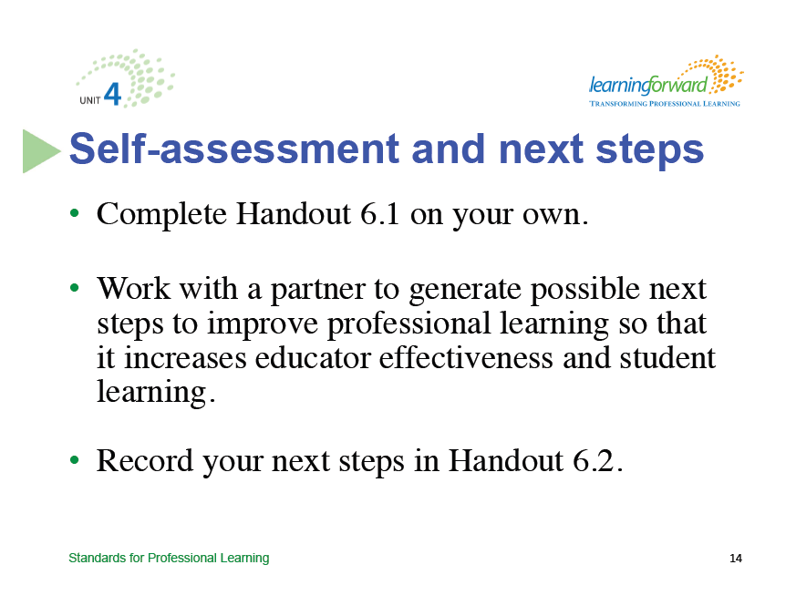
What are your strengths and weaknesses?
Packet pages 33-35

Slide 32
http://learningforward.org/publications/implementing-common-core/professional-learning-units

Slide 33
Concurrent Sessions
DISTRICTS | Session 1 | Session 2 | Session 3
A-F | Side Hallway Planning for Student Growth | Main Room Social Studies Network Update | Front Room Science Balanced Assessment
G-O | Main Room Social Studies Network Update | Front Room Science Balanced Assessment | Side Hallway Planning for Student Growth
P-Z | Front Room Science Balanced Assessment | Side Hallway Planning for Student Growth | Main Room Social Studies Network Update

Slide 34

Science Balanced Assessment
CKEC Science Content Network Meetings
Monday, January 27th, 2014
Monday February 24th, 2014
Monday, March 24th, 2014
Monday, April 28th , 2014
Terry Rhodes KDE/CKEC
terry.rhodes@education.ky.gov
www.terryrhodes1science.com

Slide 35
Clear Purpose: Assessment for and of Learning:
A Balanced Assessment System
“If we can do something with assessment information beyond using it to figure grades, we can improve learning”
Classroom Assessment for Student Learning

Slide 36
Learning Targets
How formative and summative assessment fit into a balanced assessment system
Major differences between formative and summative assessment
What the Seven Strategies of Assessment for Learning are and how they connect to research on formative assessment

Slide 37

Keys to Quality Classroom Assessment

Slide 38

Key 1:Clear Purpose
Who will use the information?
How will they use it?
What in formation, in what detail, is required?

Slide 39
Key 2: Clear Targets
Are learning targets clear to teachers?
What kinds of achievements are to be assessed?
Are these learning targets the focus of instruction?

Slide 40
Key 3: Sound Design
Do assessment methods match learning targets?
Does the sample represent learning appropriately?
Are items, tasks, and scoring rubrics of high quality?
Does the assessment control for bias?

Slide 41
Key 4: Effective Communication
Can assessment results be used to guide instruction?
Do formative assessments function as effective feedback?
Is achievement tracked by learning target and reported by standard?
Do grades communicate achievement accurately?

Slide 42
Key 5: Student Involvement
Do assessment practices meet students’ information needs?
Are learning targets clear to students?
Will the assessment yield information that students can use to self-assess and set goals?
Are students tracking and communicating their evolving learning?

Slide 43
Key 1:Clear Purpose
Who uses assessment information?

Slide 44
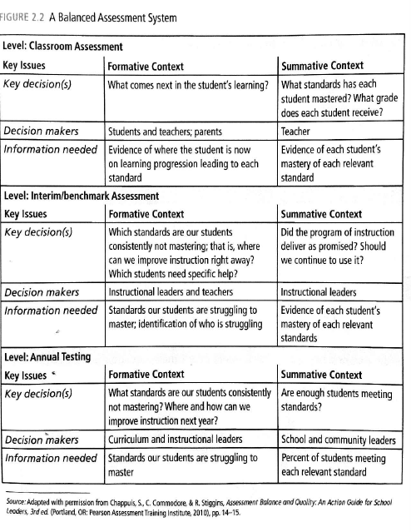
At the classroom level, what role should assessments play in planning instruction and certifying student learning?

Slide 45
Would you agree that at the district level, even formative assessments are often used only summatively? If so, what is formative about it?

Slide 46
In a balanced assessment system, the key players’ formative and summative information needs are identified and assessments are planned to meet their needs.

Slide 48
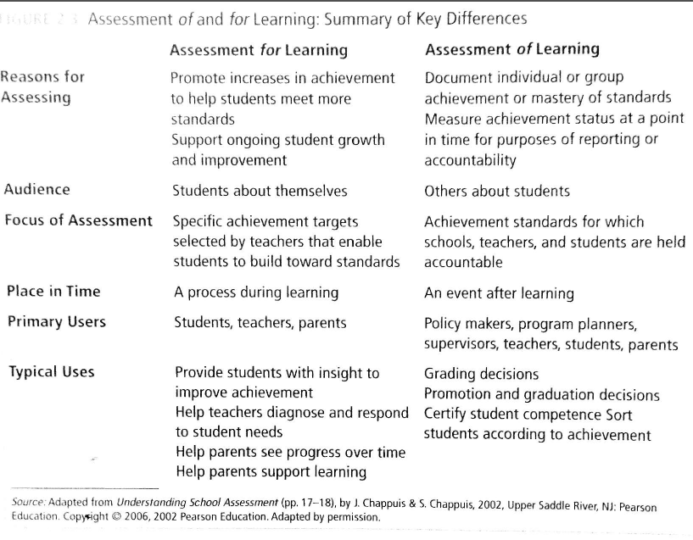
Formative Assessment: formal and informal processes teachers and students use to gather evidence for the purpose of improving learning; assessment for learning
Summative Assessment: assessment information used to provide evidence of student achievement for the purpose of making a judgment about student competence or program effectiveness; assessment of learning.

Slide 49
Why is the distinction important?
Understanding the distinction is pivotal to realizing gains in student achievement.
The gains attributed to formative assessment will not materialize unless certain conditions are met, among them
      Alignment to standards to be learned
      Alignment to what is being taught
      Pinpoints specific information so that teachers can make decisions
      Results available in time to take action
      Action is indeed taken based on results

Slide 50
Seven Strategies of Assessment for Learning
Structured around three formative assessment questions:
Where am I going?
Where am I now?
How can I close the gap?
Each group will take one strategy
Discuss and come to consensus on a summary and which of the 3 formative assessment questions are addressed
Share out

Slide 51
Assessment for learning can have a powerful impact on student achievement if carried out thoughtfully by
Enabling them to take control of their own learning by providing a clear vision of their targets
Teaching them to assess where they are in respect to the target
Offering strategies they can use to close the gap between where they are and where they need to be.

Slide 52
Concurrent Sessions
DISTRICTS | Session 1 | Session 2 | Session 3
A-F | Side Hallway Planning for Student Growth | Main Room Social Studies Network Update | Front Room Science Balanced Assessment
G-O | Main Room Social Studies Network Update | Front Room Science Balanced Assessment | Side Hallway Planning for Student Growth
P-Z | Front Room Science Balanced Assessment | Side Hallway Planning for Student Growth | Main Room Social Studies Network Update

Slide 53


CKEC Social Studies Content Network Meetings
Tuesday, January 28th, 2014
Thursday, February 27th, 2014
Tuesday, March 25th, 2014
Tuesday, April 22nd, 2014
*LA County Office of Education C3 Webcast
*Dr. Kathy Swan's "Achieving the C3: An exploration into 21st century social studies"
Packet pages 36-54
    Debbie Waggoner KDE/CKEC
    debbie.waggoner@education.ky.gov
    www.debbiewaggoner.com

Slide 54

Packet page 36

Slide 55
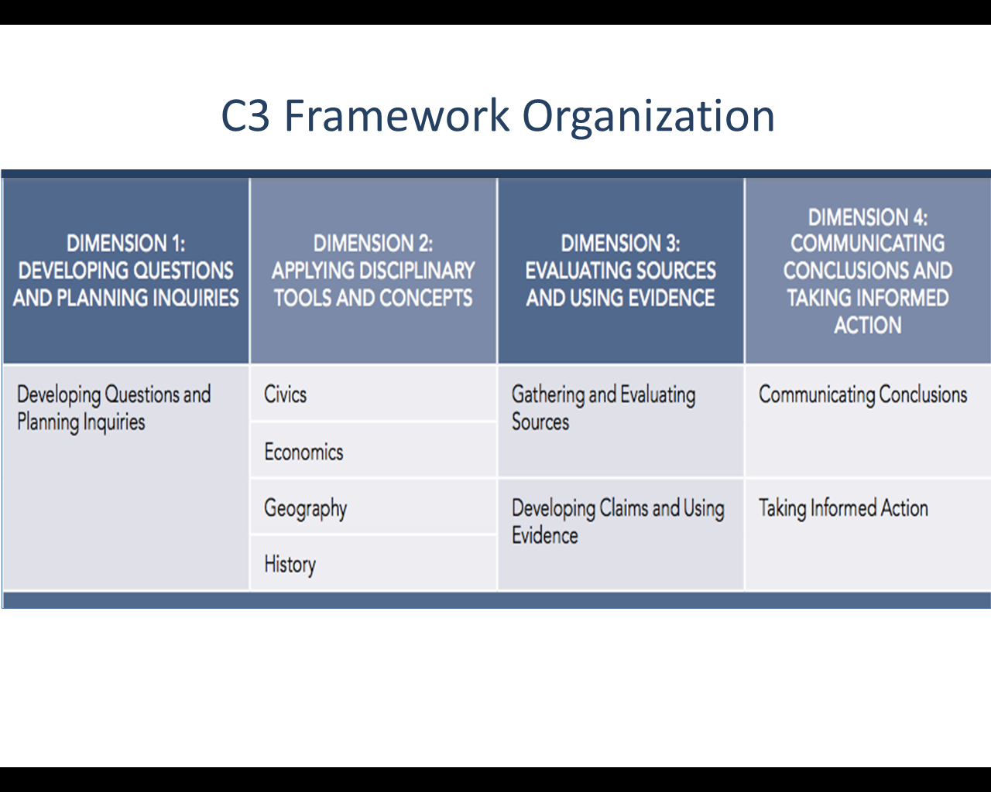













Packet page 36

Slide 56
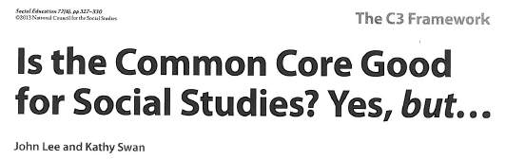

Packet pages 37-40

Slide 57
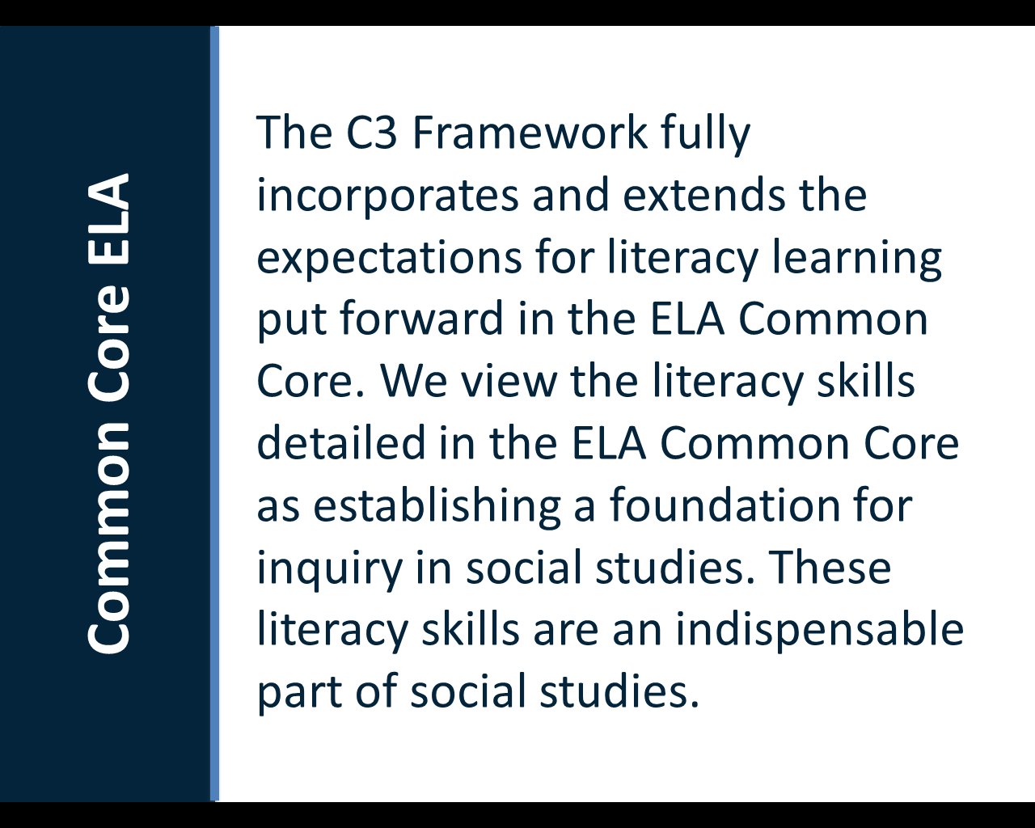
Packet pages 37-40

Slide 58
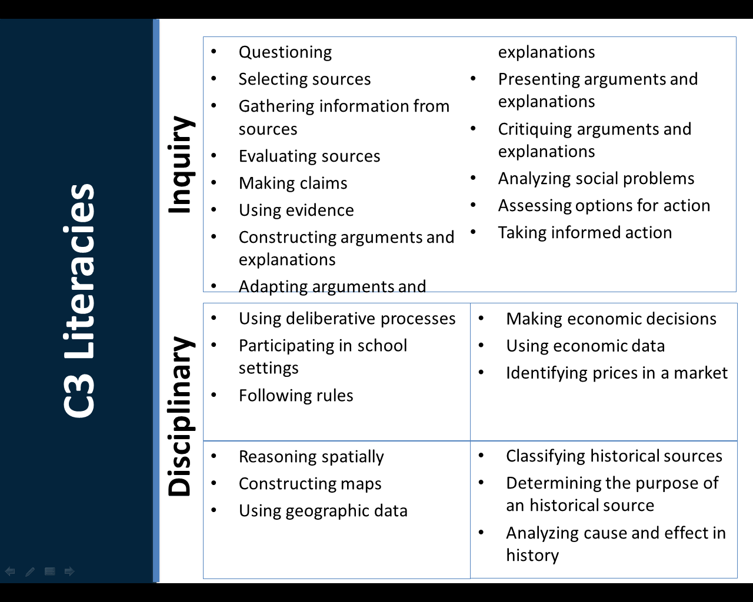
Packet page 39

Slide 59
Do your social studies teachers know the Common Core and how it applies to social studies teaching and learning?

Slide 60



Slide 61
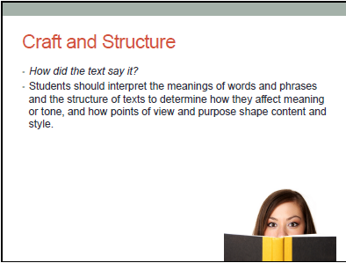

Slide 62
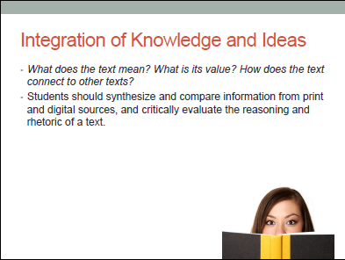


Slide 63
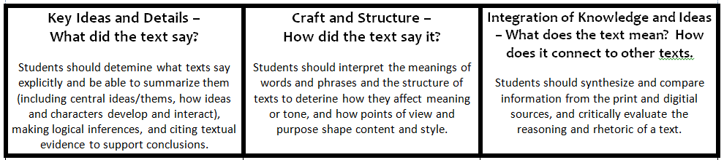
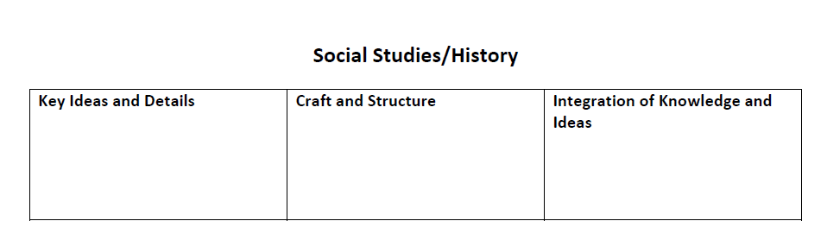

How did the text say it?
What did the text say?
What does the text mean?
How does the text connect?

Slide 64
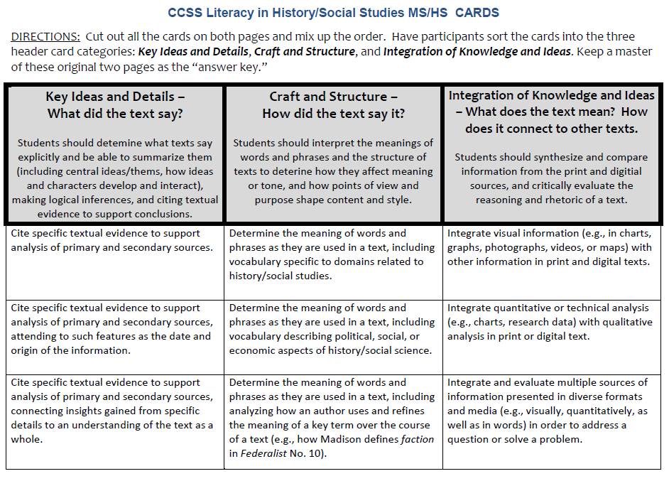

Slide 65
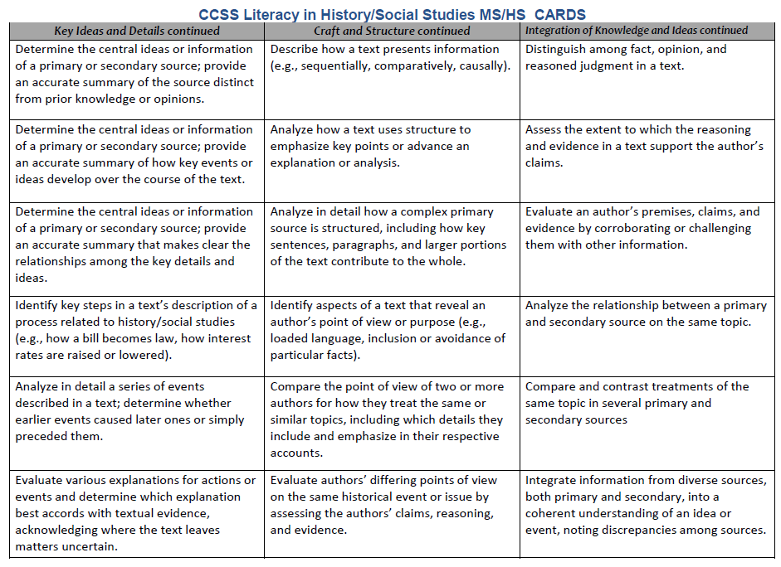

Slide 66
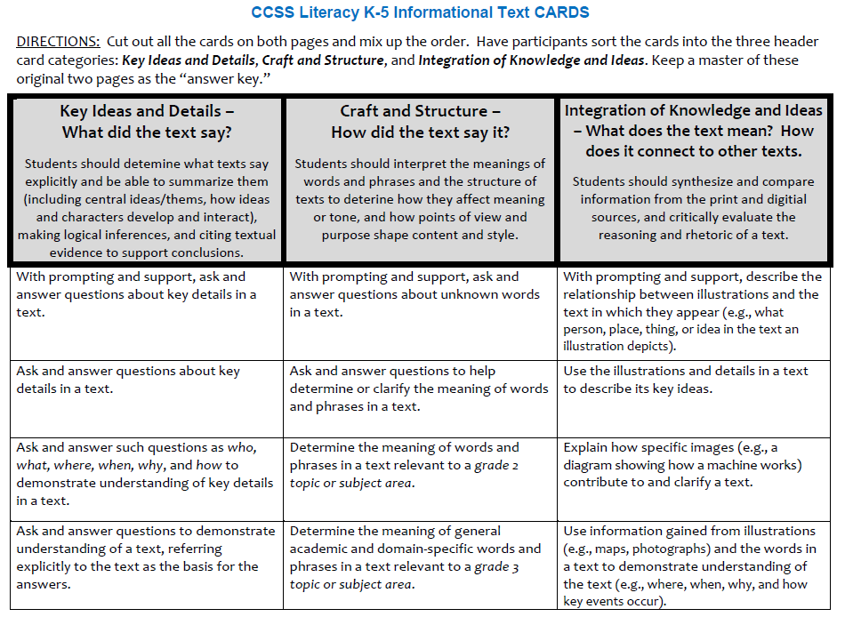

Slide 67
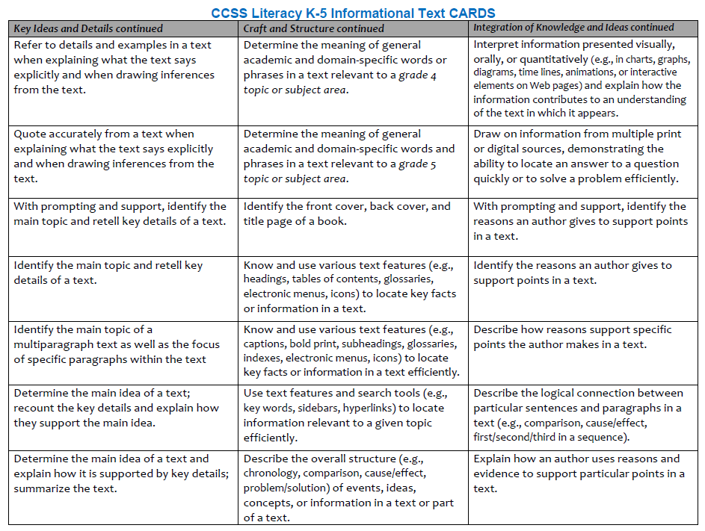

Slide 68
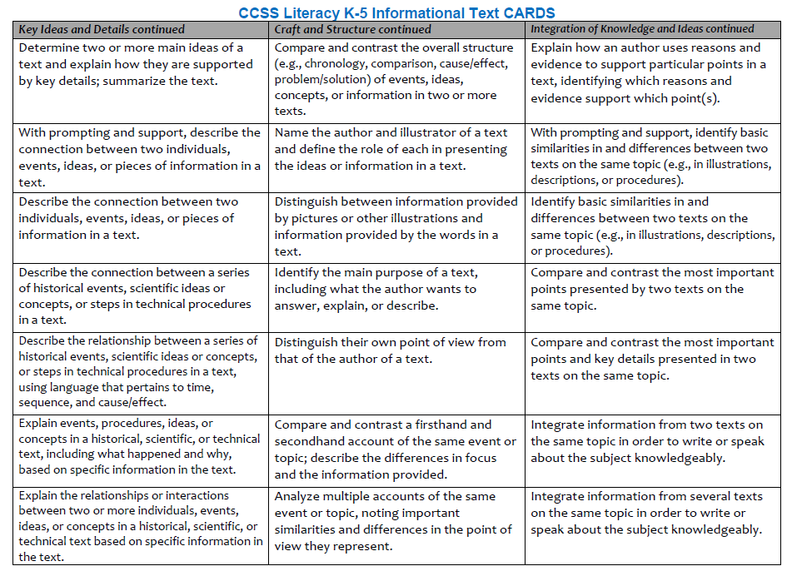

Slide 69

What is your the vision for
social studies
teaching and learning?

Slide 70
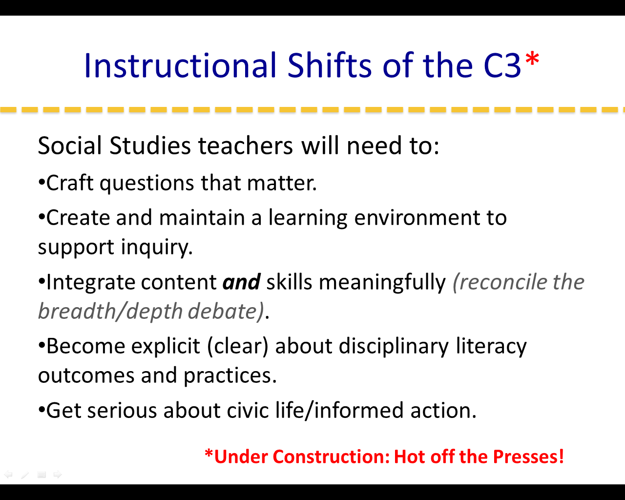

Slide 71
Preach a Vision and Continually Reaffirm It
"The greatest danger for most of us is not that our aim is too high and we miss it, but that it is too low and we reach it.“-Michelangelo
"Where there is no vision the people perish.“-Proverbs 29:18
Chapter 15 Lincoln on Leadership

Slide 72
The Great Task: Lincoln's Gettysburg Address (Video) »
Packet page 47

Slide 73
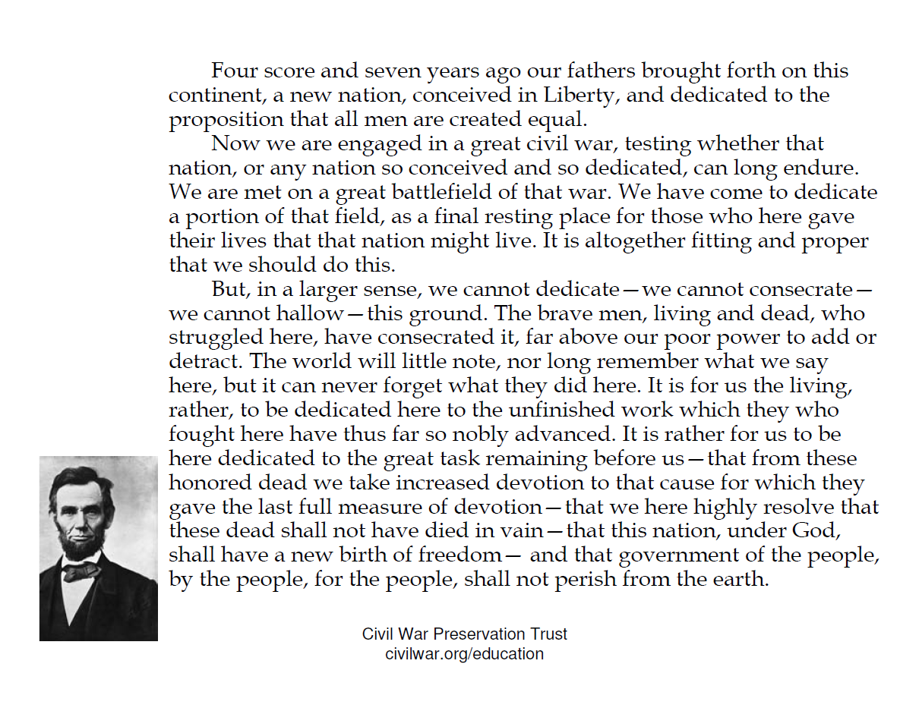
Packet page 47

Slide 74
A written model of Lincoln’s VISION….
The Gettysburg Address
Now we will use Lincoln’s Gettysburg Address as a model to help us reflect on and consider a vision of how we want Social Studies TEACHING in Kentucky schools to look.
Use the graphic organizer to write your own reflections about: The Past, The Present, The Renewal & The Future in the Gettysburg Address and your thoughts about SOCIAL STUDIES TEACHING in our state, and your district/school.
Packet page 48

Slide 75
The Past
Gettysburg Address
OUR TEACHING…where have we been?
Our Fathers
A New Nation
Conceived in Liberty
Dedicated…that all men are created equal
What did teaching look like when our teachers were K-12 students?
How did KERA change the way our social studies teachers teach?
What other past initiatives have impact on our teachers?
Packet page 48

Slide 76
The Present
Gettysburg Address
OUR TEACHING…where are we now?
Civil War…testing can we endure
Come to dedicate…
portion of the field for those who gave their lives, that the nation might live.
What does social studies teaching look like in our classrooms today?
What initiatives are we currently expecting our teachers to implement today?
Packet page 48

Slide 77
The Renewal
Gettysburg Address
OUR TEACHING…what unfinished work, are we dedicated to reviving?
The world…can never forget what they did here.
It is for us…to be dedicated...to the unfinished work...that these dead...not died in vain...that this nation
... shall have a new
birth of freedom.
How will we give our teachers the training and support they need so the vision of the Common Core and C3 framework will truly impact how our teachers teach?
Packet page 48

Slide 78

The Future
Gettysburg Address
OUR TEACHING… how do we really want it to look?
…and that the government of the people, by the people, for the people, shall not perish from the earth.
What will students who develop questions, plan inquiries, and use evidence be able to accomplish?
How will we help our teachers and students to take informed action?
Packet page 48

Slide 79

Lincoln Principles: VISION
#1.) Provide a clear, concise statement of the direction of your organization, and justify the actions you take.
#2.) Everywhere you go, at every conceivable opportunity, reaffirm, reassert, and remind everyone of the basic principles upon which your organization was founded.
#3.) Effective visions can’t be forced on the masses. Rather, you must set them in motion by means of persuasion.
Packet page 52

Slide 80
Lincoln Principles: VISION
Packet page 52
  #4.) Harness your vision through implementation of your own personal roving leadership style.
  In 1864 Lincoln ventured into the field to visit his battle-weary soldiers of the 166th Ohio Regiment to personally get the word out, and let them know personally he and the nation had not forgotten them.
#5.) When you preach your vision, don’t shoot too high. Aim lower and the common people will understand you. They are the ones you want to reach – at least they are the ones you ought to reach.
  “common man image” – born of humble beginnings, he symbolized the realization of the American dream
  the educated understand you anyway, so you don’t need to “hit” them when you aim

Slide 81

Lincoln Principles: VISION
#6.) When effecting renewal, call on the past, relate it to the present, and use them both to provide a link to the future.
#7.) You must realize that the process of renewal releases the critical human talent and energy necessary to insure success.
Packet page 52

Slide 82
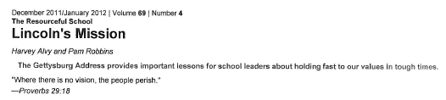
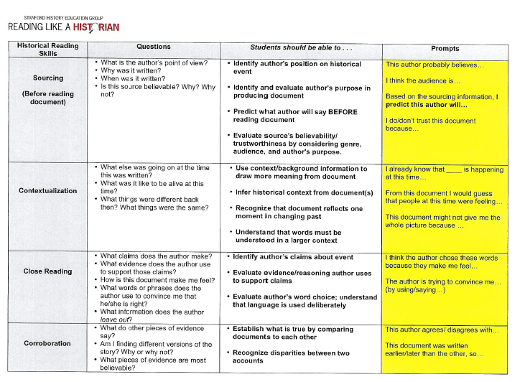
Additional Resources
Packet pages 49-51
Packet pages 53-54

Slide 83

http://youtu.be/4z7gDsSKUmU

Slide 84
Concurrent Sessions
DISTRICTS | Session 1 | Session 2 | Session 3
A-F | Side Hallway Planning for Student Growth | Main Room Social Studies Network Update | Front Room Science Balanced Assessment
G-O | Main Room Social Studies Network Update | Front Room Science Balanced Assessment | Side Hallway Planning for Student Growth
P-Z | Front Room Science Balanced Assessment | Side Hallway Planning for Student Growth | Main Room Social Studies Network Update

Slide 85



District Planning for
Student Growth
Rebecca Woosley
Effectiveness Coach
Mike Cassady
PGES Consultant
Packet pages 55-58

Slide 86
Today’s Targets
Differentiate the 4 capacities that impact systemic change
Determine your district’s readiness to implement the student growth goal process
Packet pages 55-58

Slide 87
Human Capacity:
Will and Skill
Structural Capacity:
Procedures and Policies
Organizational Capacity:
Collaboration, Communication and Interaction
Material Capacity:
Fiscal and Physical
District Planning for Student Growth

Slide 88

Human Capacity
  System has strategically situated high capacity individuals
  Intellectually Proficiency
  knowledge, expertise, understanding
  Will
  interest, patience, persistence
Packet pages 57-58

Slide 89





Organizational Capacity
Culture shaped by positive, change-oriented:
Interaction
Collaboration
Communication
LYNC
Packet pages 57-58

Slide 90
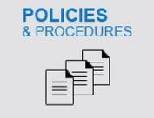


Structural Capacity
System elements independent of humans who may use or change them for function
Policies & procedures
Formalized practices
    Curriculum frameworks
    PL Design
    Hiring practices
    Alignment of Partnerships (school, district, university)
Packet pages 57-58

Slide 91


Material Capacity
Fiscal resources and/or other material supports
Financial Resources (internal/external)
Space, materials
Transportation, grounds, technology
Packet pages 57-58

Slide 92


Slide 93

At your table
Use the reflection sheet
Thinking about District Capacity
through the lens of Student Growth
CONSIDER
What’s already in place to support the student growth process?
What may be needed?
Packet pages 57-58

Slide 94
Be prepared to share one good practice

Slide 95

Administration Window: March 19-April 2
Student Voice Resources
  http://education.ky.gov/teachers/HiEffTeach/Pages/Student-Voice-Survey.aspx
  http://mediaportal.education.ky.gov/educator-effectiveness/
  Recent Change: K-2 Survey will NOT be administered during the upcoming SV window.
Notes:
Remind participants about the March 19-April 2 Student Voice Survey window. Encourage participants to review the provided links. The first link is the Student Voice page on KDE’s website. The second link is for the Student Voice video series housed on KDE’s media portal. Emphasize the recent change of K-2 students not participating in the upcoming SV window. Explain that a Beta Test using the K-2 survey is happening with identified districts now- information will be solicited from those districts concerning the K-2 administration.

Slide 96



Observation Window 3
Window
CLOSES FEBRUARY 28
Notes:
Remind participants that Window 3 closes on February 28. The fourth and final window runs from March 1-April 30.

Slide 97


Observation Window 4
CLOSES APRIL 30
MARCH 1- APRIL 30
Window

Slide 98


Certified Evaluation Plan
Work Sessions
KDE in partnership with the education cooperatives will host a work session to go through the model Certified Evaluation Plan with district teams.
SESC – Feb. 12
KVEC – Feb 13
OVEC – Feb. 19
NKEC; WKEC – Feb. 24
CKEC – Feb. 26
KEDC – March 3
GRREC – March 6-7

Slide 99

Considerations for CEP
Evaluation Committee (50/50 Committee)
Personnel Decisions for the 2014-15 school year
Preschool, Other Professionals, and KTIP Pilot Systems
Capacity Building (leveraging expertise in district)
CEP Submission

Slide 100
Concurrent Sessions
DISTRICTS | Session 1 | Session 2 | Session 3
A-F | Side Hallway Planning for Student Growth | Main Room Social Studies Network Update | Front Room Science Balanced Assessment
G-O | Main Room Social Studies Network Update | Front Room Science Balanced Assessment | Side Hallway Planning for Student Growth
P-Z | Front Room Science Balanced Assessment | Side Hallway Planning for Student Growth | Main Room Social Studies Network Update

Slide 101
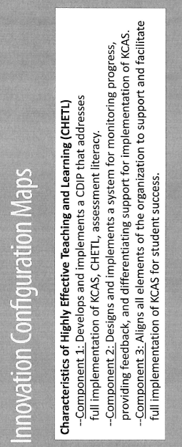
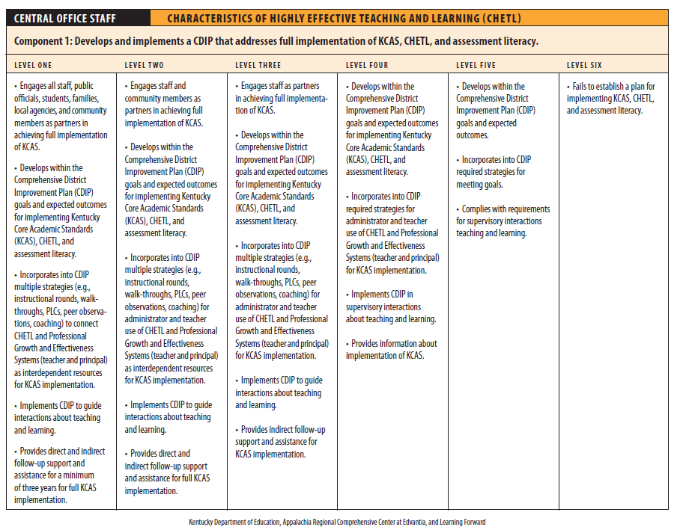

Where is your district in implementing CHETL?
Packet pages 59-64

Slide 102
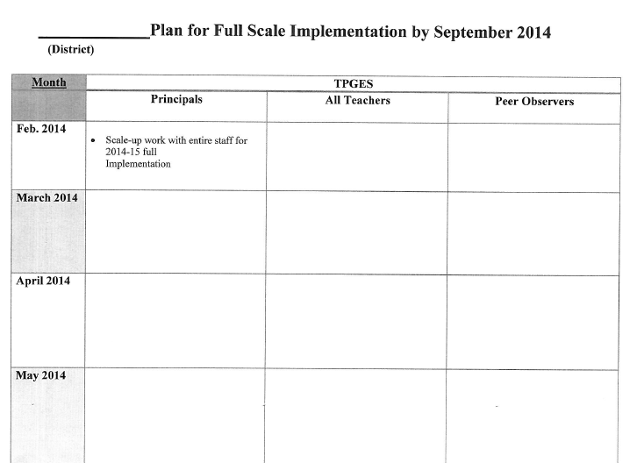
Packet pages 65-66

Slide 103
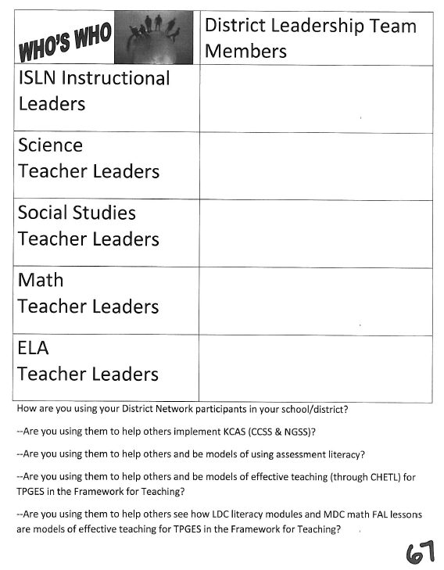
Packet page 67

Slide 104


CKEC Instructional Support
Leadership Network 2013-2014
NorthEast Christian Church 8:30am-12:30pm
September 19th, 2013
October 17th, 2013
November 21st, 2013
January 16th, 2014
February 20th, 2014
March 20th, 2014
11:30am

Slide 105

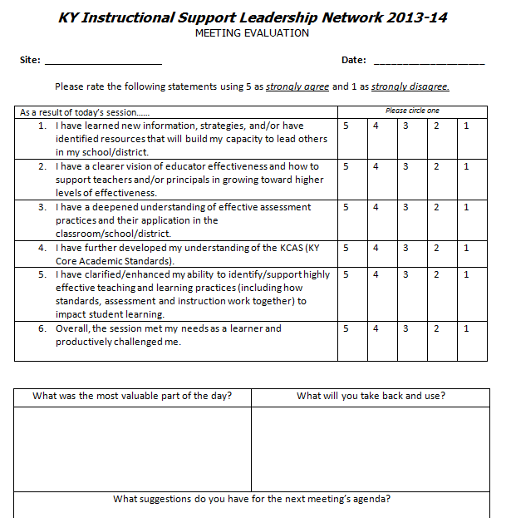
Please complete the yellow evaluation before you leave.
We need your feedback!

Slide 106


Pep Talk for Teachers and Students
http://youtu.be/RwlhUcSGqgs
See you on Thursday, March 20th, 2014
GO BIG BLUE!!!

Slide 107

Thank you!
We’re excited to be your Facilitation Team and look forward to serving you.
debbie.waggoner@education.ky.gov
terry.rhodes@education.ky.gov
kelly.philbeck@education.ky.gov
rebecca.woosley@education.ky.gov
mike.cassady@ckec.org
Notes:
(Just show this slide)

