Slide 1


CKEC Instructional Support Leadership Network
March 20th, 2014
Today’s materials can be accessed at:
http://www.debbiewaggoner.com/
mar-2014-isln.html

Slide 2
CKEC ISLN Facilitation Team
Debbie Waggoner, KDE/CKEC Instructional Specialist – Math & Social Studies Emphasis
Mike Cassady, PGES Consultant CKEC/KDE
Terry Rhodes, KDE/CKEC Instructional Specialist – Science Emphasis
Kelly Philbeck, KDE Literacy/LDC
Rebecca Woosley,
(Monica Osbourne) Effectiveness Coach, KDE

Slide 3






















Learning
Teaching
Enhancing
Supporting
Sharing
Burgin Independent School
Over 100 years of Excellence

Slide 4

Norms
Be an ambassador of “lifelong learning.” Show your enthusiasm for the work, support the learning of others, be willing to take risks, participate fully.
Come to meetings prepared. Be on time, any preparations/ readings completed, with necessary materials.
Be focused during meetings. Stick to network goals/ targets, use technology to enhance work at hand, limit sidebar conversations.
Work collaboratively. All members’ contributions are valued and honored, seek first to understand, then be understood.

Slide 5
ISLN Meeting
IMPORTANT NOTES
PINK Sheet
What do I want to remember? | How will I use this information, and how will I share it with others in my district?
Also don’t forget your
YELLOW Evaluation sheet
We Need your FEEDBACK!
Notes:
As always, we have your reflection sheet for you to record your thoughts and ideas throughout the meeting.
(Read Reflection questions)

Slide 6
Today’s Agenda
Introduction – Review of Learning Forward module materials –
Which materials can you use for professional learning with your teachers?
Concurrent Sessions:
--Science Network Deconstruction and Classroom Assessment Updates – Terry Rhodes
--Social Studies Network C3 Framework and Instructional Shifts Updates – Debbie Waggoner
--PGES Rubric: the what, the why, and the how
(reflections on using the EDI rubric from Fayette County) –
Rebecca Woosley (Monica Osborne) & Mike Cassady
Closure – Spotlight: Anderson County – PGES Roll-Out Plan Sharing
How is your district doing with Implementation?
How are you using your district network participants?
What’s your plan for preparing all staff for TPGES by September?
Join our backchannel at: www.todaysmeet.com/CKECISLN
Inside Cover

Slide 7

Pillars again
Highly Effective Teaching and learning
Pillars of Network Meetings
Network Foundations….
Kentucky’s Core Academic Standards
Assessment Literacy
Leadership
TPGES –Teacher Professional Growth and Effectiveness System

Slide 8
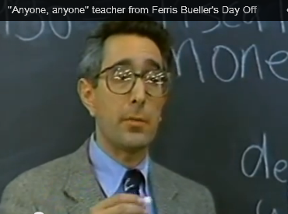
What does effective teaching look like?
We know we don’t want
our classrooms to look like
this, but what do we expect
from our meetings and
PDs for teachers?
Anyone? Anyone?
What does effective professional learning look like?
If your Faculty Meetings, PLCs, PDs, workshops, etc.
don’t look like effective teaching, then you are
missing the chance to help your teachers grow.
Notes:
http://youtu.be/uhiCFdWeQfA

Slide 9
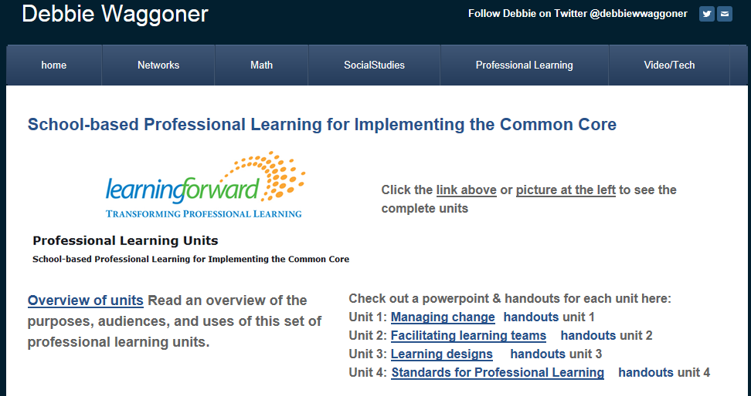
http://learningforward.org/publications/implementing-common-core/professional-learning-units

Slide 10

Learning Designs from last
month in the folders
on your tables

Slide 11
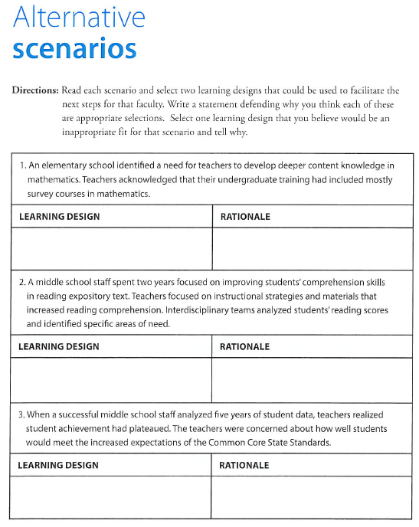
Find a learning design or two
that matches each scenario,
give a rationale for each match.
Packet page 2-3

Slide 12
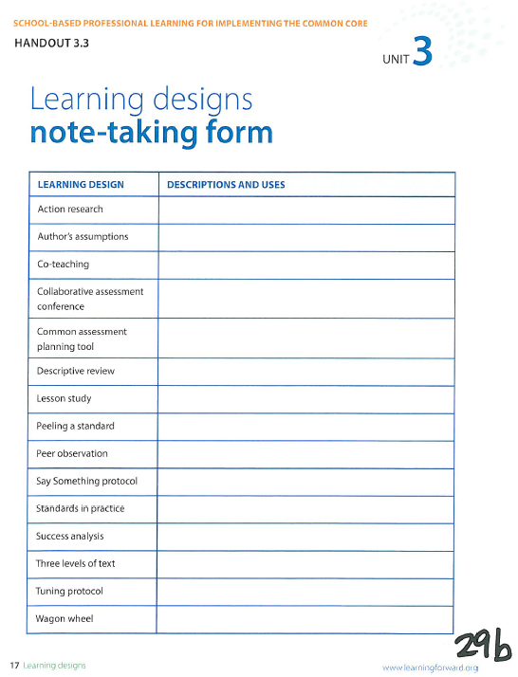
Packet page 4
1
2
3
4
5
6
7
8
9
10
11
12
13
14
15

Slide 13

Packet page 5

Slide 14

How do you make sure your teachers’
professional learning experiences
meet the expected standards?

Slide 15
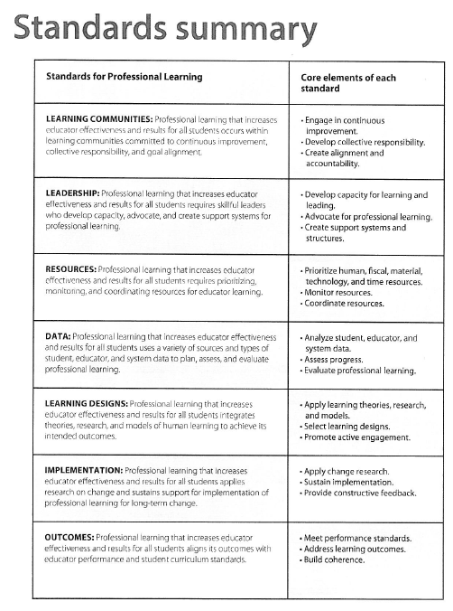
Packet page 6

Slide 16
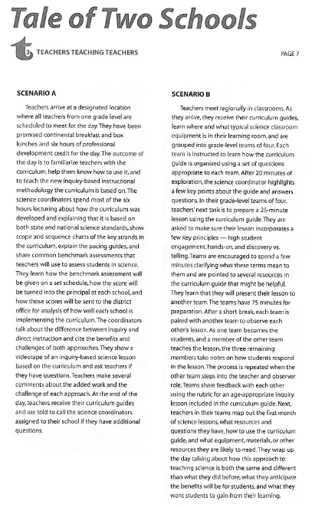
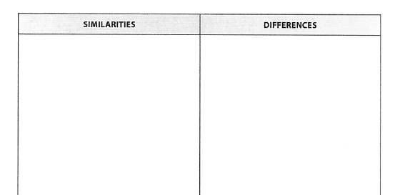
Packet pages 7-8

Slide 17
http://learningforward.org/publications/implementing-common-core/professional-learning-units

Slide 18
Concurrent Sessions
DISTRICTS | Session 1 | Session 2 | Session 3
A-F | Side Hallway PGES Rubric | Main Room Social Studies Network Update | Front Room Science Network update
G-O | Main Room Social Studies Network Update | Front Room Science Network update | Side Hallway PGES Rubric
P-Z | Front Room Science Network update | Side Hallway PGES Rubric | Main Room Social Studies Network Update

Slide 19



UPDATES

Slide 20
Deconstruction Work
First round of deconstruction was done in February
March meeting will focus on revisiting work from Feb, making revisions and adding in the assessment component
Adjusted schedule due to Jan weather

Slide 21

Classroom Assessment of KCAS-Science
Selected Response
Multiple Choice
True/False
Matching
Fill in-the-blank
Students scores on selected response assessments are usually figured as the number or proportion of questions
answered correctly.

Slide 22

Classroom Assessment of KCAS-Science
Written Response
Short Answer Items
Extended written response items
Students construct an answer in response to a question or task. Short answer items call for a very brief response having one or a limited range of possible right answers. Extended written response require a response that is greater in length and generally have a greater number of acceptable or correct answers.

Slide 23

Classroom Assessment of KCAS-Science
Performance Assessment
Performance task
Performance criteria
Assessment is based on observation and judgment; used to judge both real-time performances (demonstrations) and products (or artifacts) that students create. It has two parts: the task and the criteria for judging the quality of the
response (rubric).

Slide 24

Classroom Assessment of KCAS-Science
Personal Communication
Questions during instruction
Interviews and conferences
Participation
Oral exams
Student journals and logs
Finding out what students have learned through structured and unstructured interactions with them. Usually formative, but can also be summative

Slide 25
For your scenario, decide whether each assessment is:
Strong- works well for all learning targets of this type
Good- works for many learning targets of this type
Partial-works in some instances for learning targets of
this type
Poor-never works for learning targets of this type
To make your choices, ask yourself, which methods will provide the “most accurate information with the highest degree of efficiency?”
Packet page 9-10

Slide 26
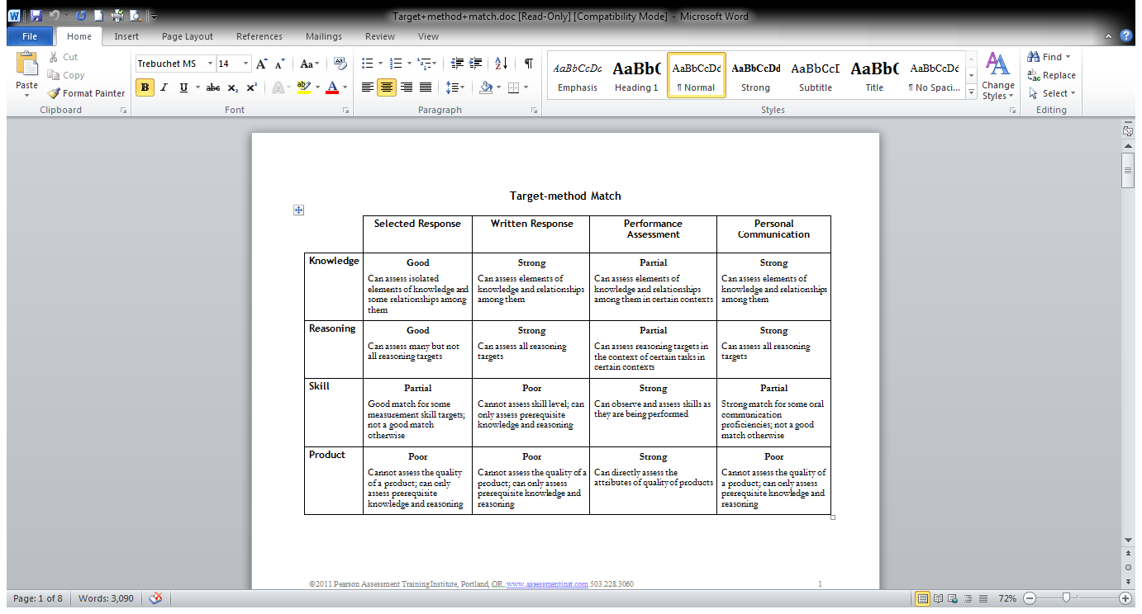
Packet page11

Slide 27


Moving NGSS to Implementation
Science Network Meetings:
-March 24th
-April 29th
Terry Rhodes
terry.rhodes@education.ky.gov
859-585-7762
www.terryrhodes1science.com

Slide 28
Concurrent Sessions
DISTRICTS | Session 1 | Session 2 | Session 3
A-F | Side Hallway PGES Rubric | Main Room Social Studies Network Update | Front Room Science Network update
G-O | Main Room Social Studies Network Update | Front Room Science Network update | Side Hallway PGES Rubric
P-Z | Front Room Science Network update | Side Hallway PGES Rubric | Main Room Social Studies Network Update

Slide 29


CKEC Social Studies Content Network Meetings
Tuesday, March 25th, 2014
Tuesday, April 22nd, 2014
*LA County Office of Education C3 Webcast
*Dr. Kathy Swan's "Achieving the C3: An exploration into 21st century social studies"
    Debbie Waggoner KDE/CKEC
    debbie.waggoner@education.ky.gov
    www.debbiewaggoner.com

Slide 30

Packet page12

Slide 31


Slide 32
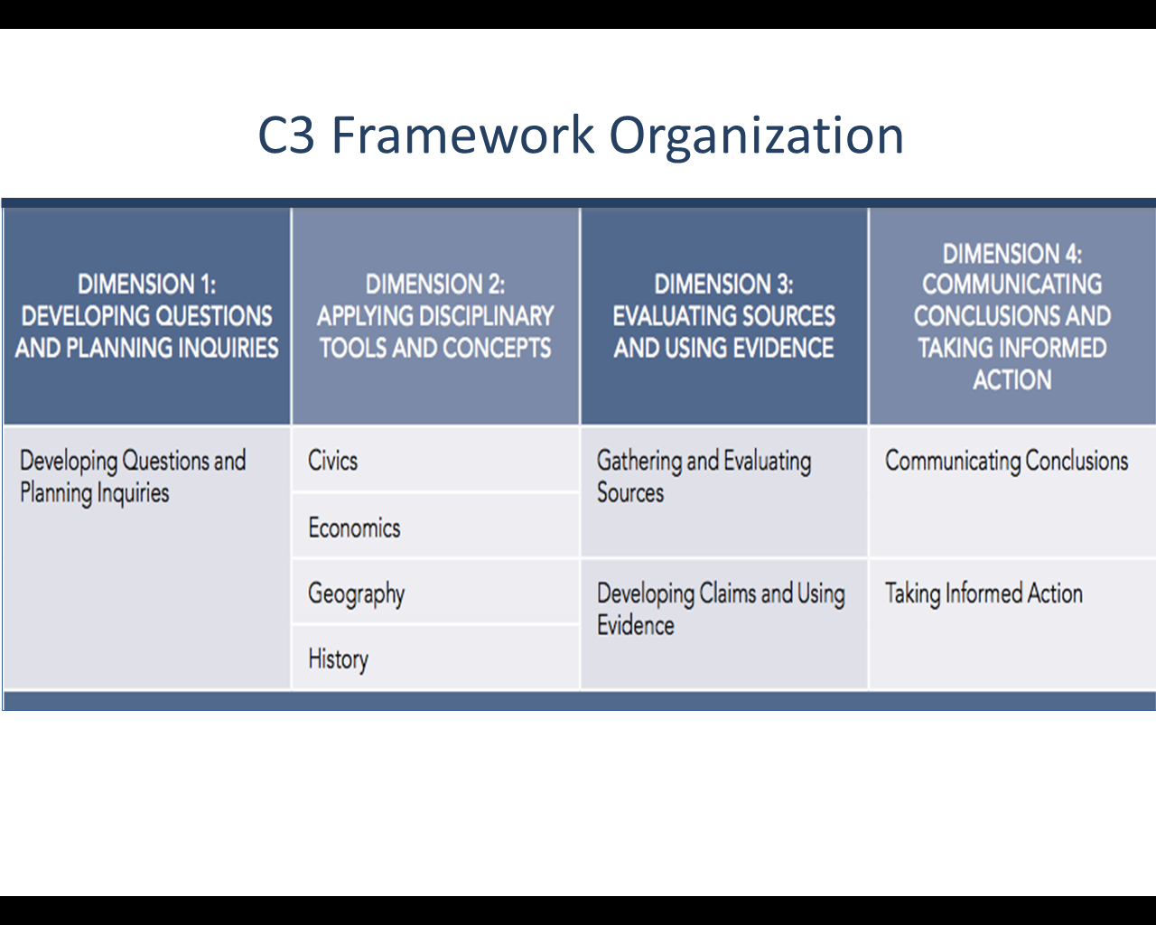














Slide 33
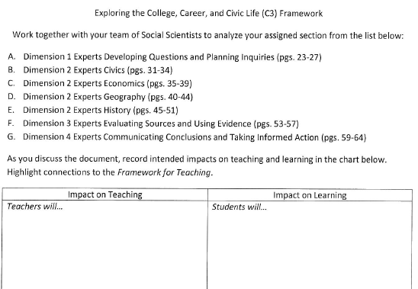

Packet page13
Read your
C3 section
& Take Notes
5 minutes
Discuss, relate to
Framework, & Summarize
on Green sheet
5 minutes
Each group shares
a one sentence
summary whole group
5 minutes
Notes:
These timers appear initially as a cream, coloured circle. The timer is initiated by clicking on, at which point the circle will fill up in a clockwise direction with the colour you see above.
At the end of the time, a bell will sound.
It is possible to change the timings of the timers by entering the animation settings and changing the timings of the relevant ‘Oval’. Note the timings have to be entered in seconds.
It is possible to have multiple timers on the same slide as these work independently of each other.

Slide 34

What is your vision for
social studies
teaching and learning?

Slide 35
I
16
32.06
C3
nstructional Shifts
Iodine
Craft questions that matter.
Establish a collaborative context to support student inquiry.
Integrate content and skills meaningfully.
Articulate disciplinary literacy practices and outcomes.
Provide tangible opportunities for taking informed action.
Packet page14-15

Slide 36
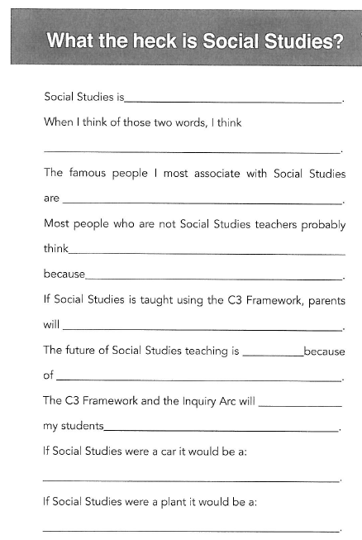
Packet page16

Slide 37
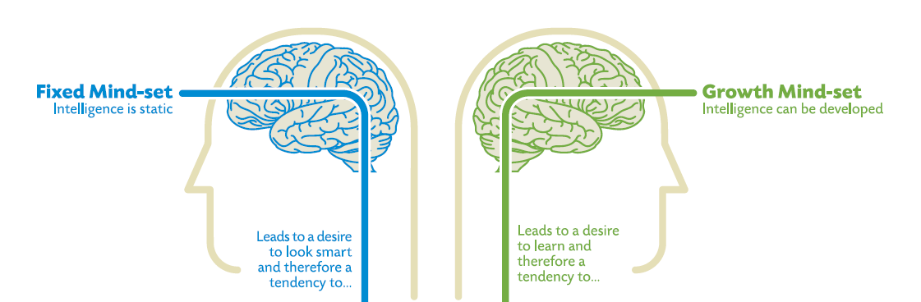
Growth vs Fixed Mindset
Why is having a growth mindset important for
social studies teaching and learning?
Packet page17

Slide 38

Packet pages 18-19
Compelling and supporting questions

Slide 39
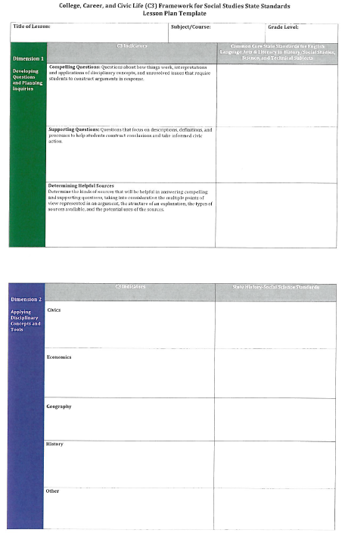
C3 lesson plan
template
Packet page 20-22

Slide 40
Concurrent Sessions
DISTRICTS | Session 1 | Session 2 | Session 3
A-F | Side Hallway PGES Rubric | Main Room Social Studies Network Update | Front Room Science Network update
G-O | Main Room Social Studies Network Update | Front Room Science Network update | Side Hallway PGES Rubric
P-Z | Front Room Science Network update | Side Hallway PGES Rubric | Main Room Social Studies Network Update

Slide 41
Professional Growth and Effectiveness System (PGES) Rubric
The What, The Why, & The How
March 2014 ISLN

Slide 42

Today’s Targets
  Deepen our understanding of PGES Implementation Rubric
  Practice using the rubric to support district implementation

Slide 43

What is the PGES
Implementation Rubric?
A resource designed for district leaders to help districts create a robust PGES by-
guiding self-assessment about PPGES and the TPGES implementation across the district
providing definitions and evidence of strong and weak implementation
informing and guiding plans for next steps
Notes:
This resource was developed by the U.S. Education Delivery Institute team support KY in implementation of the PGES. It was developed as a direct response to feedback from districts asking what infrastructure to put in place.
It will impact rollout and the sustainability of your implementation of the PGES is your district, as well as the defensibility of your system.

Slide 44
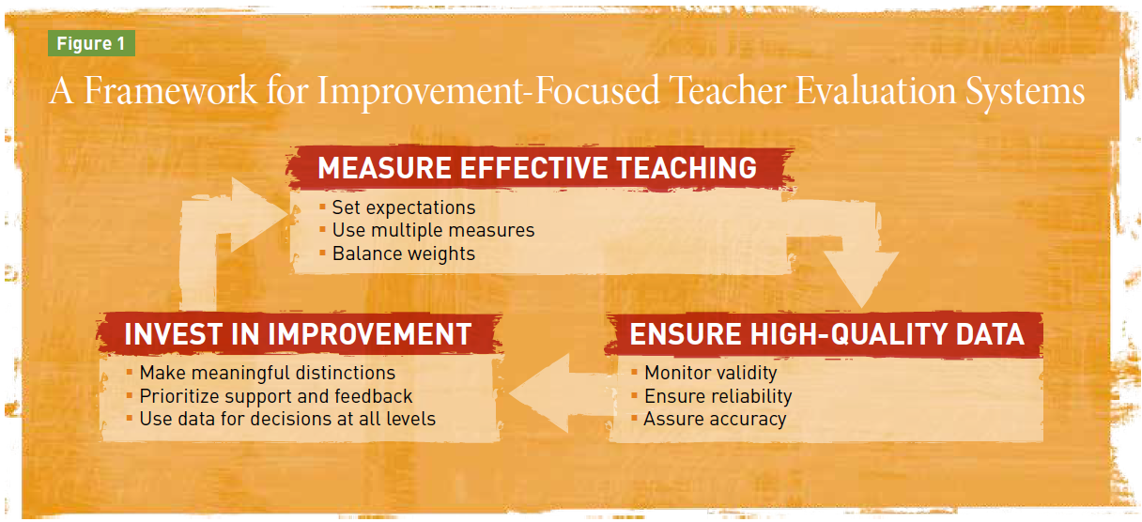




Incorporates -
the Measures of Effective Teaching (MET) principles
Integrates -
KDE’s Capacity Framework
human organizational
material structural
Notes:
This resource is based on the 9 principles from the Measure of Effective Teaching study by the Gates Foundation, and embeds the 4 capacities in KDE’s Capacity Framework throughout the rubric.
MET developed the nine guiding principles to help states & districts implement improvement-focused evaluation systems.

Slide 45
Human Capacity:
Will and Skill
Structural Capacity:
Procedures and Policies
Organizational Capacity:
Collaboration, Communication and Interaction
Material Capacity:
Fiscal and Physical
KDE Capacity Framework
Notes:
This is just a reminder about the what’s included in each of the capacities we used in Feb. to reflect on student growth implementation in your districts.
These capacities in the PGES rubric push us to think about “what”, “how” and “how well.”
The “Questions to Consider” in the Rubric also are aligned with the four capacities.

Slide 46

* to provide consistency of implementation across the state
* to communicate priorities to stakeholders
* to help districts go beyond technical implementation to the system structure that must be in place for effective PGES implementation
* to take the conversation to the needed system shifts – (building on what’s in place or what can be refined)
Notes:
The PGES Implementation Rubric:
Is a tool designed to provide consistency of implementation across the state.
Is a guidance document to communicate priorities to stakeholders.
Supports a facilitated process (using the tool) that will help districts go beyond technical implementation (essentially what you have in CEP) to the system structure that must be in place for effective implementation.
Takes the conversation to the system shifts that have to take place – considering what structures and systems are already in place and what is still needed (building on what’s in place or what can be refined).
Is based on the expectation that all districts must get to strong implementation.

Slide 47
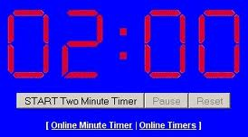
Take 2 minutes…
What do you notice about the format/organization of the Implementation Rubric?
Packet page 25-34
Notes:
Let’s take a couple of minutes to look at the format and organization of the rubric. Be prepared to share what you notice.

Slide 48
Rubric Format
Includes an overall guiding question for each section of the rubric/tool
Includes icons connected to the 4 capacities with the guiding questions
Identifies criteria for weak and strong implementation
Includes evidence that indicates strong implementation
Notes:
Includes an overall guiding question for each section of the rubric/tool:
MEASURE EFFECTIVE TEACHING,
ENSURE HIGH QUALITY DATA,
INVEST IN IMPROVEMENT
Includes guiding questions (with icons connected to the 4 capacities)
Identifies criteria for weak and strong implementation (Strong is the ultimate implementation standard for all districts)
Includes evidence that indicates strong implementation

Slide 49
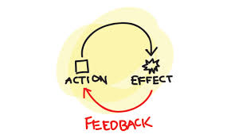
Feedback from Fayette Co.
Notes:
5 min.
Before you get started trying out the PGES Implementation Rubric, let’s hear from a member of the Fayette Co. leadership team. In late Nov./early Dec. Jefferson and Fayette counties piloted this rubric, facilitated by the EDI team. Fayette had their most recent work session yesterday. They’ve graciously agreed to share with you their perception of the impact of using this tool and process.

Slide 50

Notes:
Now, it’s your time to take a closer look at one category the tool and think/talk about where you see your district right now.

Slide 51

Read and Reflect
Review #6 - Assure Accuracy
Independently, read and reflect on the questions, the weak & strong criteria and the evidence of success
Decide where your district is currently on a scale of 1-4 and record it on a common, shared form.
Packet pages 23-24
Notes:
5 min.
Under the “Ensure High Quality Data” category, let’s look at Assure Accuracy - To what extent does your evaluation process accurately measure effective teaching?
Individually, review the rubric for number 6 (page 13) and come to a judgment on a scale of 1 to 4/weak to strong as to the district’s current status in that area.

Slide 52

Discuss your decisions, recording your district’s individual evidence on 1 form.
Discuss the evidence and come to consensus.
Use the evidence to identify any specific areas of strength and weakness and implications for next steps.
Notes:
5-7 min.
Record the rationale (the evidence) for your individual choices on the handout, then discuss the evidence and come to consensus about your district’s current status for # 6.
Use the evidence to identify specific strong or weak areas and the implications for next steps.
What next? Contact your PGES consultant, Mike Cassady, or your effectiveness coach, Becky Woosley to facilitate this process with your district leadership team.

Slide 53

PGES
Notes:
There are several PGES support resources available to you on the KDE web site. There two we want tell you about this morning.
The first is the new Student Growth site, where you can now find all the most current Student Growth resource links on one page.

Slide 54

http://education.ky.gov/teachers/HiEffTeach/Pages/Student-Growth.aspx
Notes:
Share with participants KDE’s new page devoted to Student Growth. Walk participants through the page and emphasize important resources.

Slide 55

Enduring Skills Resources:
PowerPoint of process with notes and facilitator’s guide
Sample lists of enduring skills for many content areas
Archived Enduring Skills Process Lync session
Available on Student Growth web page
Notes:
When we looked at the Student Growth goal-setting process back in the fall, you will recall that the critical foundation for quality student growth goals is the enduring skill. Some of you have already begun this process in your PLCs.
A process for leading teachers so they can accurately and collaboratively identify enduring skills is being posted on the Student Growth web page, along with sample initial lists from several content areas. The lists are not finished products, but are intended to give teachers District leaders can use this process, or use it to build the capacity of some of your teacher leaders, so content teams can identify lists of enduring skills that can be shared across content and across schools in your district.

Slide 56

Support Resources
How can you use the SGG resources to support your districts?
Notes:
Time for conversations about how staff will use these in network meetings and in working with districts.

Slide 57




Observation Window 4
CLOSES APRIL 30
MARCH 1- APRIL 30
Window
Notes:
Principals can add 2 observations in one window – making up for the loss of time due to adverse weather. It is important that all observations are entered because KDE needs to capture the observation data.

Slide 58

If you have questions as you take your next PGES implementation steps, contact your PGES consultant, Mike Cassady or
Becky Woosley, effectiveness coach.
Notes:
You tried out a mini-version of the process, but if your district leadership would like to have KDE support facilitating the process as your team thinks through the implementation rubric, contact your PGES consultant, Mike Cassady, or Becky Woosley, effectiveness coach.

Slide 59


Slide 60
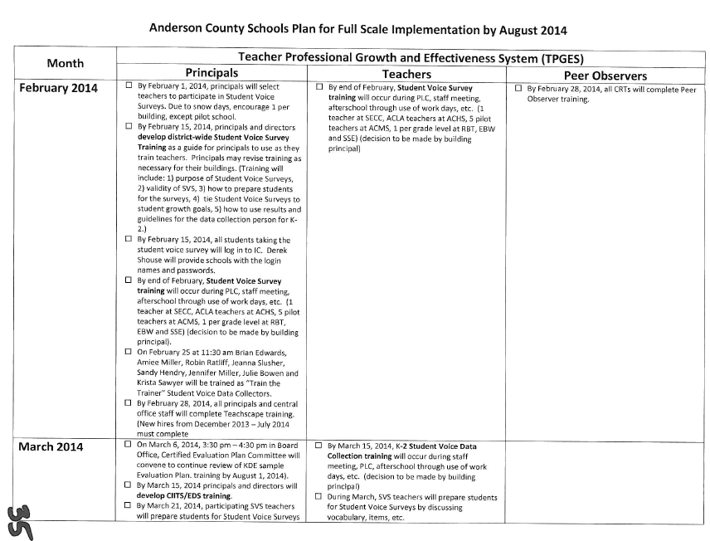
Anderson
County
Packet pages 35-38

Slide 61
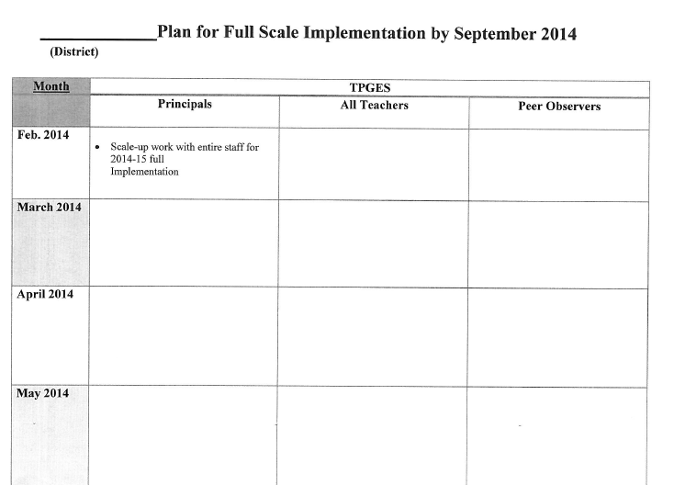
Packet pages 39-40

Slide 62
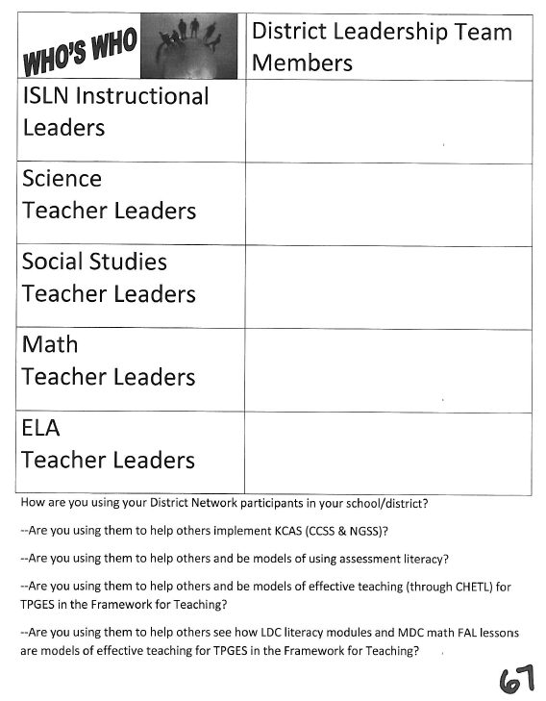
How are you using your
network teachers to be
leaders in your district?

Slide 63

CKEC Instructional Support
Leadership Network 2013-2014
NorthEast Christian Church
September 19th, 2013
October 17th, 2013
November 21st, 2013
January 16th, 2014
February 20th, 2014
March 20th, 2014

Slide 64

Coming up this summer: ISLN/KLA Annual State-wide Meeting June 26th /27th - Lexington Center
MORE DETAILS COMING SOON
CKEC Science and Social Studies Summer Network meeting:
Friday, July 25th with
Ken Mattingly – CASL in action
June 26— 3 cycles of TED talks/sessions on these topics: Teacher Effectiveness, Highly Effective Teaching and Learning in Science/Social Studies, Principal Effectiveness (Would you like to lead a TED talk or session?)
June 27— ‘morning working sessions’ on a variety of topics districts sign up for these as desired

Slide 65

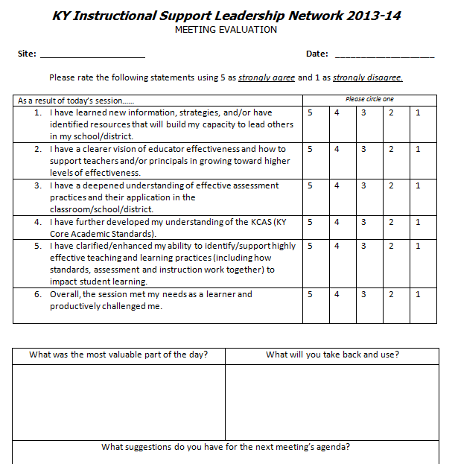
Please complete the yellow evaluation before you leave.
We need your feedback!

Slide 66
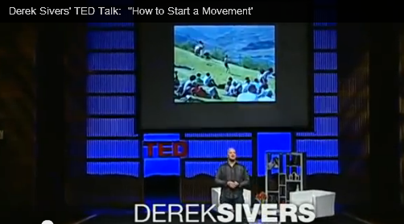

One Lone NUT
How to Start a Movement - The One Lone NUT
GO BIG BLUE!!!
Notes:
http://youtu.be/RXMnDG3QzxE

