Slide 1


CKEC Instructional Support Leadership Network
JANUARY 16th, 2014
Today’s materials can be accessed at:
http://www.debbiewaggoner.com/
jan-2014-isln.html

Slide 2
CKEC ISLN Facilitation Team
Debbie Waggoner, KDE/CKEC Instructional Specialist – Math & Social Studies Emphasis
Mike Cassady, PGES Consultant CKEC/KDE
Terry Rhodes, KDE/CKEC Instructional Specialist – Science Emphasis
Kelly Philbeck, KDE Literacy/LDC
Monica Osborne subbing for Rebecca Woosley, Effectiveness Coach, KDE

Slide 3






















Learning
Teaching
Enhancing
Supporting
Sharing
Welcome,
Who is in the room?
Burgin Independent School
Over 100 years of Excellence
Notes:
We also want to recognize the 21 participating districts in our region.
New participants stand briefly as a few districts “fly in” and we name them

Slide 4

Norms
Be an ambassador of “lifelong learning.” Show your enthusiasm for the work, support the learning of others, be willing to take risks, participate fully.
Come to meetings prepared. Be on time, any preparations/ readings completed, with necessary materials.
Be focused during meetings. Stick to network goals/ targets, use technology to enhance work at hand, limit sidebar conversations.
Work collaboratively. All members’ contributions are valued and honored, seek first to understand, then be understood.

Slide 5
ISLN Meeting
IMPORTANT NOTES
PINK Sheet
What do I want to remember? | How will I use this information, and how will I share it with others in my district?
Also don’t forget your
YELLOW Evaluation sheet
We Need your FEEDBACK!
Notes:
As always, we have your reflection sheet for you to record your thoughts and ideas throughout the meeting.
(Read Reflection questions)

Slide 6
Today’s Agenda
CKEC ISLN January 16th, 2014 Agenda
Introduction – Review Characteristics of Network Participants
Student Voice – Teacher Panel – Monica Osborne
  Concurrent Sessions:
  --Science Network Update – Terry Rhodes
  --Social Studies Network Preview – Debbie Waggoner
  --Analyzing Student work – Kelly Philbeck
PGES update – Mike Cassidy
Closure – Planning for Full Scale Implementation
Inside Cover

Slide 7

Pillars again
Highly Effective Teaching and learning
Pillars of Network Meetings
Network Foundations….
Kentucky’s Core Academic Standards
Assessment Literacy
Leadership
TPGES –Teacher Professional Growth and Effectiveness System

Slide 8
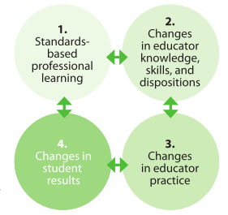
Building Capacity
Develop Skills
Increase Knowledge
Use Resources to Develop a Plan to Meet Specific District Needs
Long Term Sustainable Model
Notes:
Reference Capacity Building vs. Train the Trainer

Slide 9
Characteristics of a Network Participant
What role are your teacher leader network participants taking in the classroom, in the school and on the district leadership team?
Activity: Find the large manila envelope; empty the contents on to the table. As a group, discuss and decide which descriptors (green or lavender) go under the appropriate characteristics (red or yellow).

Slide 10
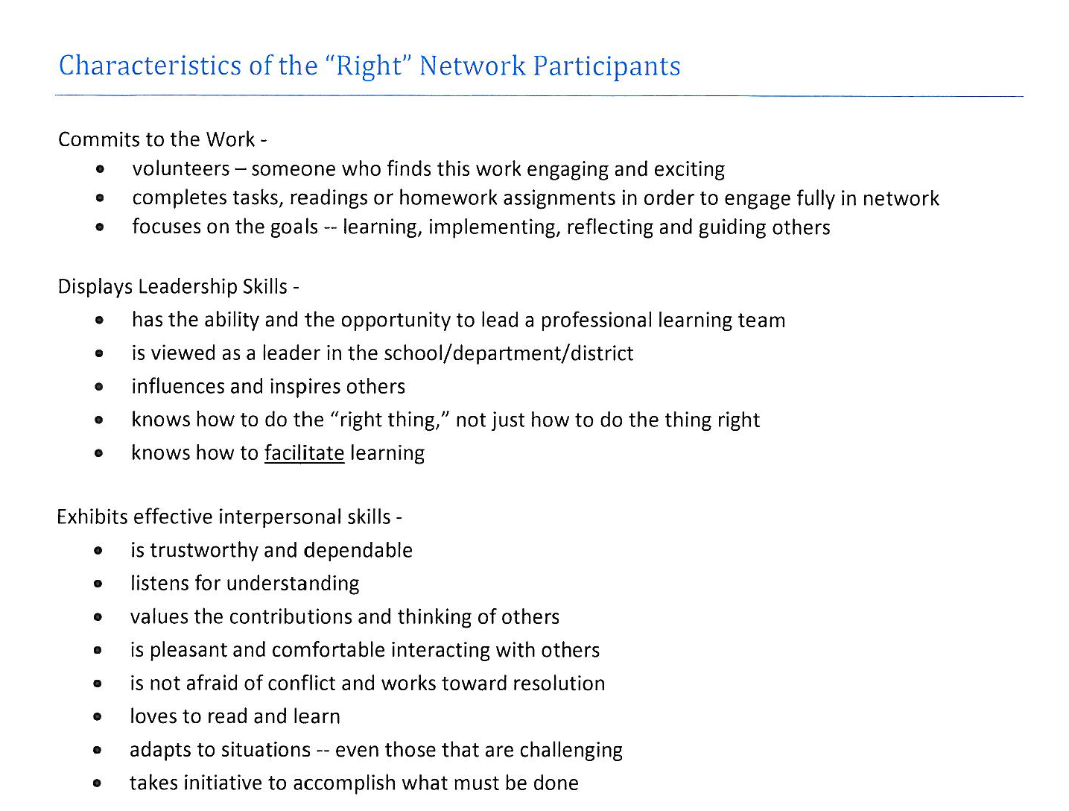
Packet pages 25-26

Slide 11
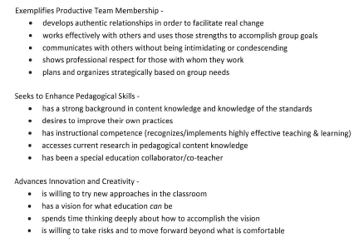
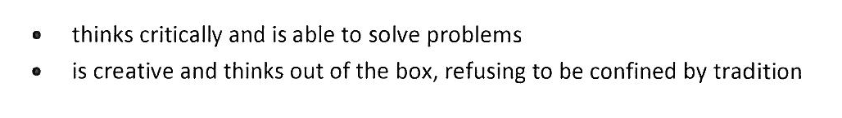
Packet pages 25-26

Slide 12
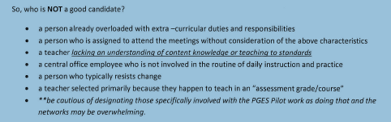
Packet pages 25-26

Slide 13


1. Kentucky’s Core Academic Standards
  How are you understanding & implementing
the standards in your classroom, school & district?
2. Highly Effective Teaching and Learning
  How are you emphasizing highly effective teaching and learning characteristics in your classroom, school & district?
3. Assessment Literacy
  How are you using formative/summative assessment to improve instruction & learning in your classroom, school & district?
4. Leadership
  How are you using the leadership capacity you are building to share information in your school & district?

Slide 14
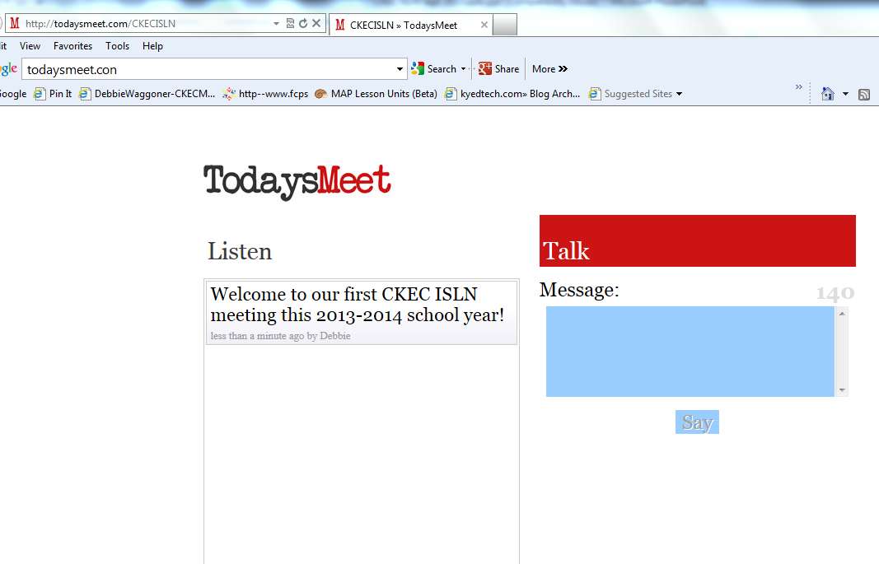
www.todaysmeet.com/CKECISLN

Slide 15



Teacher Professional Growth & Effectiveness System
Monica Osborne, presenter
KDE Effectiveness Coach
Student Voice
Packet pages 1-8
Notes:
Welcome to today’s session that will focus on the Student Voice Survey and the evidence it will provide for the Teacher Professional Growth & Effectiveness system.
I am here today to lead your discussion for Becky Woosley, who is in Colorado supporting the Gates Common Assignments grant work.

Slide 16





What do all of these sites have in common?
Notes:
Take a few minutes to get the group thinking about how feedback in routinely used outside of education to improve service. Ask them to reflect on:
What is the purpose of these sites? (to provide support to the “customer”)
Are the people providing feedback doctors, movie producers, hotel managers? (No, they are the public who uses these services.)
Why is the feedback on these sites so important and valuable?
Emphasize that the feedback on the sites is constructed by people who have had first-hand experience with what they are reviewing.
Now consider –
WHO in schools really has a first-hand experience with teachers? STUDENTS.

Slide 17

Learning Targets
I can. . . .
explain why student voice surveys are important.
explain why student perception surveys are a valid measure of teacher effectiveness.
use the Student Voice Toolkit to implement the survey.
access Student Voice Survey data in CIITS.
use the results to improve student achievement.
Notes:
I can explain why student voice surveys are important.
The session will provide you with a fundamental understanding of why this measure is valuable.
I can explain why student perception surveys are a valid measure of teacher effectiveness.
The session will examine the Measure of Effective Teaching research data that supports this measure.
I can use the SV Toolkit to implement the survey.
During the session we will briefly review KDE resources that will support your district’s implementation of the survey.
I can access Student Voice Survey data.
During the session you will be show how to locate and access the survey data.
I can use the results to improve student achievement.
The session will demonstrate how the survey results connect to the FfT as well as how you can use those results to impact instruction.
So, let’s get started with our first learning target.

Slide 18

(FfT)
Domain 1: Planning & Preparation
Domain 2: Classroom Environment
Domain 3: Instruction
Domain 4: Professional Responsibilities
Domain 5: Student Growth
Notes:
This document provides common language for teacher effectiveness. Using the performance levels, it allows for supervisor and teacher discussion, evaluation, and teacher reflection around a rubric. You may have started sharing this document with teachers in your district and you may have begun conversations about what it means to be an effective teacher. This framework is a foundation for beginning those conversations.
The Teacher Professional Growth & Effectiveness System that will be piloted during the next school year also proposes multiple ways for measuring a teacher’s effectiveness. Although the Kentucky Framework for Teaching provides us the common language, the additional measures provide different processes within the system for measuring effectiveness.

Slide 19
PGES Sources of Evidence
Observation
Teacher Professional Growth and Effectiveness System
Peer Observation
formative
Professional
Growth
These provide multiple sources of evidence to inform professional practice
Self-Reflection
Student Voice
Student Growth
State Contribution:
Student Growth %
Local Contribution:
Student Growth Goals
Notes:
The Teacher Professional Growth and Effectiveness System is designed to provide multiple sources of evidence to inform professional practice. During our session today, we will focus on Student Voice and the impact it can have on improving teacher practice.

Slide 20


Why is student voice an important measure of teacher
effectiveness?
Notes:
So let’s start with the question: Why is student voice an important measure of teacher effectiveness?

Slide 21
Measures of Effective Teaching (MET) Project
The Measures of Effective Teaching (MET) project was designed to help teachers and school systems close the gap between their expectations for effective teaching and what is actually happening in classrooms.
Notes:
The MET Project, funded by the Bill and Melinda Gates Foundation, was a 3 year study. KY leaders were present in Phoenix when the result of the study were announced in Jan. of 2013.

Slide 22
Evidence of Effective Teaching (MET) Project Results
Evidence from multiple sources, including both observations and student perception surveys, are more predictive of student growth than observations alone.
Click here for final MET Project results
Notes:
Evidence from the perspective of students was one of the key fundamentals used to measure teacher effectiveness in the MET study.

Slide 23
It was only when I discovered that feedback was most powerful when it was from the student to the teacher that I started to understand it better.
- J. Hattie
Visible Learning, p. 173
Notes:
J. Hattie, author of Visible Learning, says it best.
Understanding the power of student feedback helps us recognize the impact of student voice on measuring teacher effectiveness.

Slide 24
How do we know student voice
Is valid?
(most frequent teacher question)
Notes:
This is the most common question from teachers when they learn that KY will use student voice as one evidence of effective practice.

Slide 25

Click for full report
Positive impact
Positive impact
Positive impact
Notes:
This screenshot from the full MET project report shows the positive impact of the results for ELA and for math. Notice that as the number of positive student responses goes up, student gains increase as well. This positive impact is just part of the evidence that validates that student voice correlates with teacher effectiveness.
You can access the final MET report by clicking on the title on this slide.

Slide 26

SO WHAT DOES THIS MEAN?
Research shows a clear connection between
students’ perceptions
and their achievement.
Notes:
The results are clear. There is a solid connection between students’ perceptions and their growth – and their growth is the ultimate outcome.

Slide 27

How is the Student Voice Survey
designed

Slide 28
The Student Voice Survey -
Is a confidential, on-line survey (accessed through Infinite Campus)
Asks students for feedback about their teaching and learning classroom experiences
Is organized around 7 teaching practices
Poses questions aligned to the Framework for Teaching
Notes:
What is the Student Voice Survey? It -
Is a confidential, on-line survey
Asks students for feedback about their teaching and learning classroom experiences
Is organized around 7 teaching practices
Poses questions aligned to the Framework for Teaching

Slide 29
Kentucky’s Administration of the
Student Voice Survey
Notes:
Let’s take a look at how the survey will be administered in your school.

Slide 30
KY is administering an abbreviated version of the Tripod Survey
Student surveys will be used to collect data and to generate reports focused on
classroom learning conditions
student engagement
student climate
Student responses are anonymous.
Individual teacher results will not be shared publicly.
Packet pages 1-4
Notes:
The important things to know about Student Voice at this time are noted in the bullets on the screen in this slide and the next one.
(click through the bullets reading each as it comes up)
We have provided copies of the questions for you in the packet and you can also access them from the Student Voice Toolkit found on the KDE website.

Slide 31
KY’s Administration of the
Student Voice Survey
Multiple versions: K-2, 3-5 and 6-12 (grade appropriate language and questions have been through an extensive validation process)
The K-2 survey will be read to students and responses will be entered for each student online.
The 3-5 and the 6-12 surveys will be administered online.
Student surveys are administered
at the classroom level.
Notes:
The important things to know about Student Voice at this time are noted in the bullets on the screen.
(click through the bullets reading each as it comes up)

Slide 32
KY’s Administration of the Survey :
Districts and schools will use the Student Voice Survey Toolkit to support implementation of the survey.
http://education.ky.gov/teachers/HiEffTeach/Pages/Student-Voice-Survey.aspx
S.T.U.D.E.N.T.
Voice Survey
Notes:
The Student Voice Survey Toolkit, located at the link to the KDE web page you see on the screen, provides all the guidance and supporting documents districts and schools will need to implement the survey.
It is important for your districts Point of Contact to review and use this Toolkit NOW, so all teachers participating in the pilot (and their students) will be ready for survey implementation the last two weeks of March. There are some district/school decisions and preparation that need to be made in advance.
http://education.ky.gov/teachers/HiEffTeach/Pages/Student-Voice-Survey.aspx

Slide 33
Guidance for Survey Implementation
All teachers in the pilot must participate in the Student Voice survey.
Any teacher in the district is eligible to participate.
Building principals will determine any additional teachers (beyond those participating in the pilot) to administer the student voice survey.
The district will determine the number of sections/classes required per teacher to participate in the survey.
Participating teachers must have a minimum of one section respond to the survey.
FAQ Packet pages 5-8
Notes:
Teachers with fewer than 10 students will not be able to participate in the Survey, but as long as art, music, PE teacher, etc. have at least 10 students, they are eligible to participate.

Slide 34

Guidance for Survey Implementation
The Toolkit includes specific responsibilities for the
District Point of Contact
Infinite Campus Coordinators
Building Principals
Teachers
Notes:
It is important to carefully read and follow all the directions included in the Toolkit. Additional resources needed included in the Toolkit are the confidentiality agreement, the parent permission letter, and directions on preparing the campus portal.
We have also posted the FAQ that is posted with the Toolkit. It is an easy to use summary of the purpose and the implementation process that you will find helpful when used WITH the Guide.

Slide 35
K-2 Survey Protocol
Building Principals will identify adult Student Voice Survey administrators to proctor
K-2 students who participate in the Student Voice Survey.
The proctor should be someone familiar to the students; but Should Not be the classroom teacher that is the focus of the survey.
Packet pages 1-4

Slide 36
K-2 Survey Protocol
The proctoring process will be one on one
Reading and clarifying Student Voice Survey questions
Inputting individual student responses into Infinite Campus.
Notes:
The proctoring process will be one on one; reading and clarifying Student Voice Survey questions; and inputting individual student responses into Infinite Campus.

Slide 37

Connections
Now, let’s connect KY S.T.U.D.E.N.T. Voice to the Framework.
S.T.U.D.E.N.T. Voice
Support
Transparency
Understanding
Discipline
Engagement
Nurturing
Trust
Notes:
Students respond to the effectiveness of teacher practice.
According to Harvard researcher, Dr. Ferguson, “Educators often think caring [nurturing] is the most critical practice for student achievement, … but actually the practices most highly correlated with high achievement were, in order:”
• Discipline (students responding that they treated the teacher with respect, their class was well-behaved, their class didn't waste time)
• Transparency ( equates to challenging students: they respond that they ‘learn a lot every day,’ and they ‘learn to correct (their) mistakes’
• Understand (students responding that their teacher clearly explains difficult concepts/processes/ideas)
“Teachers who were in the top quartile in terms of the numbers of students reporting that they practiced the seven [teaching practices], Ferguson said, had students achieving a half year of learning more than students of teachers in the bottom quartile of the seven [teaching practices].”
This is part of the reason why student perception data is so critical in terms of changing teacher practice and the impact that change can have on student achievement.
Source of quotes: http://blogs.edweek.org/edweek/inside-school-research/2012/04/the_most_and_least_effective.html
(an article by Sarah Sparks in the August 9, 2012 Education Week, “Studies Give Nuanced Look at Teacher Effectiveness”)

Slide 38
Student Voice
KY S.T.U.D.E.N.T. Voice | Framework for Teaching
Nurture: My teacher seems to know if something is bothering me. | 2A: Creating an Environment of Respect and Rapport
Engage: I like the way we learn in this class. | 3C: Engaging Students in Learning 3B: Using Questioning and Discussion Techniques
Trust: My teacher wants us to share our thoughts. | Which component fits here?
Discipline: My classmates behave the way the teacher wants them to. | 2C: Managing Classroom Procedures Which additional component fits here?
Support: In this class, we learn to correct our mistakes. | Which component fits here?
Transparency: My teacher explains difficult things clearly. | Which component fits here?
Understand: The comments I get help me know how to improve. | Which component fits here?
Notes:
Now let’s stop and look at the connections between the Framework for Teaching and the Student Voice Survey questions. You will need to use the copies of Domain 2 and 3 included in today’s packet.
These 7 elements of Teaching Practice align with components of the FfT. Let’s look at the connections between Nurture and Engage and the Framework for Teaching.
You will note that there is a question (in red) in place of five of those aligned components.
Now let’s pause and take some time at your tables to compare Domain 2 & 3 to the S.T.U.D.E.N.T. Voice criteria.

Slide 39
Student Voice
KY S.T.U.D.E.N.T. Voice | Framework for Teaching
Nurture: My teacher seems to know if something is bothering me. | 2A: Creating an Environment of Respect and Rapport
Engage: I like the way we learn in this class. | 3C: Engaging Students in Learning 3B: Using Questioning and Discussion Techniques
Trust: My teacher wants us to share our thoughts. | 2B: Establishing a Culture for Learning
Discipline: My classmates behave the way the teacher wants them to. | 2C: Managing Classroom Procedures 2D: Managing Student Behavior
Support: In this class, we learn to correct our mistakes. | 2B: Establishing a Culture for Learning
Transparency: My teacher explains difficult things clearly. | 3A: Communicating with Students
Understand: The comments I get help me know how to improve. | 3D: Using Assessment in Instruction
Notes:
Did your responses match? One important connection to make here is the relationship that students perceive between formative assessment and their own growth.

Slide 40
Let’s hear from KY teachers about how their Student Voice data has impacted their instruction.
Abby Dobie – from Jessamine Co.
Natalie Allen – from Jessamine Co.
Michelle Divine – from Washington Co.
Brandy Beasley – from Anderson Co.
Notes:
Four KY teachers are here with us today to share with you the impact the that the feedback from students has had on their practice.
Abby Dobie and Natalie Allen– from Jessamine Co.
Michelle Divine – from Washington Co.
Brandy Beasley – from Anderson Co.
They will respond to 4 questions:
1. Provide background information. What do you teach? How long have you been teaching?
2. What have you learned about your teaching from the feedback students gave?
3. How has the student feedback impacted your practice?
4. What is the one thing you would encourage teachers to do in order to get the most from the survey results?

Slide 41
Now you know…
- the value of student perception data.
- how student perception data ties to the Framework for Teaching.
What do you need to know next?
Where to find the student voice results
How to interpret the results
What teachers can do to grow professionally once they know the results
Notes:
Once teachers have the results, they need to think about how to interpret and use the results to grow professionally.

Slide 42
Educator Development area of CIITS
Educator Development Suite (EDS)
Notes:
You can access professional learning resources by logging into CIITS and clicking on the EDS tab.

Slide 43
Student Perception Results
Student Voice Results
Notes:
This screen shows the web page where you will access your student voice results when you click on the EDS tab.
Let’s look at how to analyze some sample results.

Slide 44
Examining Survey Results
What are some obvious strengths?
What are some obvious weaknesses?
What overall conclusion can be drawn about this teacher?
`
Sample Results
Trust
Transparency
Understand
Discipline
Support
Nurture
Engage
Notes:
This is an example of data that shows the percentage of positive responses a teacher received.

Slide 45
Examining Survey Results
What are some obvious strengths?
What are some obvious weaknesses?
What overall conclusion can be drawn about this teacher?
`
Trust
Transparency
Understand
Discipline
Support
Nurture
Engage
Notes:
This example shows the percentage of positive responses a teacher received. Let’s pause and at your tables discuss each of the questions in the box on the left of the screen. As you respond, think about what evidence supports your decision.
Now, let’s think about what you decided. (Teachers should have noticed that Trust and Discipline are two obvious strengths and Understand and Engage are the obvious weaknesses. This teacher has control of student behaviors and recognizes her students need to understand, but student engagement and checking for understanding are areas that needs work.)

Slide 46
Examining Survey Results
How can this data inform professional growth decisions?
What other evidence can provide useful information? Where can this information be found?
`
Trust
Transparency
Understand
Discipline
Support
Nurture
Engage
Notes:
Let’s pause again to discuss the questions in the box at your table.
Observation evidence will likely provide other relevant evidence to support the choice of those two areas.

Slide 47
Examining Survey Results
Based on the student perception results, what area of the Framework for Teaching should this teacher address in their Professional Growth Plan?
Trust
Transparency
Understand
Discipline
Support
Nurture
Engage
Notes:
Now, pause one more time and briefly discuss the question on the screen. Based on the student perception results, what area of the Framework for Teaching should this teacher address in their Professional Growth Plan?
Did you pinpoint Support- 2B: Establishing a Culture for Learning?
And Engage - 3C: Engaging Students in Learning?

Slide 48

Where can you access support for professional growth needs identified in the Student Voice Survey results?

Slide 49
My PD Profile
PGP
Notes:
Using the information from the domains and components you identified, you can make decisions for your Professional Growth Plan by clicking on the PD Profile link in the Educator Development Suite.

Slide 50
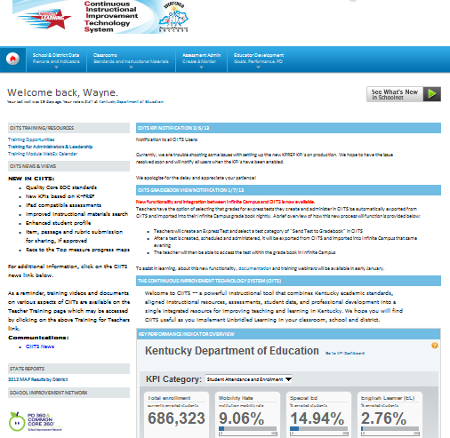
Using CIITS to Address Areas for Growth
PD 360
Notes:
Using professional development resources found in CIITS we can move from identifying areas for growth to developing a professional learning plan that connects these areas to the Framework for Teaching.
Notice where the PD 360 icon appears on the page.

Slide 51
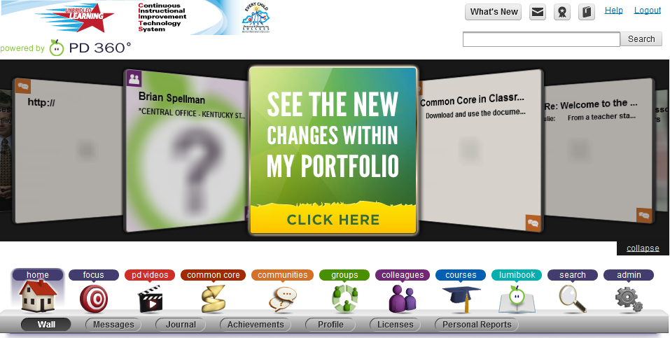
Focus
Notes:
After opening the PD 360 icon, the click path to locate professional learning opportunities that address growth areas connected to the Framework for Teaching begins in the area titled Focus.

Slide 52

PD Connected to Framework for Teaching
Notes:
The screen you see next contains several icons, the target represents the Focus button that will take you to professional learning connected to the FfT.

Slide 53
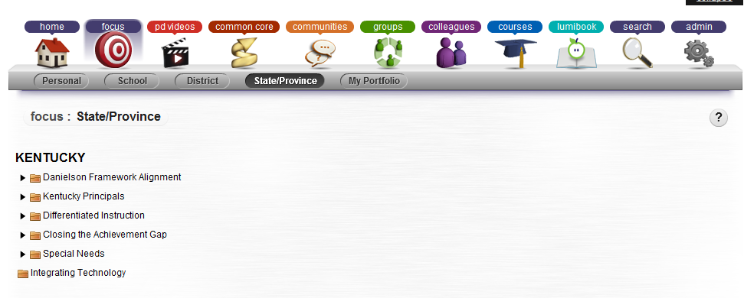
Resources for Kentucky
Notes:
From there, select the State button to find resources populated by KDE to support your professional growth.
Notice on the screen: those resources include folders for the Danielson Framework, KY Principals, Differentiated Instruction, Closing the Achievement Gap and Special Needs.

Slide 54
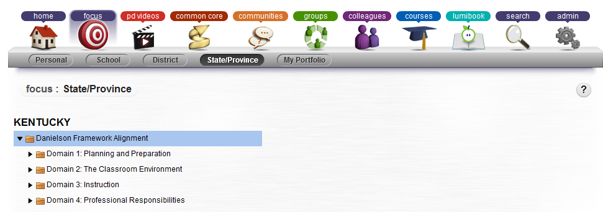
Notes:
PD 360 Resources that connect the Danielson Framework for Teaching can be found in the dropdown box.

Slide 55
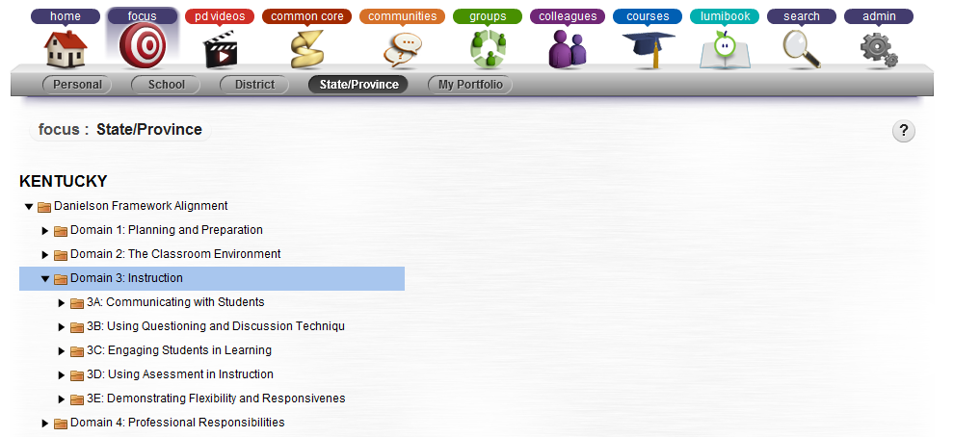
Notes:
This screen is what you will see next. Select the components you identified as needs when analyzing your student voice results. Clicking there will bring up specific professional learning opportunities that target those identified needs.
Classroom observation data will also provide relevant evidence that will provide teachers and leaders additional details to inform professional learning (PL) decisions.

Slide 56
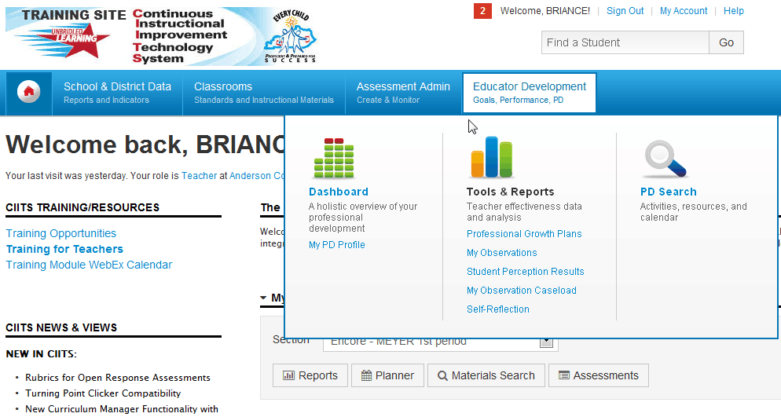
Viewing Student Voice Survey Results-Teacher
Notes:
Student Voice Results are loaded into CIITS yearly. In March students will be asked to complete a survey on their teacher. Questions are attached to this Lync session. Once the results are loaded, a teacher can then view the results.
KDE will send specific directions on administrating the survey.

Slide 57
Accessing Student Voice
Survey Results
If you WERE a participant in a Field Test district go to your data in CIITS → EDS → Tools and Reports to view your data.
If you were NOT a participant in a Field test district, the following slide provides a screen shot of what the data will look like.

Slide 58
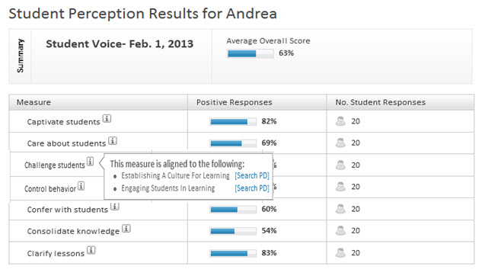
PD 360 Focus Area for Framework
How can these results inform a teacher’s professional learning?
You can search for PD through the survey results.
Notes:
This is a screen shot of sample student voice results for a teacher, before KY modified the Tripod Survey developed by Cambridge
Note: you can also search for PD through the survey results.

Slide 59
Contact Information
Cathy.White@education.ky.gov
  Branch Manager, Office of Next Generation Professionals
teacherleader@education.ky.gov
Notes:
If you have questions about the Student Voice Survey you can get support from the two sources on the screen, or by contacting your regional PGES consultant or your effectiveness coach.

Slide 60
Concurrent Sessions
groups | Session 1 | Session 2 | Session 3
RED | Side Hallway Analyzing Student Work | Main Room Social Studies Network Preview | Front Room Science Network Update
YELLOW | Main Room Social Studies Network Preview | Front Room Science Network Update | Side Hallway Analyzing Student Work
BLUE | Front Room Science Network Update | Side Hallway Analyzing Student Work | Main Room Social Studies Network Preview

Slide 61
Science Overview
Unpacking vs Deconstruction
Learning Targets
DCI Collaboration Plan
Roles of Teacher Leaders
Terry Rhodes KDE/CKEC
terry.rhodes@education.ky.gov
www.terryrhodes1science.com

Slide 62

VS
Unpacking vs Deconstruction

Slide 63
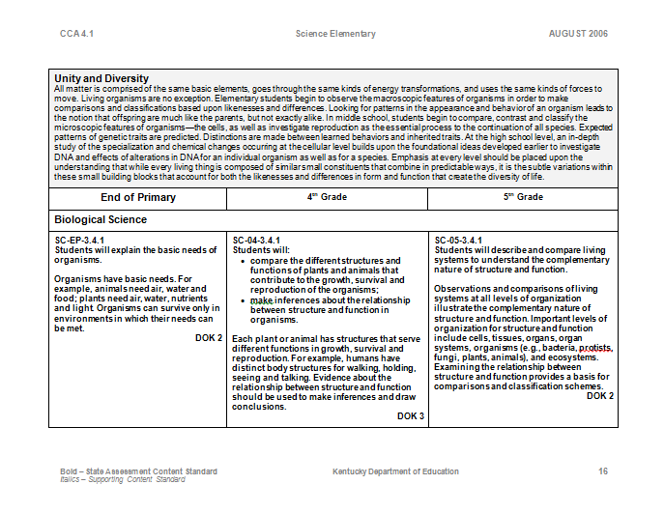
Packet Page 9-13
Life Science Standard 4.1

Slide 64
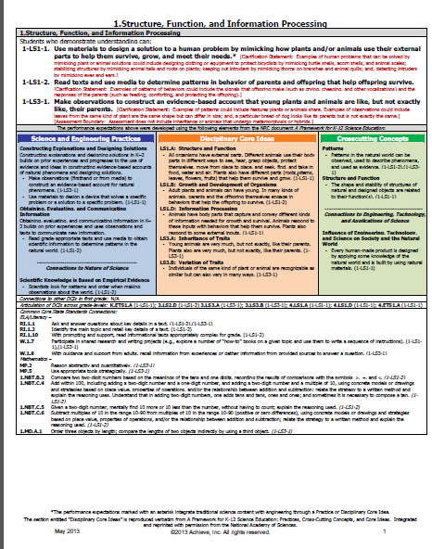
Life Science
Standard
NGSS
Packet Page 14-19

Slide 65
Components
Core Ideas
Clarification Statement
Assessment Boundary
Practices
XCC
Math Connections
Literacy Connections
Grade Specific
4.1
Y
Y
N
N
N
N
N
Minimal
NGSS
Y
Y
Y
Y
Y
Y
Y
Y
“Unpacking”

Slide 66
Components
Core Ideas
Clarification Statement
Assessment Boundary
Practices
XCC
Math Connections
Literacy Connections
Grade Specific
Targets
4.1
Y
Y
N
N
N
N
N
Minimal
No
NGSS
Y
Y
Y
Y
Y
Y
Y
Y
No
“Deconstructing”

Slide 67
Attributes of Clear Learning Targets
Learning Targets (are):
Accomplished in a few days at most
Specific to what and how
Usually consist of concept (noun), skill (verb) and often a specified context
Teachable/learnable using a variety of instructional activities/strategies/context/tools
One component in a sequence of scaffolded accomplishments-focused on what is to be LEARNED
…as opposed to
Long term
Global and somewhat ambiguous
Lacking one or more of the components
A single approach or activity is the only approach possible with the given target; not transferable to another context
Only focused on what is to be DONE (activity)

Slide 68

You Be the Judge-Learning Target or Not?
I can analyze the change in position over time (motion) of an object
I can model radioactive decay by counting pennies that land face-up to represent nuclear fission
I can describe how materials change when they are heated or cooled
I can flip a coin one hundred times to determine the probability of heads
I can use authentic ancient Egyptian techniques to mummify a chicken
I can use evidence to construct explanations of plant and animal life cycles

Slide 69
Types of Learning Targets
Notes:
Unp

Slide 70

Knowledge
The underlying facts and concepts of the discipline that students need to know (describe, explain, recall, identify)

Slide 71


Reasoning
Students use and apply what they know to reason and solve problems (use, formulate, analyze, infer)
Skill
Students perform an action or task that must be observed to be assessed (measure, observe, use equipment)

Slide 72

Product
The product itself is the focus of the standard and there must be a product to determine if the student can create it (constructs, creates, develops)

Slide 73
Target Types tend to be Cumulative or Hierarchal
Knowledge = knowledge
Reasoning = knowledge + reasoning
Skill = knowledge + reasoning + skill
Product/Performance=
  knowledge + reasoning + skill + product/performance

Slide 74
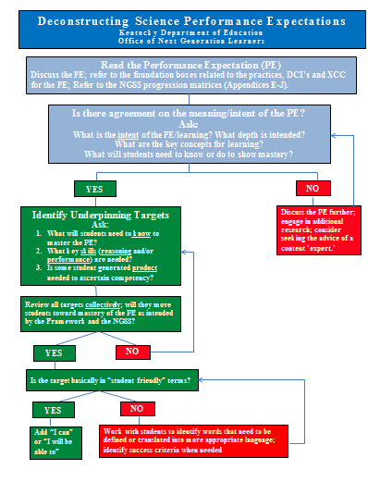
Packet Page 20

Slide 75
DCI Collaboration Plan
Co-op | PS1.A Structure and Matter | PS4.A Wave Properties | LS2.A Interdependent Relationships | ESS1.C History of Planet Earth
NKCES | K-8, HS | HS | HS | HS
GRREC | HS | K-8,HS | HS | HS
KEDC | HS | HS | HS | K-8,HS
SESC | K-8,HS | HS | HS | HS
KVEC | HS | K-8,HS | HS | HS
OVEC | HS | HS | HS | K-8,HS
WKEC | HS | HS | K-8,HS | HS
CKEC | HS | HS | K-8,HS | HS
High School teachers will work within their content specialty
Packet Page 21

Slide 76
Collaboration Plan
Over the next 3 meetings, the science networks will begin a collaborative deconstruction of K-12 progressions across 4 identified DCI’s.
The end result will be learning targets and sample classroom performance assessments for the 4 progressions
Two co-ops will collaborate on each K-12 progression; we are paired with WKEC

Slide 77
Teacher Leaders
How can we best utilize our Network Teacher Leaders as we move forward in this implementation process?
Pair up in groups of 2 or 3 and wait for my instructions
When I say begin, with your partners, you will have 2 minutes to read and discuss role # 1; I will keep time.
We will continue through all 10 roles. Do not be overachievers and move forward!
Packet Page 22-24

Slide 78

How can we best utilize our Network Teacher Leaders as we move forward in this implementation process?
What steps have you taken in your district to utilize these teacher leaders (science, ELA and Math)?
Are you utilizing the network teachers in building capacity within your district to start the NGSS work, continue CCSS work, and begin TPGES implementation?

Slide 79
Concurrent Sessions
groups | Session 1 | Session 2 | Session 3
RED | Side Hallway Analyzing Student Work | Main Room Social Studies Network Preview | Front Room Science Network Update
YELLOW | Main Room Social Studies Network Preview | Front Room Science Network Update | Side Hallway Analyzing Student Work
BLUE | Front Room Science Network Update | Side Hallway Analyzing Student Work | Main Room Social Studies Network Preview

Slide 80

*LA County Office of Education C3 Webcast
*Dr. Kathy Swan's "Achieving the C3: An exploration into 21st century social studies"
Debbie Waggoner KDE/CKEC
debbie.waggoner@education.ky.gov
www.debbiewaggoner.com

Slide 81


Kentucky Leadership Networks for Social Studies
Teacher Development
KCAS SS and Literacy in History/SS
Curriculum
+
Instruction
Assessment
FRAMEWORK ≠ STANDARDS
Notes:
Resources CURRENTLY AVAILABLE TO INFORM HIGHLY EFFECTIVE PRACTICE…AND AS WE DO SO AND GET MORE INFORMATION FROM THE FIELD, THEN WE CAN DECIDE HOW BEST TO REVISE STANDARDS …It is important to note that we do have a Framework that is based upon the Inquiry Arc and presented into four dimensions: 1. Developing Questions and Planning Inquiries 2. Applying Disciplinary Concepts and Tools 3. Evaluating sources and using evidence and 4. Communicating conclusions and taking informed action.
OVER TIME, Our goal is to have a solid, defensible, world-class draft of college/career ready standards to present to the Kentucky Board of Education –SOMETIME in 2014.

Slide 82




Slide 83

“Our Democratic Republic will not sustain unless students are aware of their changing cultural and physical environments; know the past; read, write, and think deeply; and act in ways that promote the common good.”
The College, Career and Civic Life (C3) Framework for Social Studies State Standards: Guidance for Enhancing the Rigor of K-12 Civics, Economics, Geography and History p. 5

Slide 84
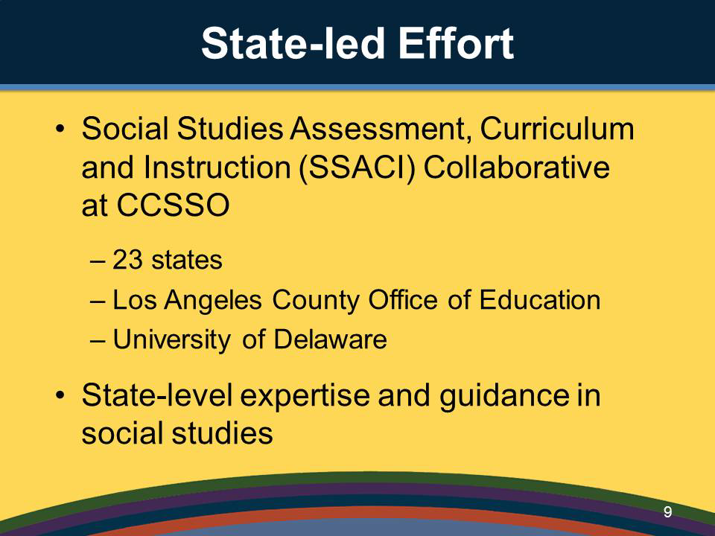


Slide 85


Slide 86


Slide 87
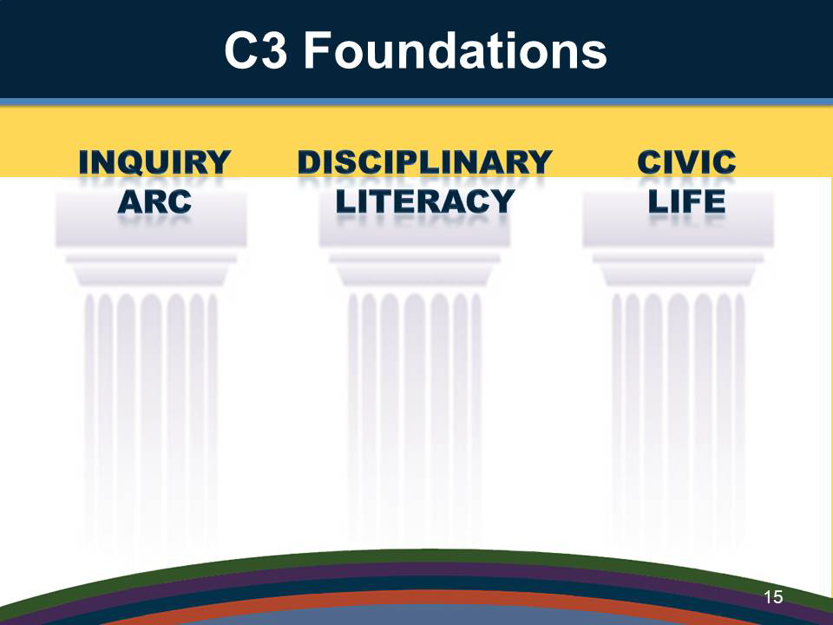

Slide 88
Picture Prediction: Based on the symbols included in this graphic, predict what you think might be the critical components of the C3 framework.

Slide 89

D1

Slide 90

DIMENSION ONE: Developing Questions and Planning Inquires
Constructing Compelling Questions
Constructing Supporting Questions
Determining Helpful Resources

Slide 91
D2

Slide 92

DIMENSION TWO: Applying Disciplinary Concepts and Tools
CIVICS
GEOGRAPHY
ECONOMICS
HISTORY

Slide 93
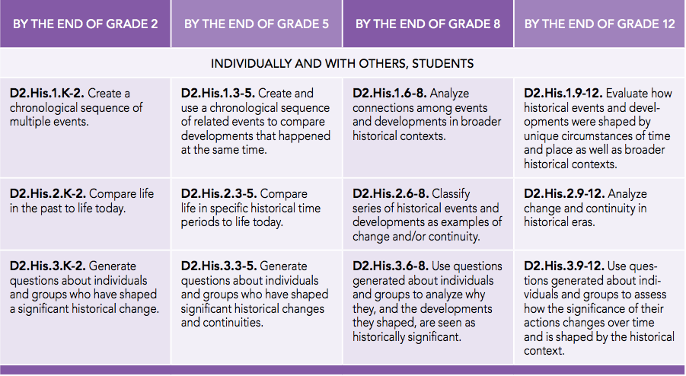
History K-12 Pathway

Slide 94
D3

Slide 95

DIMENSION THREE: Evaluating Sources and Using Evidence
Gathering and Evaluating Sources
Developing Claims Using Evidence

Slide 96
D4

Slide 97

DIMENSION FOUR: Communicating Conclusions and
Taking Informed Action
Communicating Conclusions
Critiquing Conclusions
Taking Informed Action

Slide 98
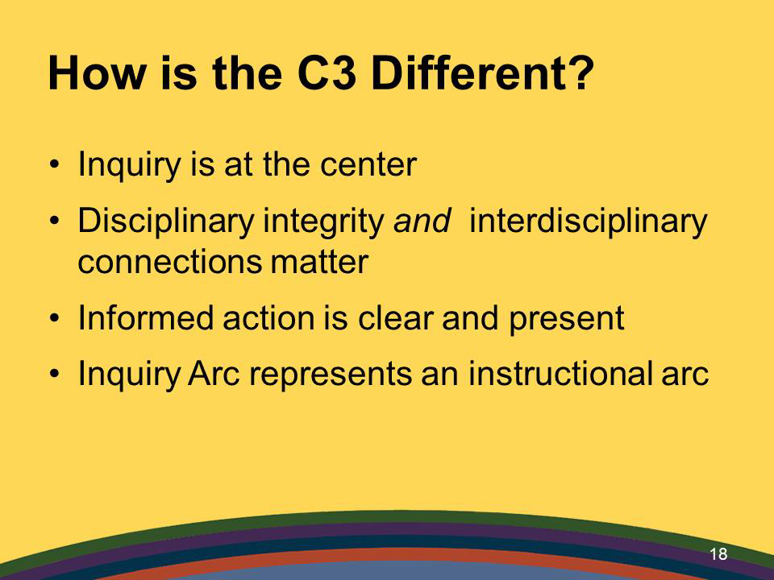

Slide 99
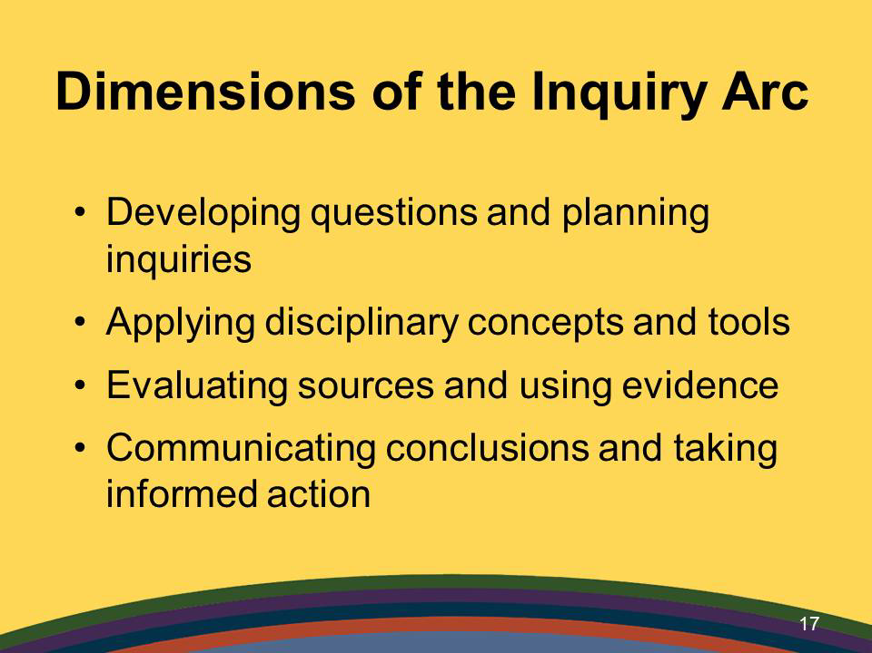

Where do you see each of the four dimensions from the C3 Framework in the Framework for Teaching?
Review pages 37-42 to compare 1A, 1D, 3B, 3C

Slide 100

Thinking Like A Historian…
The Reading Like a Historian curriculum engages students in historical inquiry. Each lesson revolves around a central historical question and features sets of primary documents designed for groups of students with diverse reading skills and abilities.
Reading Like a Historian Curriculum Website: http://sheg.stanford.edu/rlh
Reading Like a Historian Overview Video http://youtu.be/wWz08mVUIt8

Slide 101
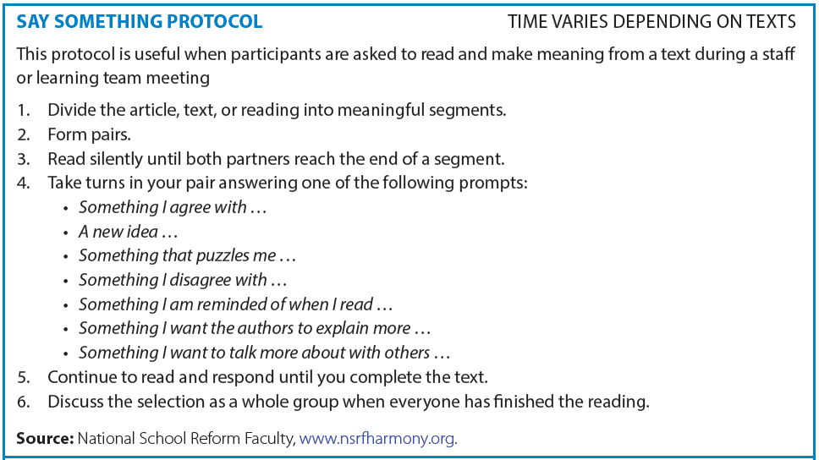

Thinking Like A Historian
Say Something
protocol on page 35
Read page 31-32 – then say something to your partner
Read page 33- 34 – then say something to your partner

Slide 102

“Agents of Change”
CKEC Social Studies Content Network Meeting
Tuesday, January 28th, 2014
Thursday, February 27th, 2014
Tuesday, March 25th, 2014
-- Update on Social Studies Standards Work in Kentucky, January 2014 packet page27-28
-- C3 – College, Career, and Civic Life Framework overview packet page29-30
The only way to make sense out of change is to plunge into it, move with it, and join the dance.
--Alan Watts

Slide 103
Concurrent Sessions
groups | Session 1 | Session 2 | Session 3
RED | Side Hallway Analyzing Student Work | Main Room Social Studies Network Preview | Front Room Science Network Update
YELLOW | Main Room Social Studies Network Preview | Front Room Science Network Update | Side Hallway Analyzing Student Work
BLUE | Front Room Science Network Update | Side Hallway Analyzing Student Work | Main Room Social Studies Network Preview

Slide 104

ANALYZING STUDENT WORK
Kelly Philbeck KDE/CKEC
kelly.philbeck@education.ky.gov
www.kellyphilbeck.com
WEBSITES: www.nsrfharmony.org
www.aspendrl.org

Slide 105
TUNING PROTOCOL
Learning from Student Work – Overview
Tuning Protocol
Tuning Protocol Worksheet
Packet pages 43-48

Slide 106

Literacy Design Collaborative
Information sheet – explanatory module
HS Student work sample
Definitions of LDC Informational/Expository Scoring Elements
Scoring Rubric for Informational or Explanatory Template Tasks
Packet pages 49-53

Slide 107
Concurrent Sessions
groups | Session 1 | Session 2 | Session 3
RED | Side Hallway Analyzing Student Work | Main Room Social Studies Network Preview | Front Room Science Network Update
YELLOW | Main Room Social Studies Network Preview | Front Room Science Network Update | Side Hallway Analyzing Student Work
BLUE | Front Room Science Network Update | Side Hallway Analyzing Student Work | Main Room Social Studies Network Preview

Slide 108

Wednesday, February 26
CKEC Certified Evaluation Plan Training
NorthEast Christian Church
9:00am – 4:00pm
Mike Cassady CKEC/KDE - PGES
mike.cassady@ckec.org

Slide 109

As we move into
2014…
Use the Plan for Full Scale Implementation organizer to begin to plan what you need to do or have in place each month so all teachers and leaders will be ready by September 2014.
Packet pages 54-56
Notes:
We will revisit this tool every time we reconvene and we will be asking districts to share their plans with each other in Jan., Feb. and March.

Slide 110

Please complete your (yellow) evaluation before you leave.
We need your feedback!

Slide 111


CKEC Instructional Support
Leadership Network 2013-2014
NorthEast Christian Church 8:30am-12:30pm
September 19th, 2013
October 17th, 2013
November 21st, 2013
January 16th, 2014
February 20th, 2014
March 20th, 2014

Slide 112


Have a happy….
SNOW Day
President’s Day
See you on February 20th

Slide 113
Thank you!
We’re excited to be your Facilitation Team and look forward to serving you.
debbie.waggoner@education.ky.gov
terry.rhodes@education.ky.gov
kelly.philbeck@education.ky.gov
rebecca.woosley@education.ky.gov
mike.cassady@ckec.org
Notes:
(Just show this slide)

