Slide 1
CKEC Social Studies Update
Debbie Waggoner, KDE Instructional Specialist
CKEC SS Network Meetings:
Tues Mar 24th, 2015
Tues Apr 21st, 2015

Slide 2
Update on SS Standards (Mar. 2015)
Revisions have been occurring as a result of public and focus group feedback.
The majority of responses (approx. 80%) were to make NO changes to the existing draft.
Supplementary resources (appendices) are in the works:
Curriculum considerations documents for K-8 (See Kindergarten copy)
High school suggested course options – tradition vs. integrated
K-2 Integrated unit samples
Glossary
Ky. BOE to have second read in June.
Statement of Considerations presented in August with KDE rationale regarding decisions around public feedback.
Implementation still planned for Fall 2015

Slide 3
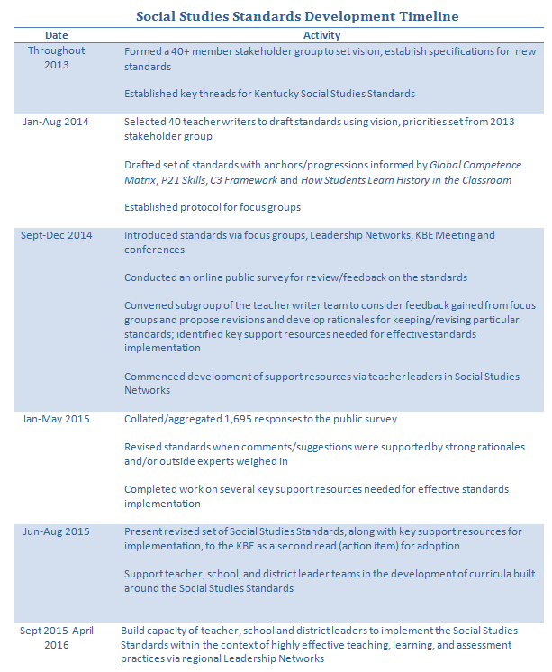

Slide 4
Are you Willing to Be Disturbed?
Read the short one-page passage.
While reading, highlight the one statement that resonates with you.
Beginning with the person at your table whose birthday is closest to Easter, share your statement.
As a table group discuss how this passage might be helpful as you distill content from the standards today, and as you go back and lead it in your district.
4
Notes:
Most of us would probably agree that understanding the new standards is not an easy process.
Now that we are going to give each other constructive feedback we may find that being told we could improve to be a bit disturbing.
How can we learn and grow without being disturbed?

Slide 5
Are you Willing to Be Disturbed?
Video Clip “I remember” by Intel
http://www.youtube.com/watch?v=8i0iPphcgtU
Discuss with your table group the implications this video and the Are you willing to be disturbed? passage have on:
the need for the new focus on social studies standards for the next generation and
your role as a social studies leader in your school and district to help prepare teachers for this shift…
5
Notes:
The amount of new information we each come in contact with daily is greater than at any time in history.
We can’t expect to keep doing things the same way and keep up, we have all ourselves to be disturbed so we can learn from one another.
This video shows how the world has already changed just in the time these young kids have been alive.

Slide 6
Target
Participants can distill content from draft standards through a process for curricular design.

Slide 7
Modeling a Protocol for Distilling Content from Standards
Architecture Study
Anchor
Grade-level Narrative
Grade-level Standard
Context Examples
Connections

Slide 8
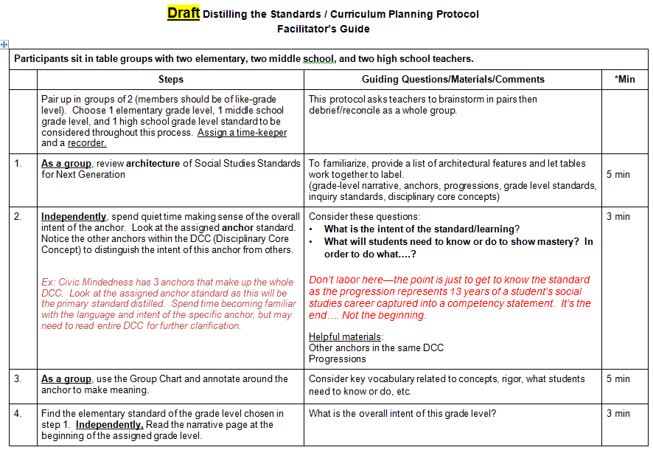
Work through steps 1-8 of the PROTOCOL with your table group

Slide 9
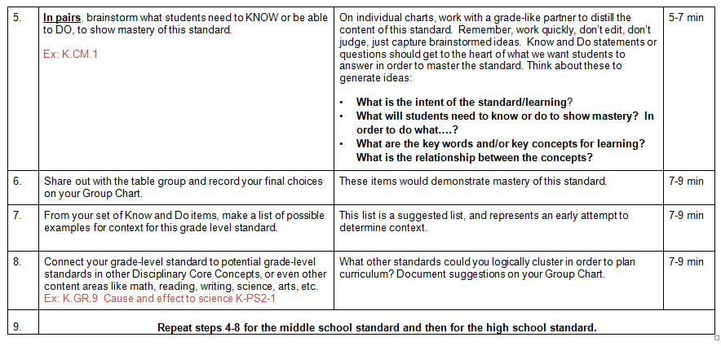
Work through steps 1-8 of the PROTOCOL with your table group

Slide 10
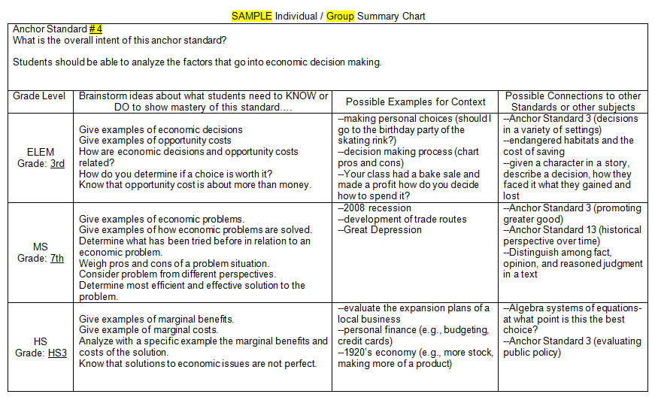
Anchor Standard #4 Economic Decision Making
Analyze and explain how resource availability, opportunity cost, and incentives are an essential part of economic decision making.
3rd Explain how economic decisions are affected by opportunity cost.
7th Evaluate approaches to solve various economic problems and offer alternative solutions.
HS3: Analyze marginal benefits and marginal costs of the solution for an economic issue.

Slide 11
CKEC Summer SS Network
Thurs. June 11th | Tues. July 21st | Thurs. July 23rd
Curriculum Planning Day | Curriculum Planning Day | Joint Science and Social Studies LDC Day
When is your district team
going to attend?

Slide 12
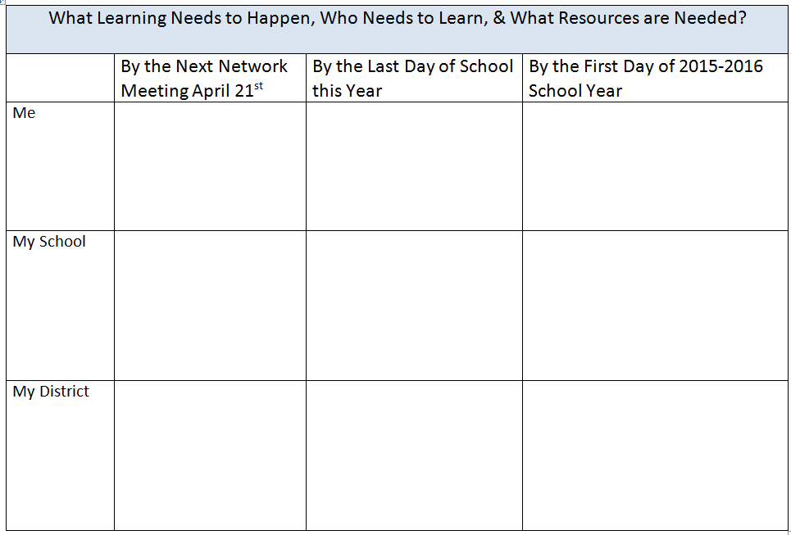
*Add District Name
What capacities are in place to make curricula decisions?
How do we prepare our district, school, and team to write SS curriculum?
Take a picture for your records
& turn in once finished

Slide 13
Kentucky Rising
Kentucky Rising establishes criteria for a high school diploma, certificate, or endorsement that certifies a graduate meets the employment requirements of foreign industries that are directly investing in the state and industries that are creating trade with other countries.
By ensuring Kentucky’s workforce is an asset to global development, Kentucky can continue to create jobs for residents that grow the state’s economy. “Global ready diploma”
Kentucky Rising both supports and intersects with ALL content areas, especially social studies. An emphasis on Kentucky Rising as an intentional focus aligns the rigor of KCAS, PGES, 21st Century Skills and Program Reviews while developing a skilled and highly adaptable workforce.

Slide 14
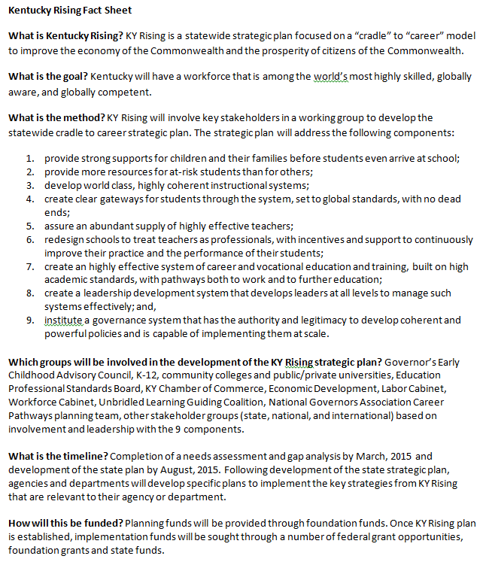

Slide 15
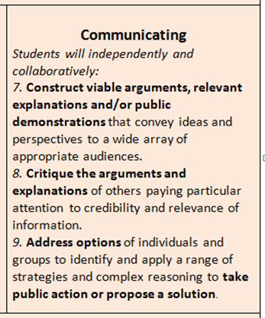
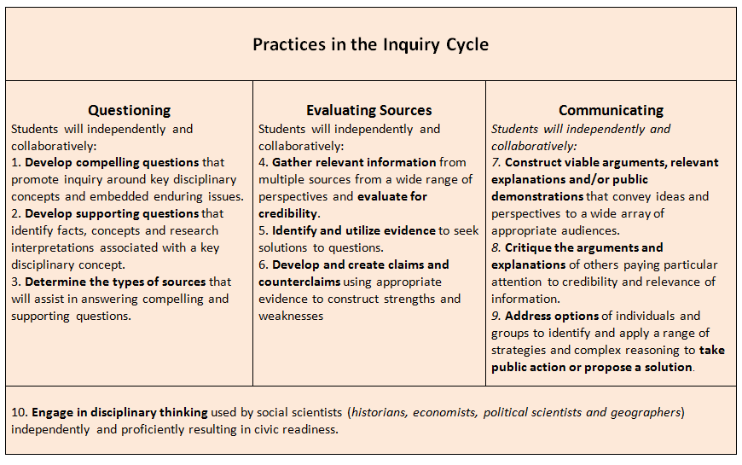
Focus on Inquiry enhances classroom practice…

Slide 16
GO BIG BLUE! #BBN #WeAreUK #PursuitOfPerfection #TimeForNINE

