Slide 1
Professional learning communities Facilitate teacher leadership and learning
Rebecca Woosley and Kelly Philbeck
Notes:
Continuing our focus on shared leadership, we are going to share a discussion about how well PLCs are structured and functioning in your schools and districts.

Slide 2
One way to foster teacher leadership:
Promote and Support
Professional Learning Communities

Slide 3
How do you schedule /facilitate teacher leadership, coaching and collaboration during the day in your school /district?
Share your ideas for Creative Scheduling
Notes:
Please take time at your tables to list some of the ways you facilitate teacher leadership and learning in your school or district. We’ll capture all the creative scheduling ideas you share and include them on Debbie’s web page for you.
Why is it important to do this?

Slide 4
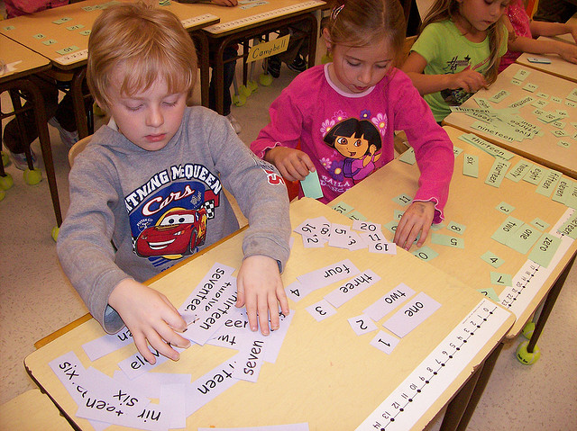
Making matches
Using the list of 5 critical attributes, and the indicators from the Teacher Innovation Configuration maps(IC), determine which indicators best describe teacher leaders contributions to PLCs today.

Slide 5
5 Critical attributes of a Successful PLC
Supportive/shared leadership
Collective Creativity/Collaborative Problem Solving
Shared values/vision
Supportive conditions (time provided in the school day)
Shared personal practice
Notes:
We’d like to hear from you about how PLCs in your district are meeting these success criteria.
Shared leadership means principals and PLC leaders meeting and sharing progress and goals on a regular basis. It also means principals protecting PLC time and not layering on other administrative agenda items that interfere with the purpose of the PLC.
Collaboration in problem solving leads to creativity and prevents frustrations. It also fosters creativity and practices that support student engagement.
A focus on student success should be the shared vision that informs all the instructional practices and decisions made by the PLC.
Supportive conditions facilitate the value and vision shared with leadership. If the structure of the schedule does not facilitate meeting during the school day now, that should be a question that schools are thinking about before the next school year.
The opportunity for teachers to mentor each other and learn together (through model lessons, shared lessons, evidence from student work) is part of how teacher leaders can support teacher and student growth.

Slide 6
Effects of a successful plc system
Promotes a collaborative teacher culture focused on student success
Improves school culture when practices & learning are authentic
Tasks transform from simple, rote memory and recall to intellectually challenging activities
Notes:
What else can you add to this list? If your PLCs are not getting these outcomes, let’s think about what changes you can begin to implement now that would help foster these outcomes.

Slide 7
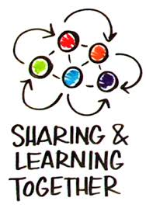
Best practices for a successful PLC

Slide 8
Best practices for a successful PLC
Establish regular times (within the school day) to conduct PLC meetings
Generate and enforce participation & professionalism norms
Provide guidelines, but allow team members to determine the frequency of meetings
Be focused and intentional in meetings (team prepared agendas)
Prepare teachers to use evidence
Notes:
All of the elements on the slide are somewhat self-explanatory except for the last one – preparing teachers to use evidence. Let’s talk about what that means. This is an important part of assessment literacy. Do teachers know how to analyze student evidence (especially from formative assessments or common assessments) and use that evidence to make intentional instructional decisions. If this is not a part of their literacy practice, your PLC teacher leaders can facilitate that professional learning with the real work students are doing in those content areas, so that every teacher becomes an instructional leader in his/her classes – and all teachers become proficient at this critical aspect of assessment literacy.
How are you supporting teachers’ ability to use evidence to support instruction?

Slide 9
Resource
From Isolation to Collaboration: Promoting Teacher Leadership Through PLCs. CTQ, 2008

