Slide 1
Important News Concerning KCAS-Science Clarification on Science Testing in 2015 Kentucky will embark on the development of a new science assessment system to match the standards. The new system will take time to build.
Thus, staff of the Kentucky Department of Education (KDE) proposed to
the Kentucky Board of Education in June 2014 to suspend the K-PREP science testing at grades 4 and 7 in the spring of 2015 since the only test available measures out-of-date standards.
However, the United States Department of Education (USED), during the review of Kentucky’s ESEA waiver extension submission, made it clear that there must be a science test at these levels administered in Kentucky in 2015. In order to meet USED requirements, the following will occur:

Slide 2
Elementary and middle schools will administer at grades 4 and 7 a science Norm-Referenced Test (NRT).
The Stanford NRT has been given for the last three years as Part A of the K-PREP science test. The NRT is 30 questions and takes 40 minutes of testing time.
National percentile results will be reported, but scores will not be used in the state accountability system.

Slide 3
Alternate Assessment students will be tested in science in spring 2015 at grades 4, 7 and 11.
Grades 4 and 7 will not be used in state accountability. The process for Alternate Assessment for grade 11 science is still under development.
Science tests will continue to be part of the ACT EXPLORE (grade 8), ACT PLAN (grade 10) and the ACT (grade 11). For Alternate Assessment students, the Transition Attainment Record will continue.
Results for all will be reported and used in accountability.

Slide 4
As the new science assessment system develops, educators will be kept informed of timelines and other important info

Slide 5
Change
“Change is the law of life. And those who look only to the past or present are certain to miss the future.” —John F. Kennedy
“Things do not happen. Things are made to happen.” —John F. Kennedy
“Change is a natural process that is necessary for improvement. Sometimes changing things that no one sees is necessary for improvement; sometime even changing my underwear is an improvement!” — George Carlin?

Slide 6
If Not you…Then Who?
The state assessment drives what happens in our classrooms and it derails authentic science learning for our students

Slide 7
So, what if…..
Imagine if you had the opportunity to reverse that model?
What if you could be part of a system where instructional planning based on 3-dimensional science standards was the cornerstone of assessment design?

Slide 8
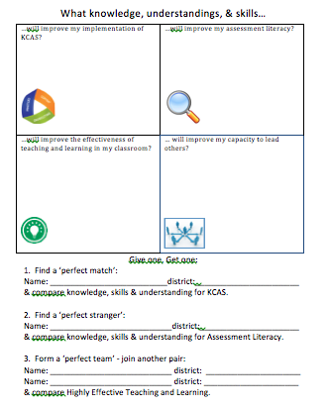
Journal the following, using support from the brief.
Why is a new assessment system needed?
Compare the characteristics of the traditional assessment system with those needed to measure mastery of the new science standards.
Why isn't it feasible to assess all PEs at a specific grade level with a single assessment?
What components constitute a systems approach to assessment? Which of these components represent a significant shift from our current system?
What recommendations were made regarding the development of a new assessment system in the BOTA report?

Slide 9
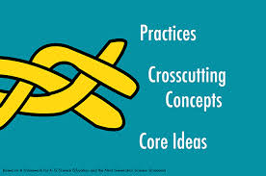
What if…
Kentucky teachers focused first on shifting their instruction and developing assessments to reflect the 3-dimensional learning intention of the framework which requires not only a deeper understanding of fewer concepts intentionally developed over time, but also incorporates what we’ve learned about how kids best learn science?

Slide 10
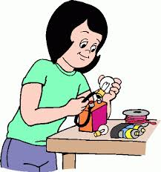
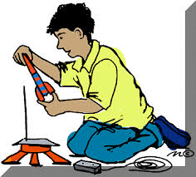
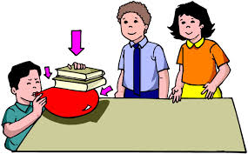
What if…
Teacher and student learning determined what our state assessment looked like so that our kids are assessed in a way they can demonstrate what they really know?

Slide 11
Our new science standards require a shift from what scientists and engineers know to what scientists and engineers do with what they know.
Instructional experiences created from these standards will give students an opportunity that many have not had before: to solve problems, evaluate evidence and search for important questions.

Slide 12
Teachers will have the opportunity to design experiences and assessments that emphasize the broad range of scientific and engineering thinking rather than only fundamental knowledge.
Students won’t just be given the pieces of the puzzle, they will practice using the same skills that scientists and engineers use to assemble those pieces through the process of gathering information, applying reasoning and communicating their findings.

Slide 13
Imagine…
A world where classroom experiences drive state assessment
A world where students engage in authentic science experiences
YOU are the pivotal point in this process!

Slide 14
Draft Plan for New Science Assessments

Slide 15
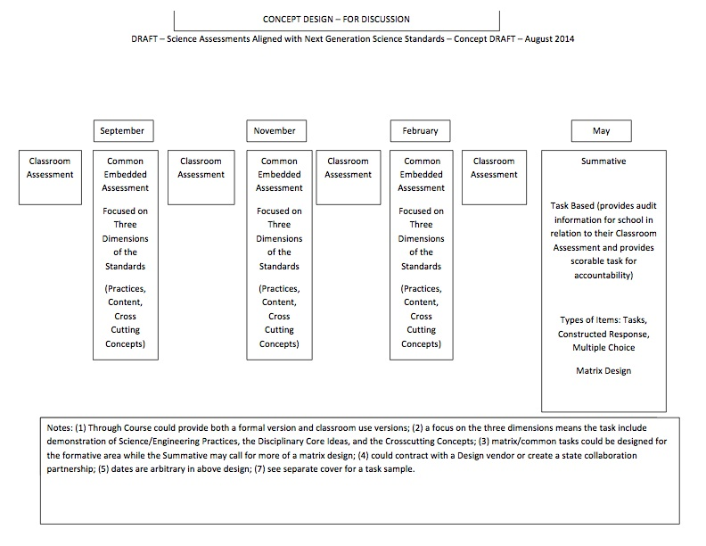

Slide 16
IF NOT YOU, THEN WHO?

Slide 17
Reasoning
Communicating
Gathering
Obtain Information
Ask Questions/Define Problems
Plan & Carry Out Investigations
Use Models to Gather Data
Use Mathematics & Computational Thinking
Evaluate Information
Analyze Data
Use Mathematics and Computational Thinking
Construct Explanations/Solve Problems
Developing Arguments from Evidence
Use Models to Predict & Develop Evidence
Communicate Information
Using Argue from Evidence (written/oral)
Use Models to Communicate
(Moulding, 2012)
Notes:
Professional development must provide teachers with a way to engage student is all aspects of science.

Slide 18
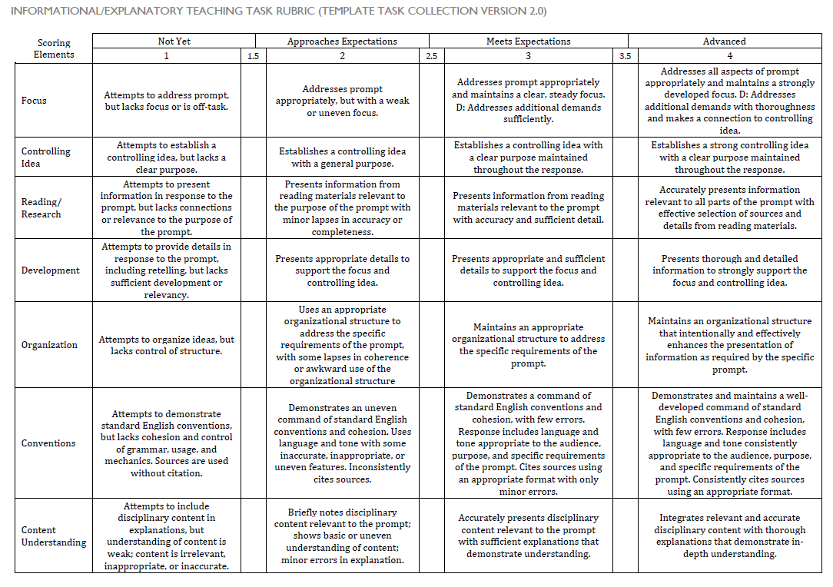
Grades 6-12

Slide 19
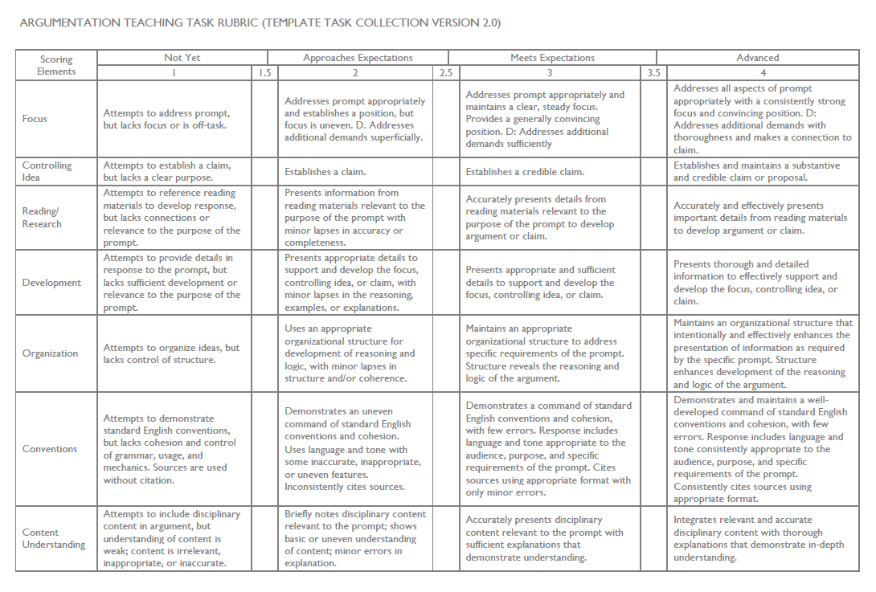
Grades 6-12

Slide 20
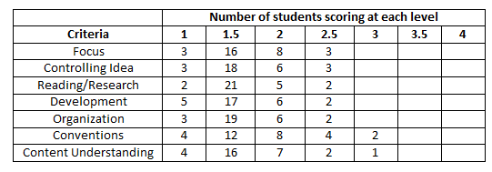
Coming Up next month… how to use the LDC rubric to collect evidence for student growth goals….
{

