Slide 1
Science Updates
Classroom Assessment
Engaging in Argument from Evidence

Slide 2
IT SAYS…I SAY…
Classroom Assessment:
Minute by Minute, Day by Day
Educational Leadership, Nov 2005

Slide 3
Take a few moments to read the article, paying particular attention to the numbered sections.
As you read, fill in column 1…It Says..with one important/intriguing/controversial/memorable idea from the section
After reading, fill in column 2…I Say…with a personal connection/reaction to the quote
Turn and Talk with your table partner, sharing your entries

Slide 4
ENGAGING IN ARGUMENT FROM
EVIDENCE: HOW TO FRAME
ARGUMENTS IN THE CLASSROOM

Slide 5
WHAT IS ARGUMENT?
“We define scientific argument as an attempt to validate or refute a claim on the
basis of reasons in a manner that reflects the values of the scientific community.”
Scientific Argumentation in Biology 2013

Slide 6
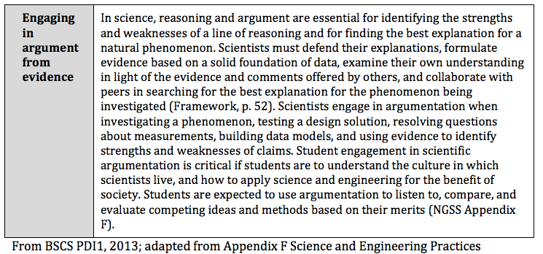

Slide 7
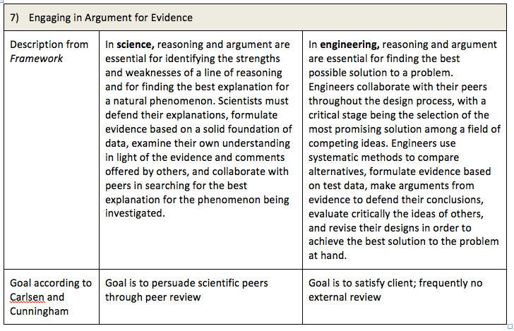

Slide 8
GENERATE AN ARGUMENT
INSTRUCTIONAL MODEL
THE TEACHER IDENTIFIES THE
TASK AND QUESTION
GENERATE A TENTATIVE
ARGUMENT
ARGUMENTATION
SESSION
REFLECTIVE
DESCUSSION
FINAL WRITTEN
ARGUMENT

Slide 9
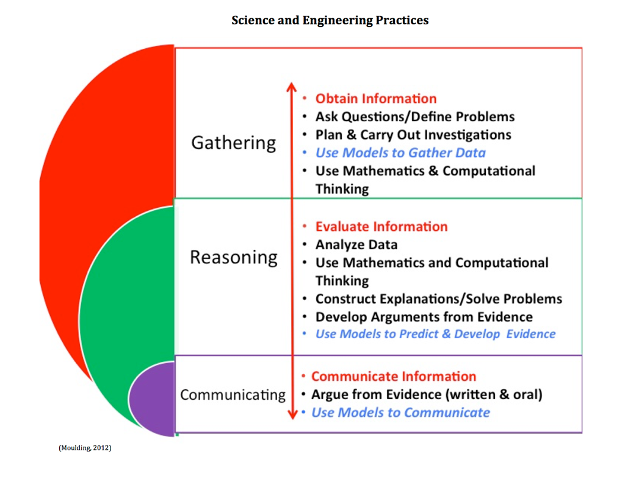

Slide 10
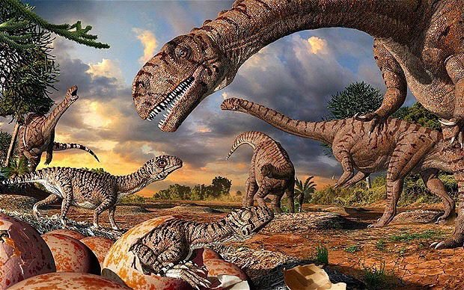
RESEARCH
QUESTION
What caused the mass extinction of the non-avian dinosaurs?

Slide 11
WHAT DO WE ALREADY KNOW?
What do we know about the causes of the mass extinction of the non-avian dinosaurs?
Brainstorm a list
Which causes would be classified as a sudden extinction? Place an (*) Gradual? Place a (#)
Gathering

Slide 12
EVIDENCE:
Sort through the scientific evidence cards.
Organize the evidence cards into groups that seem to be related to each other.
Gathering

Slide 13
TENTATIVE
ARGUMENT

Slide 15
CLAIM:
In your group decide on a cause of dinosaur extinction that is supported by the evidence.
Write your claim on your chart.
Reasoning

Slide 16
EVIDENCE:
List all the pieces of evidence that support your claim.
Gathering

Slide 17
REASONING:
Provide your justification of the evidence.
Explain why the evidence is relevant and why it provides adequate support for the claim.
Include relevant scientific principles and use scientific terms.
Reasoning

Slide 18
ARGUMENTATION
SESSION
Round Robin
Argumentation session
Mix up your groups
Be intentional making
connections with the cross
cutting concepts.
Communicating

Slide 19
SOME OTHER QUESTIONS:
How did you analyze the available data?
Was there any data that did not fit with your claim?
Do you think your analysis is accurate?
Do you think your reasoning is appropriate?
Why does your evidence support your claim?

Slide 20
REFLECTIVE
DISCUSSION
Return to your original
group.
What do you need to
Modify?
What did you learn about
dinosaur extinction?
Reasoning

Slide 21
WRITE AN
ARGUMENT
Communicating

Slide 22
WRITING PROMPTS:
Communicating

Slide 23
KCAS ELA & SCIENCE
MS-ESS1-4. Construct a scientific explanation based on evidence from rock
strata for how the geologic time scale is used to organize Earth's 4.6-billionyear-
old history. [Clarification Statement: Emphasis is on how analyses of rock formations and the fossils they contain are used to establish relative ages of major events in Earth’s history. Examples of Earth’s major events could range from being very recent (such as the last Ice Age or the earliest fossils of homo sapiens) to very old (such as the formation of Earth or the earliest evidence of life). Examples can include the formation of mountain chains and ocean basins, the evolution or extinction of particular living organisms, or significant volcanic eruptions.] [Assessment Boundary: Assessment does not include recalling the names of specific periods or epochs and events within them.]
CCSS.ELA-LITERACY.WHST.6-8.1.B
WHST.6-8.1.B Support claim(s) with logical reasoning and relevant, accurate
data and evidence that demonstrate an understanding of the topic or text,
using credible sources.

Slide 24
WITH OLDER
STUDENTS:
ALTERNATIVES
INCLUDE
COUNTERARGUMENT

Slide 25
CLAIM:
In your group decide on a cause of dinosaur extinction that is supported by the evidence.
Write your claim on your chart.
Evaluate alternatives: Write your Counter Claim
Reasoning

Slide 26
EVIDENCE:
List all the pieces of evidence that support your claim and counter claim.
Gathering

Slide 27
REASONING:
Provide your justification of the evidence.
Explain why the evidence is relevant and why it
provides adequate support for the claim.
Include relevant scientific principles and use scientific
terms.
Evaluate alternatives: Your Challenge to the Counter
Claim
Reasoning

Slide 28
EVALUATE ALTERNATIVES
INSTRUCTIONAL MODEL
THE TEACHER IDENTIFIES THE TASK, THE RESEARCH QUESTION AND THE ALTERNATIVES
GENERATE A TENTATIVE ARGUMENT AND COUNTERARGUMENT
COLLECT DATA
ARGUMENTATION SESSION
REFLECTIVE DISCUSSION
FINAL WRITTEN ARGUMENT

Slide 31
Agenda for January Science Leadership
Classroom Assessment and Student Achievement
Breakouts
Formative Assessment
Writing Student Experiences
Assessment Task Evaluation Protocol
Inquiry
Engaging in Argumentation from Evidence-Guppies
Reflection/Evaluation/Books

