Slide 1
Social Studies Standards for the Next Generation

Slide 2
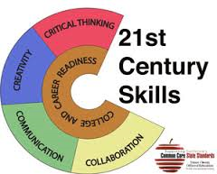
Informing the Work

Slide 3
Development Process
May 2014 Request for Application for Writing Team Members
June 2014 Up to Five Teachers Per Cooperative Region Selected
June/July 2014 Four Writing Sites Convened Over Five Days
July 31, 2014 Representatives from Each Cooperative Region Met to Propose a Completed Draft

Slide 5
New
Now

Slide 6
Let’s Take
A Look

Slide 7
The Architecture
Inquiry Cycle
Inquiry Cycle
Disciplinary Core Concepts
Inquiry Cycle
Inquiry Cycle

Slide 8
based on C3
Anchor Standard 1 | Civic and Political Institutions Determine the importance of the institutions of society and the principles that these institutions are intended to reflect, which requires the demonstration of in-depth understanding of law, politics, and government.
K | Identify the roles and responsibilities of community members
1st | Explain the need for and purposes of rules in a community
2nd | Explain what governments are and how communities work to accomplish tasks and establish responsibilities
3rd | Explain how citizens responsibly participate in democratic processes and practice civic responsibility
4th | Describe the origins, functions, and structure of state government to determine how it supports freedom within a democracy
5th | Explain how government effects how citizens, political and economic groups function within society
Notes:
Concept of Anchor Standards and Progressions – Anchors come from Exit Criteria in C3
progressions particularly emphasize developmentally appropriate skills/reasoning – congruent to ELA standards expectations at same levels; this was the critical work of the 40 teachers this summer –bringing their own expertise and professional knowledge to this work.

Slide 9
Coherence, Congruency, Clarity
Coherence—grade to grade, scaffolding, rigor, content
Congruency—progression to the anchor (individually and collectively)
Clarity—clear use of language

Slide 10
Inquiry Cycle
15 Standards
Notes:
link back to the architecture discussion… and how this translates the key strands/components that were selected.

Slide 11
What’s Next…
August 21, 2014 Reconvening of Cohort 1 for guidance and refinement
September 2014 Targeted Focus Groups
*Higher Education
*Content Leadership Networks
*Other Key Stakeholders
October 2014 First Read KBE
November 2014 Continue to solicit Feedback and Refine Draft
December 2014 Second Read
January 2015 Public Comment Period

Slide 12
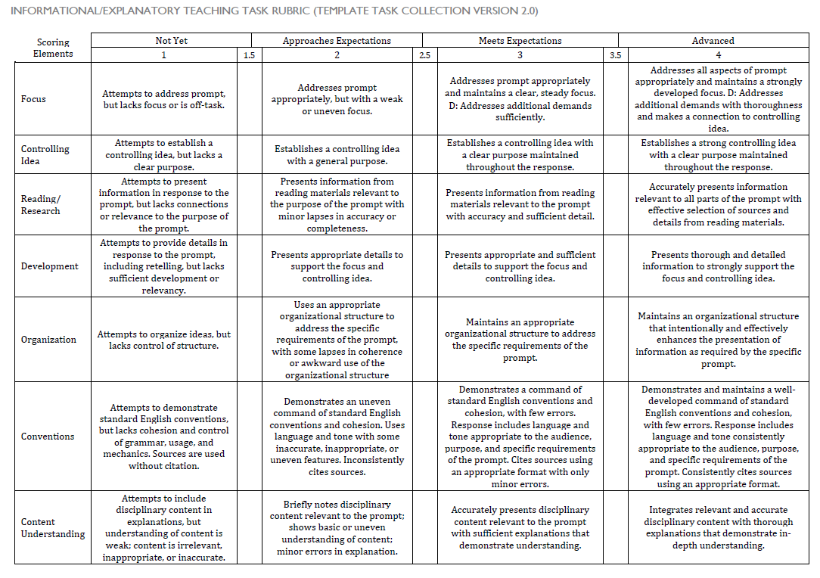
Grades 6-12

Slide 13
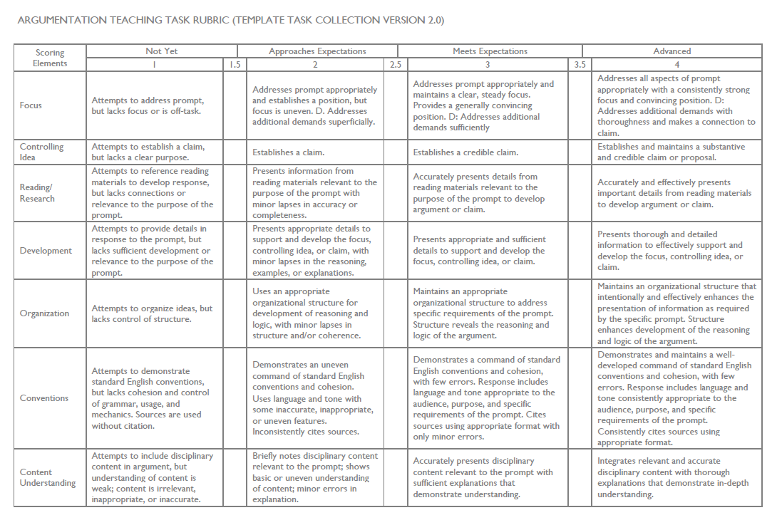
Grades 6-12

Slide 14
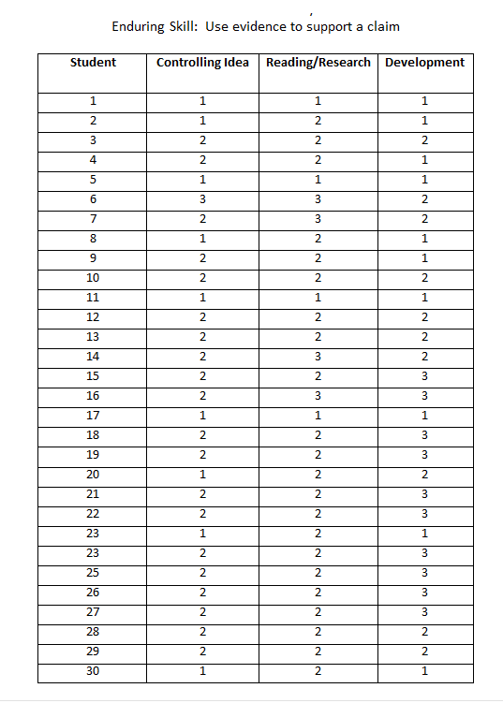
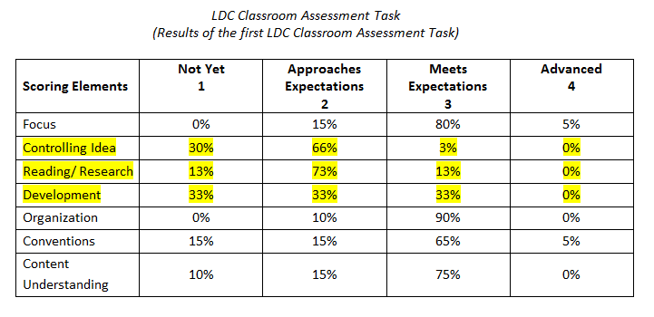
Coming Up next month… how to use the LDC rubric to collect evidence for student growth goals….
Possible enduring skills for social studies:
* Construct compelling and supporting questions to develop inquiry skills.
* Use evidence to support a claim.
* Evaluate the credibility of sources.
* Communicate conclusions to a range of audiences
* Critique own work as well as the work of others.
* Take informed action.

Slide 15
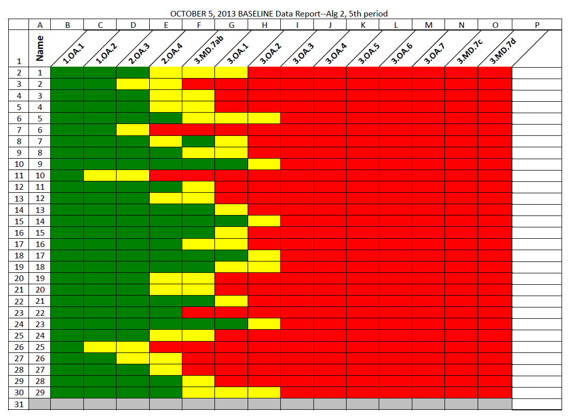
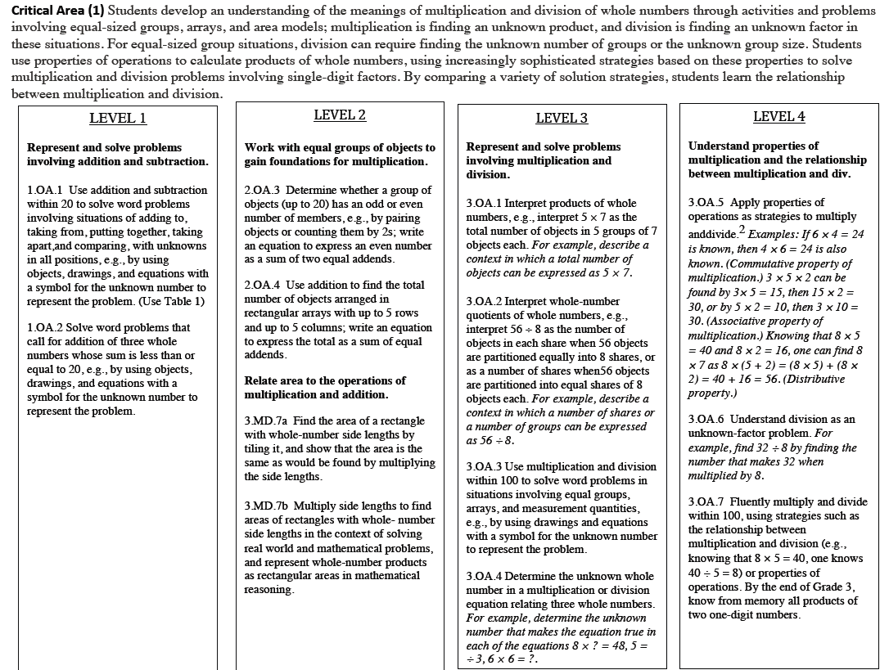
Math example: http://www.jennyray.net/math-sgg-samples.html

