Slide 1
Science Network Updates
Terry Rhodes, KDE Instructional Specialist
CKEC Science Network Meetings:
Wed Mar 25th, 2015
Wed Apr 22nd , 2015
Assessment System
Building Capacity Within Districts
What’s Next?

Slide 2
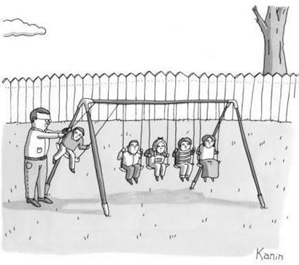
What is the caption ?
Notes:
What is your caption for this cartoon?

Slide 3
Strategic Assessment
Using assessment tools involves three stages:
Clarifying the elements of the targeted performance expectation,
Designing assessment tasks that are precisely aligned to the specific expectations in the targets, and
Testing the assessment and then using information derived from previous assessments to refine the effectiveness of the items.
By focusing on the objective of the assessment, an accurate probe of students’ knowledge may be developed.
Assessing learning requires well-targeted assessments combined with thoughtful analysis of student responses.

Slide 4
3-PS2-2. Make observations and/or measurements of an object’s motion to provide evidence that a pattern can be used to predict future motion.
[Clarification Statement: Examples of motion with a predictable pattern could include a child swinging in a swing, a ball rolling back and forth in a bowl, and two children on a see-saw.] [Assessment Boundary: Assessment does not include technical terms such as period and frequency.]

Slide 5
Contrast with this experience…
Pendulum Lab
Name _______________
_____
Retrieve two pendulums and measure the length.
Write down the measurement in the chart. Count how many times each pendulum swings back and forth in 10 seconds and record your measurements in the table below
Repeat twice
Do the same for the second pendulum.
 | Pendulum 1 Measurement (cm) | Pendulum 2 Measurement (cm)
Trial 1
Trial 2
Trial 3

Slide 6
Consider this Lesson Idea…
Predicting Motion
Gathering: Students in groups of two compare the motion of 2 pendulums of different lengths (provided), and work collaboratively to quantify this comparison. Students develop and use a table to record data.

Slide 7
Comparison
How does the Learning Experience differ from the traditional science classroom?
How does the Learning Experience show an assessment of learning vs assessment of learning?
What is the students role during this process vs their role during a traditional method?
Does it meet the intent of the standard? How would I know?

Slide 8
Kentucky’s Next Generation Science
Assessment System
Work is taking place to define a framework for a balanced science assessment system
WestEd has been selected to be the “thinking partner” to deliver the framework and items/test specifications based on KY educator input
WestEd is NOT creating the assessments themselves-just the specifications
A new vendor will be sought to create operational assessments that meet the specifications developed
KY teachers’ voices matter and are being sought to inform the specifications
And finally…

Slide 9
6. It is the intent to broaden the discussion of science assessments
include the high school model, but we are starting with the K-8
first. With that in mind:
The focus is on building a framework for a system of assessment that begins in the classroom, focusing on generating information that enables teachers to adjust instruction and students to track their learning and focus on growth and improvement-for all levels/courses
The process of identifying defensible evidence of student understanding goes beyond the bounds of any particular assessment
The information the vendor will provide can be extrapolated to all science levels/courses

Slide 10
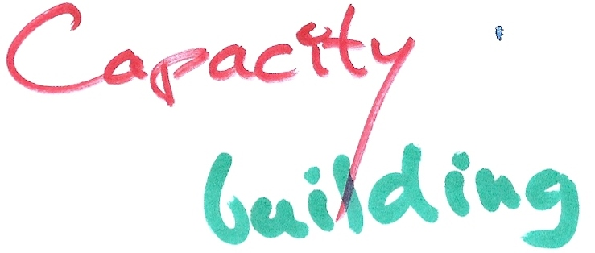
1.5 years into this process
Survey says…
Are the structures in place to build
capacity in your district?

Slide 11
19.51%
26.83%

Slide 12
17.07%

Slide 13
19.51%

Slide 18
Plan for Supporting Teachers and Building Capacity
The goal of professional learning is to increases educator effectiveness and results for all students.
Leadership —skillful leaders who develop capacity, advocate, and create support systems for professional learning.
What is the need for professional learning centered around NGSS in your school/district?
Where do you feel the greatest need exists and what is your evidence?
Notes:
Reflect on what you have just experienced. Do you see a need for ongoing PL related to NGSS?
Whole group discussion

Slide 19
7 Principals for Implementing NGSS
Ensure coherence across levels (state, district, schools), across grades, and across different components of the system--curriculum, assessment, instruction, professional development
Attend to what is unique about science
Develop and provide continuing support for leadership in science at the state, district and school levels
Build and leverage networks, partnerships, and collaborations
Take enough time to implement well
Make equity a priority
Ensure that communication is ongoing and relevant
Guide to Implementing the Next Generation Science Standards, National Research Council
http://www.nap.edu/catalog/18802/guide-to-implementing-the-next-generation-science-standards
Notes:
2 min intro to the Guide. 3 and 4 are really the focus of the morning

Slide 20
What is your current PL plan?
Professional learning emphasizes that learning is a process that continues over time, extends into practice and expects results for both educators and students. (KDE Professional Learning Standards)
Do modifications to your plan need to be made to provide the professional learning opportunities that teachers will need in your district as they implement the KCAS science standards?
Notes:
Study the Standards for Professional Learning (www.learningforward.org/standards ) to inform and strengthen CSIPs/CDIPs. (Remember: Kentucky amended the REGULATION on professional learning last year…the new standards are now the ‘rule.’ We have multiple support resources on the KDE Professional Learning page at: http://education.ky.gov/teachers/PD/Pages/default.aspx --and there is a MODEL PL plan in the GUIDANCE at:http://education.ky.gov/teachers/PD/Documents/KY%20Professional%20Learning%20Guidance.pdf )

Slide 21
